Slide 1
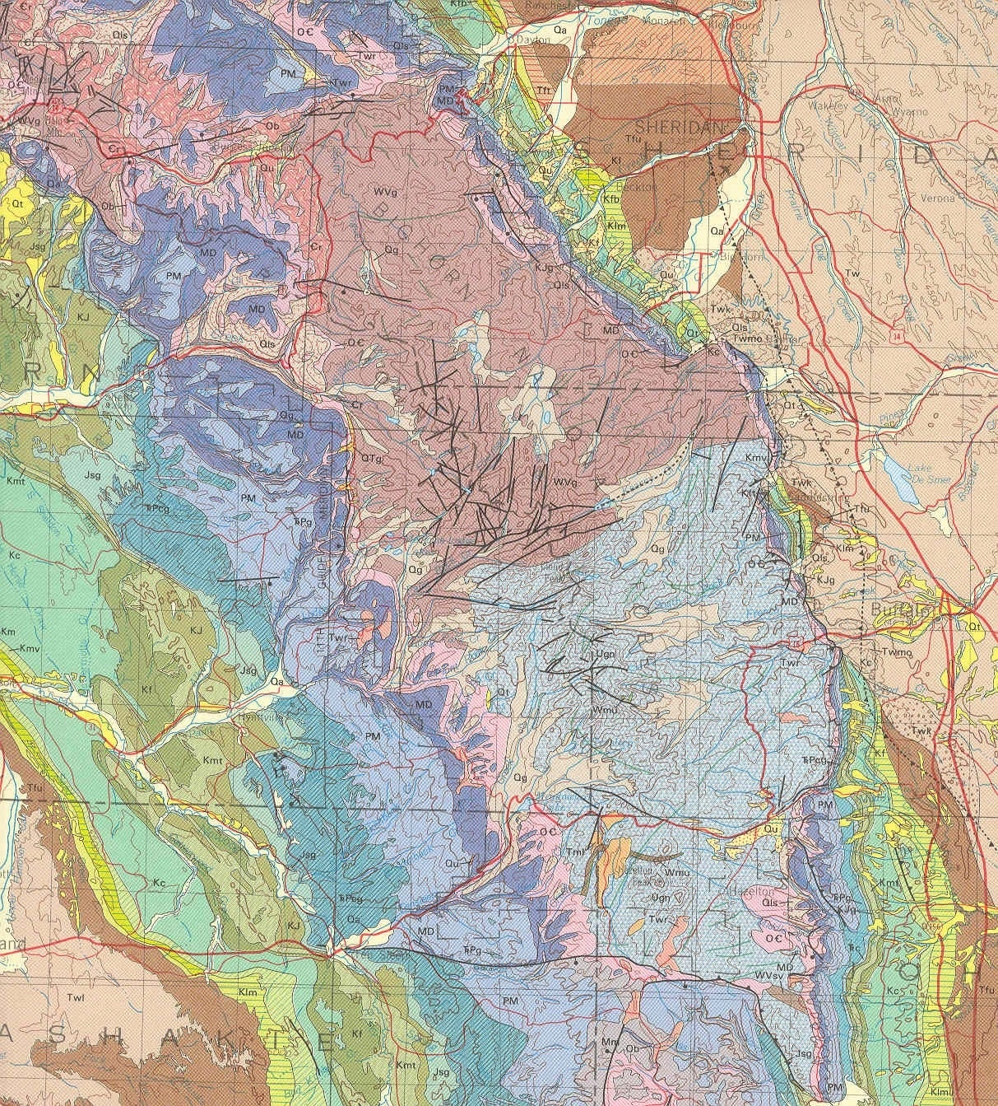
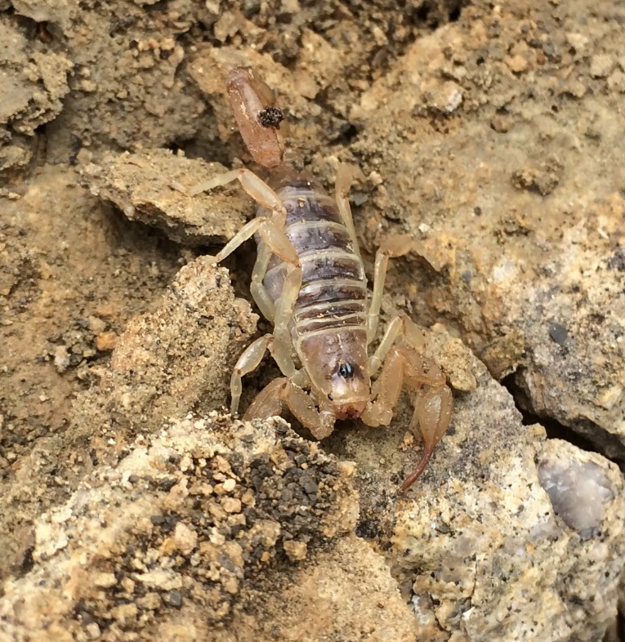
MESOZOIC STRATIGRAPHY
BIG HORN AND POWER RIVER BASINS

Slide 2
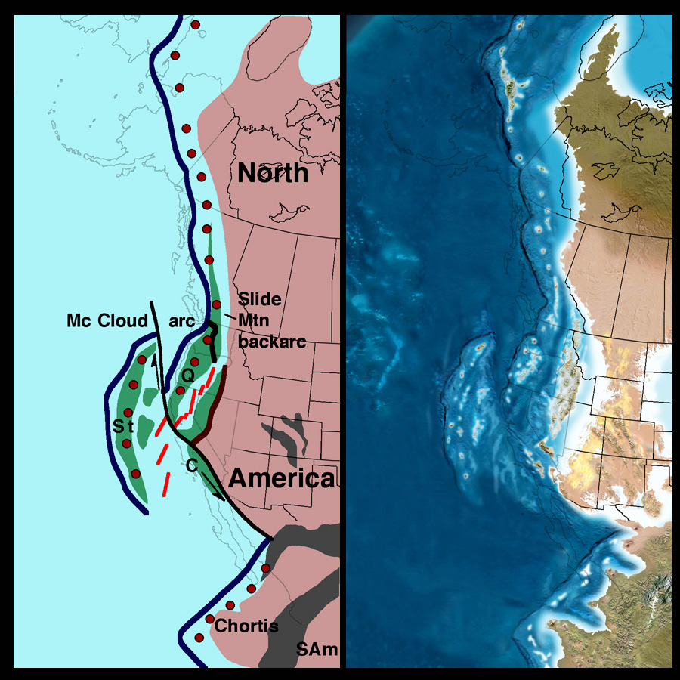
Early
Permian

Slide 3
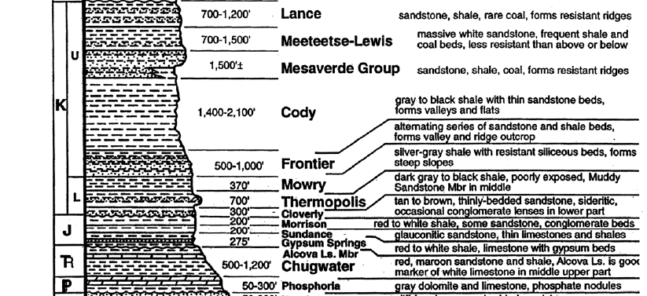

Slide 4
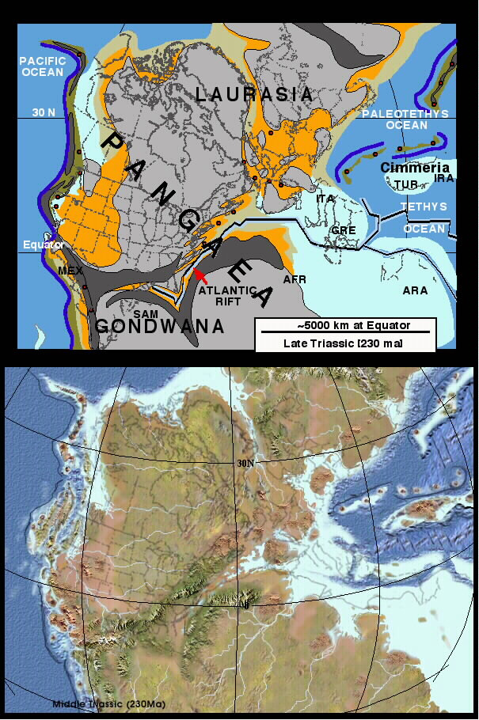
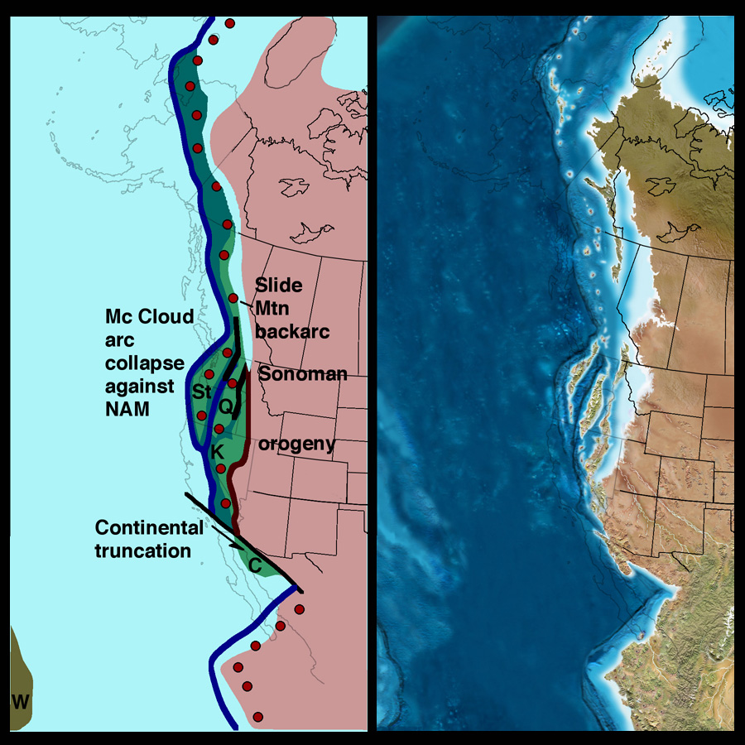
Late Triassic

Slide 6
Triassic System
Thick succession of red beds. Variable amounts of soft sandstone and mudstone.
Chugwater Formation here, Spearfish in the Black Hills. Dinwoody Formation is included in the Absarokas.
Dense, thin, laminated, light-colored limestones (Alcova and Popo Agie) occur near the top.
Thick gypsum at top to the west (in part Early Jurassic).
Arid coastal plane.

Slide 7
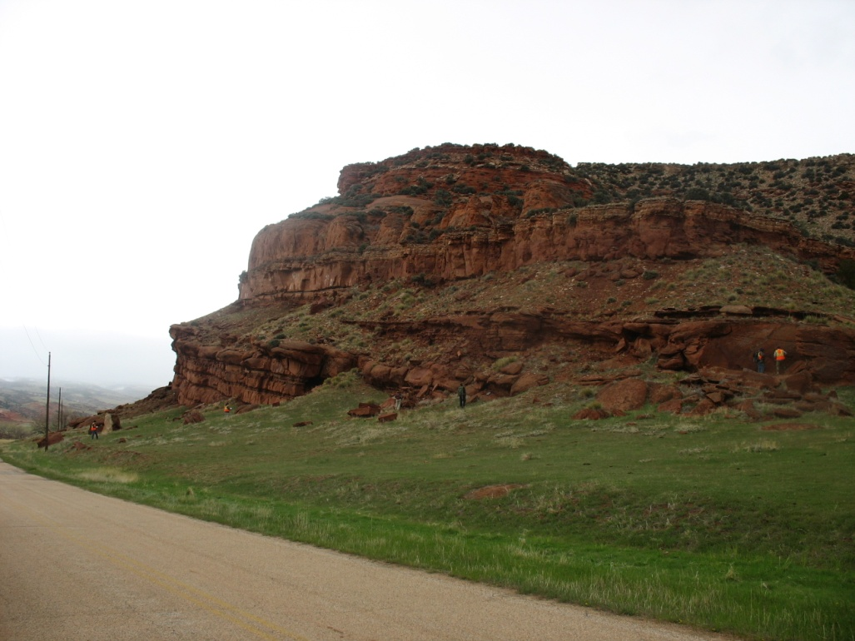
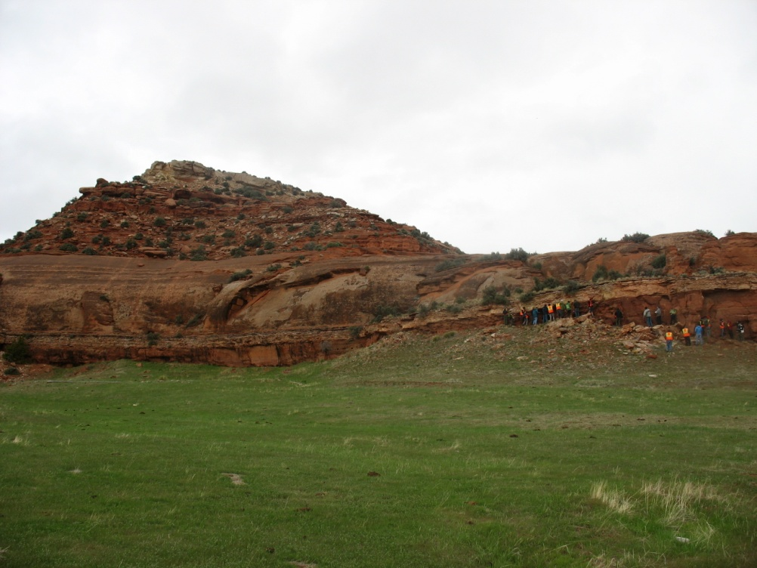
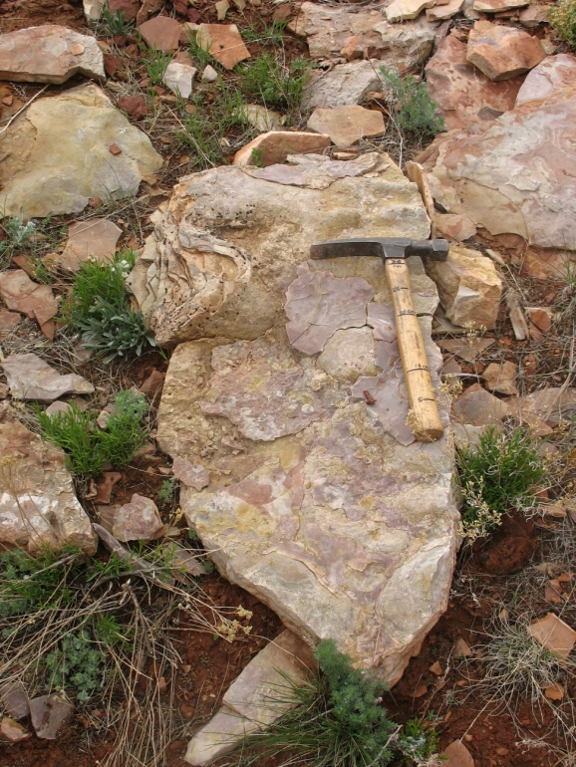
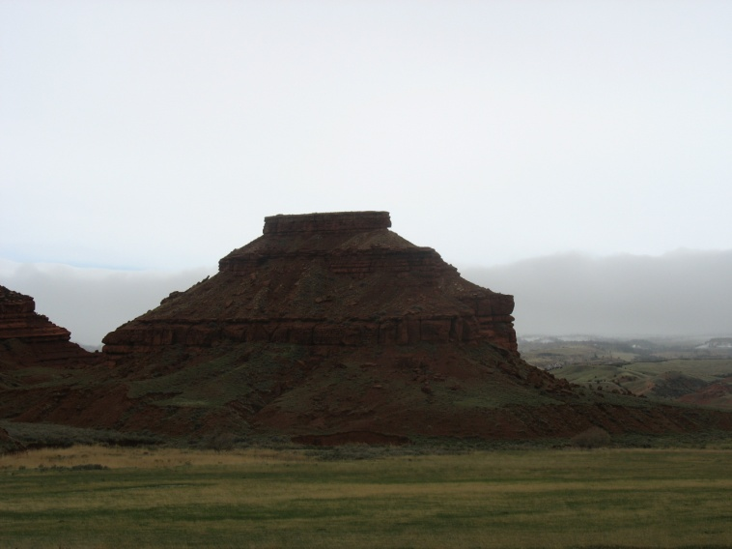
Chugwater Formation

Slide 9
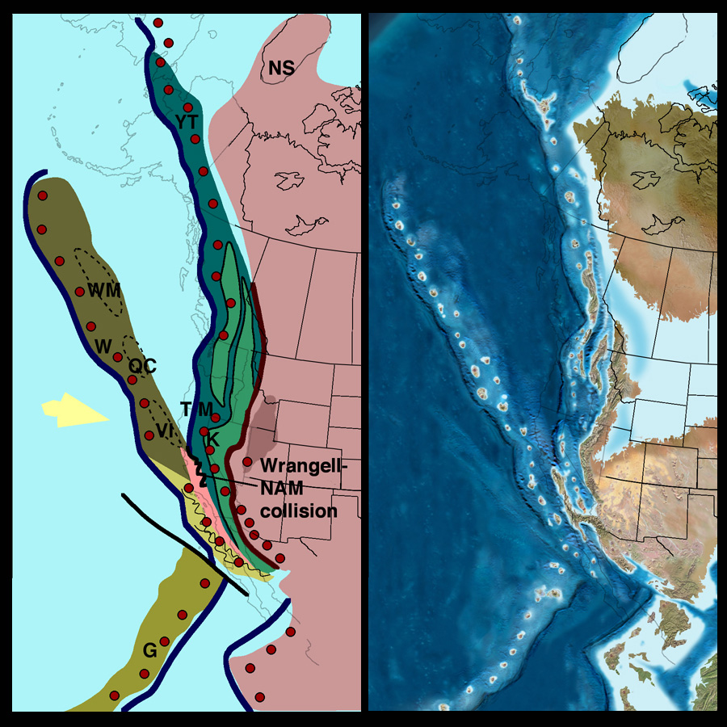
Middle Jurassic (160 Ma).
Major arc magmatism. Initial collision between southern Wrangellia and Cordilleran margin at approximately the latitude of Klamaths and Sierras
Fringing arcs south of collision zone Ophiolites obducted in collision zone and in inter arc region between Cordilleran arc and fringing arcs
Foreland basin in Utah and thrusting in Nevada
Rift basin in southwestern North America related to opening Gulf of Mexico

Slide 10
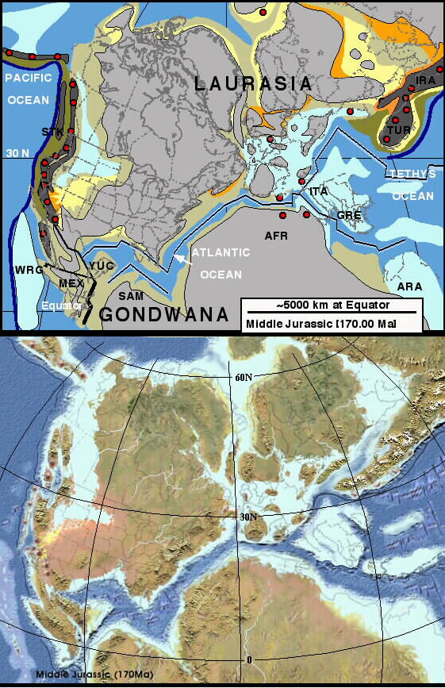
Middle Jurassic

Slide 11
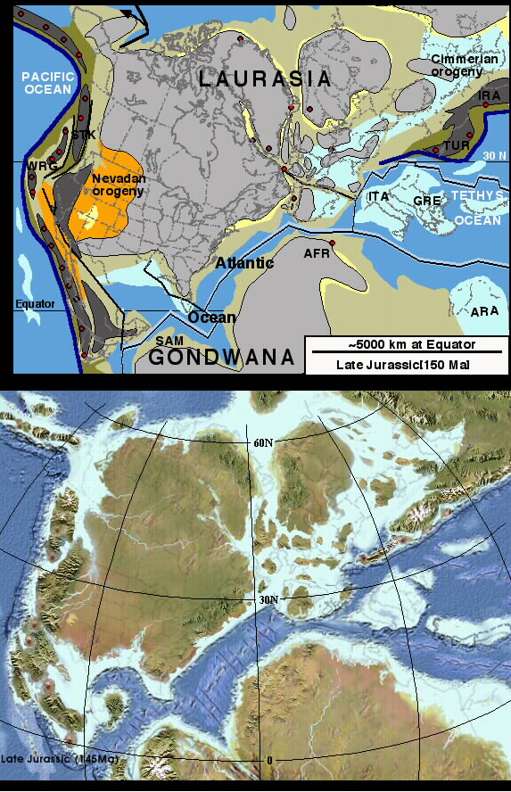
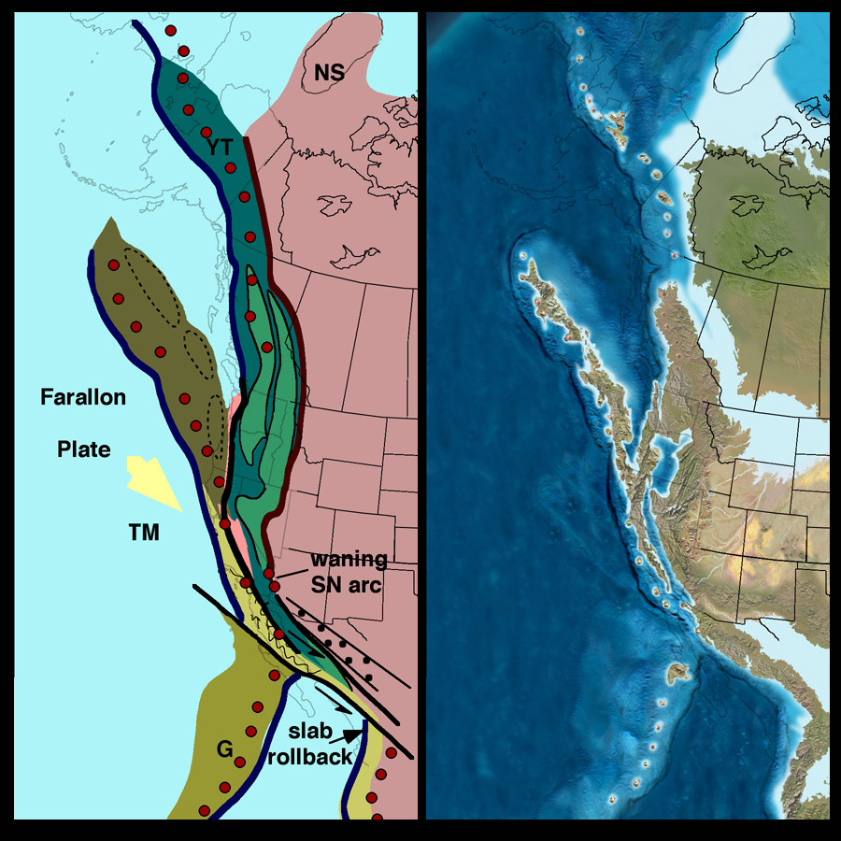
Late Jurassic

Slide 12
Jurassic System
Disconformably overlies the Triassic. Only Upper Jurassic rocks are present here.
Sundance Formation - Here it is largely marine, and consists of green shale with some thin limestone and sandstone. Shale has belemnite fossils. “Oyster Bed” is present near the top. Yellow rippled sandstone near the top. Ripples are symmetric.
Morrison – Generally poorly exposed here. Consists of interbedded red, yellow, and purple mudstone, sandstone and conglomerate. Humid coastal plane? Dinosaur bones.

Slide 13
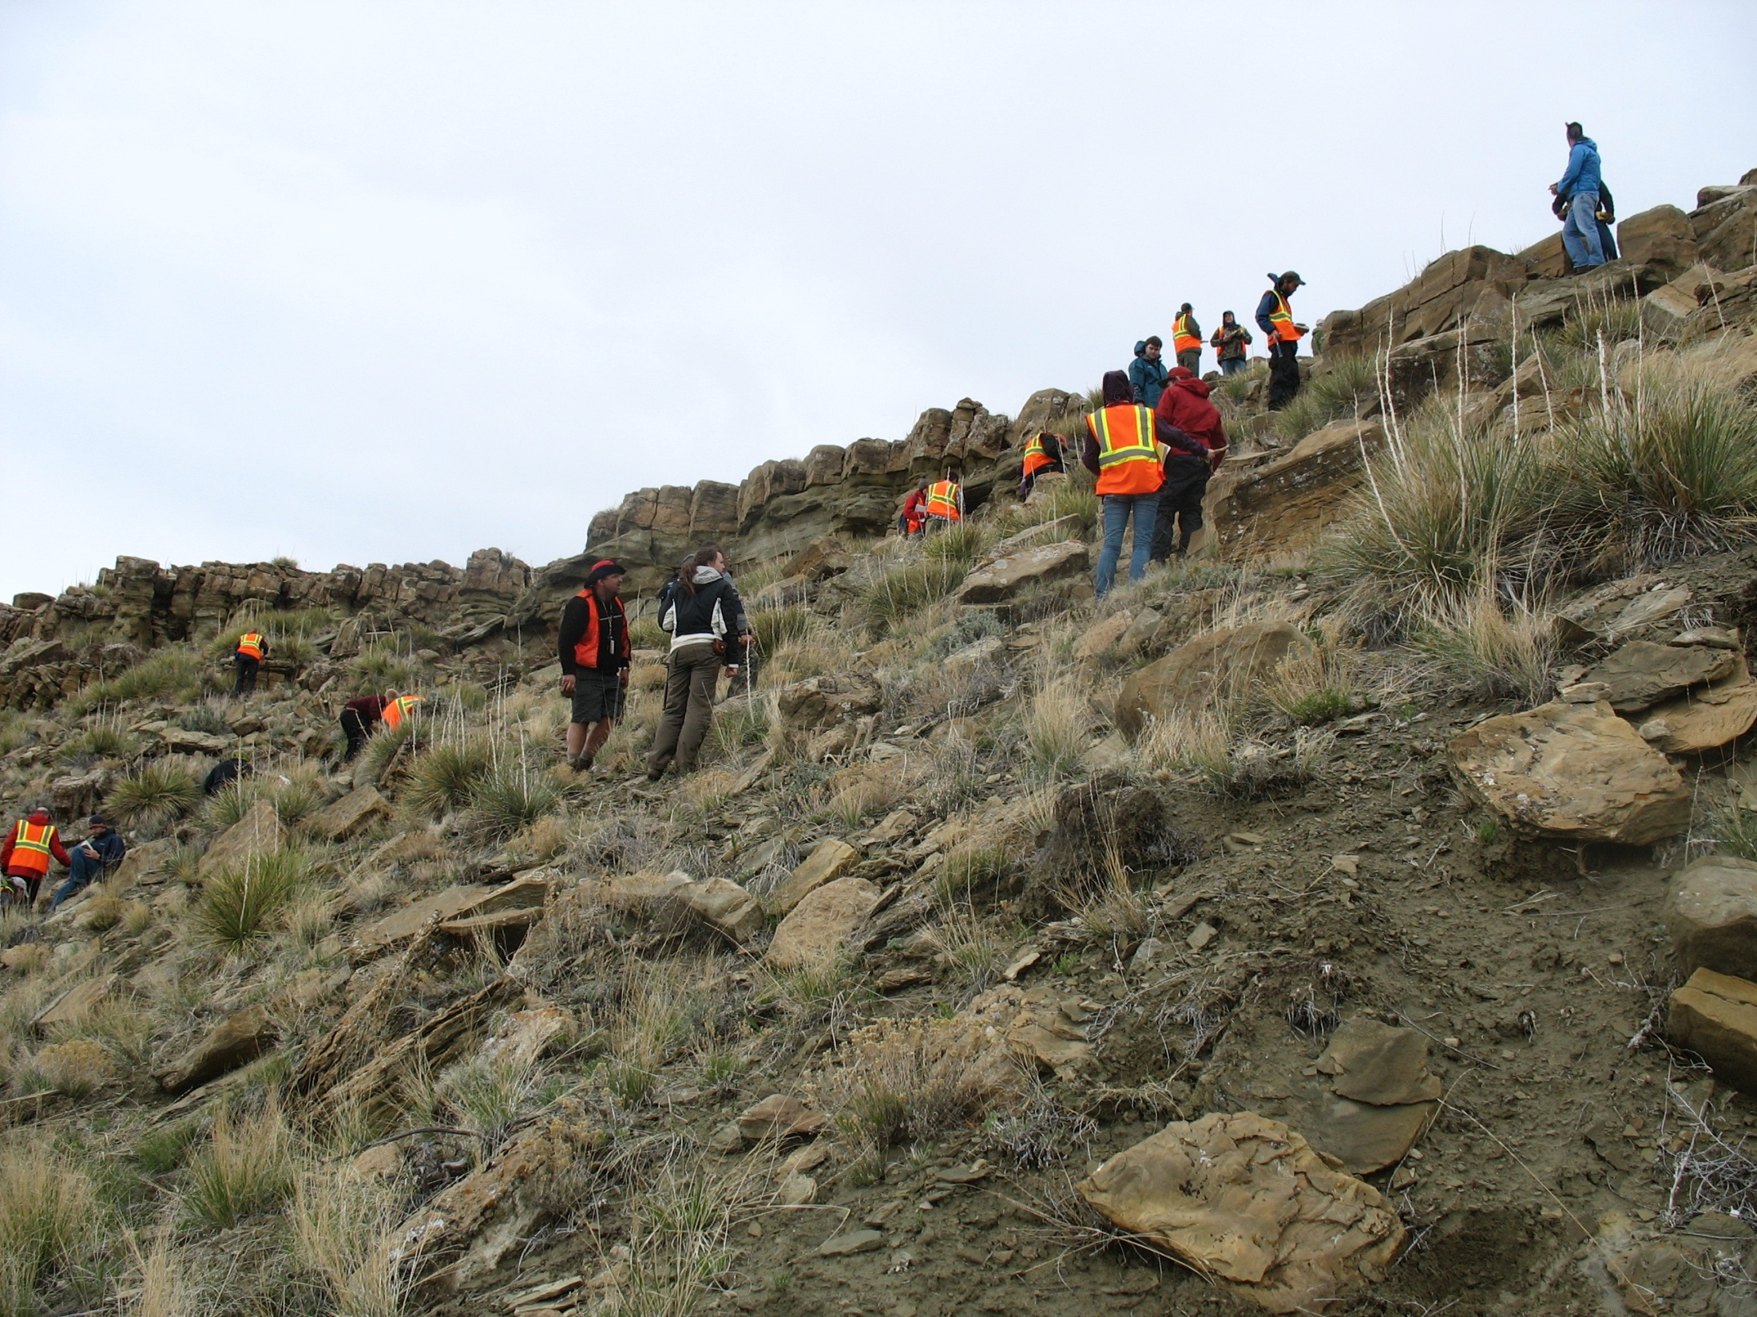
Sundance Formation
Largely marine,
Lower green shale with some thin limestone and sandstone.
Shale has bivalve, brachiopod and belemnite fossils.
“Oyster Bed” is present near the top. Yellow cross-bedded and rippled sandstone near the top.
Ripples are asymmetric, symmetric, climbing.

Slide 14
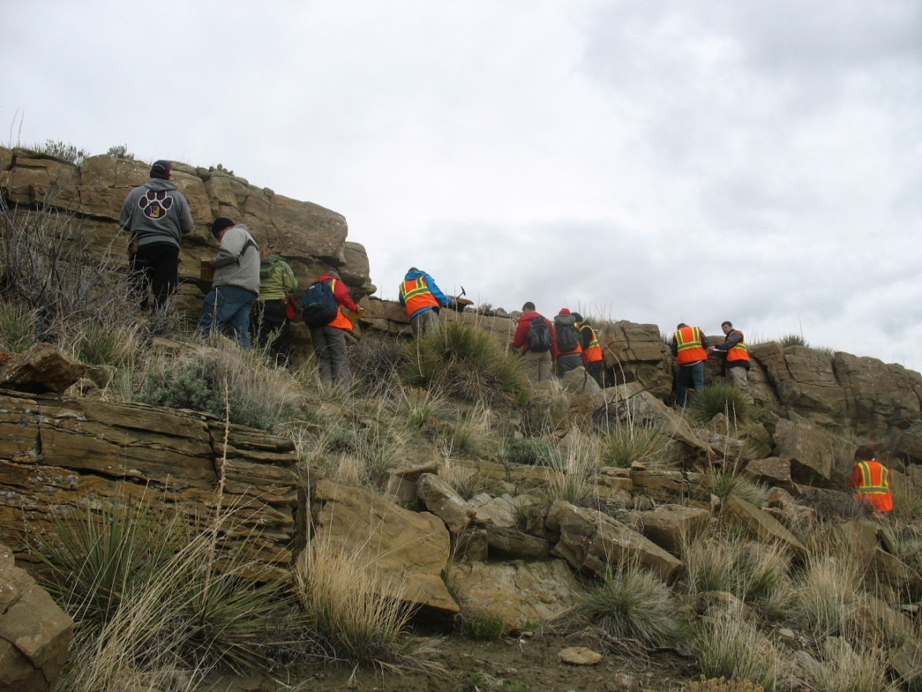
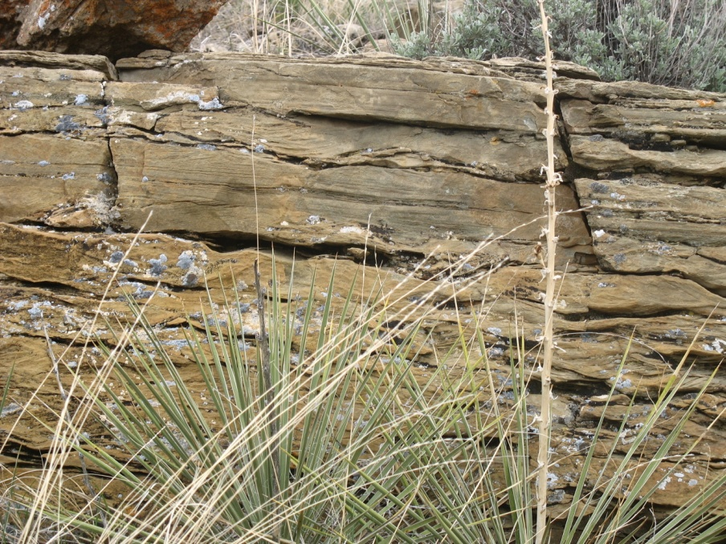
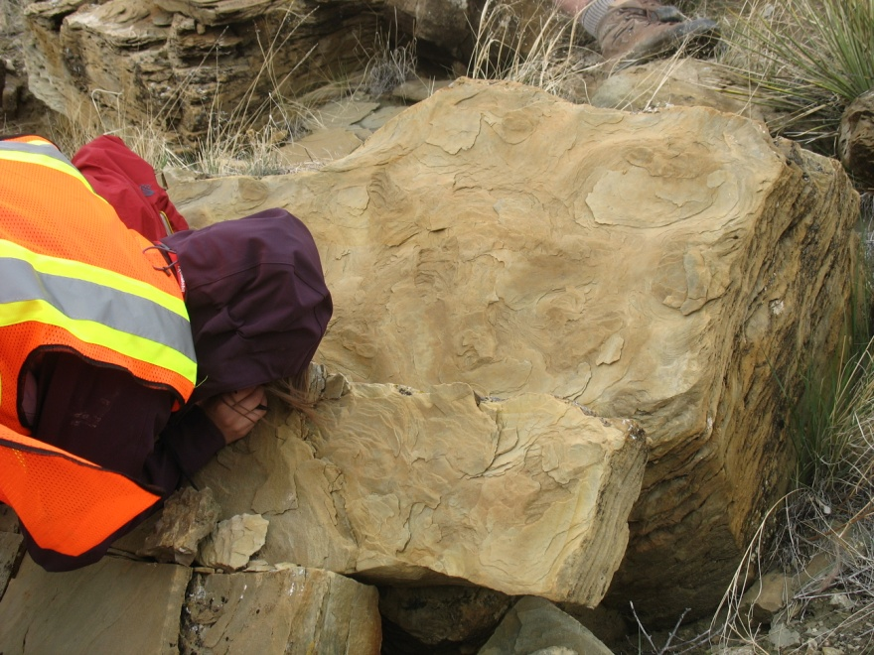
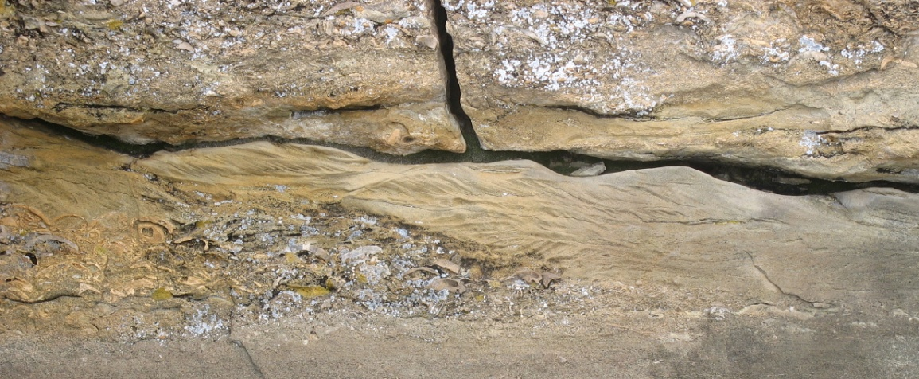

Slide 15
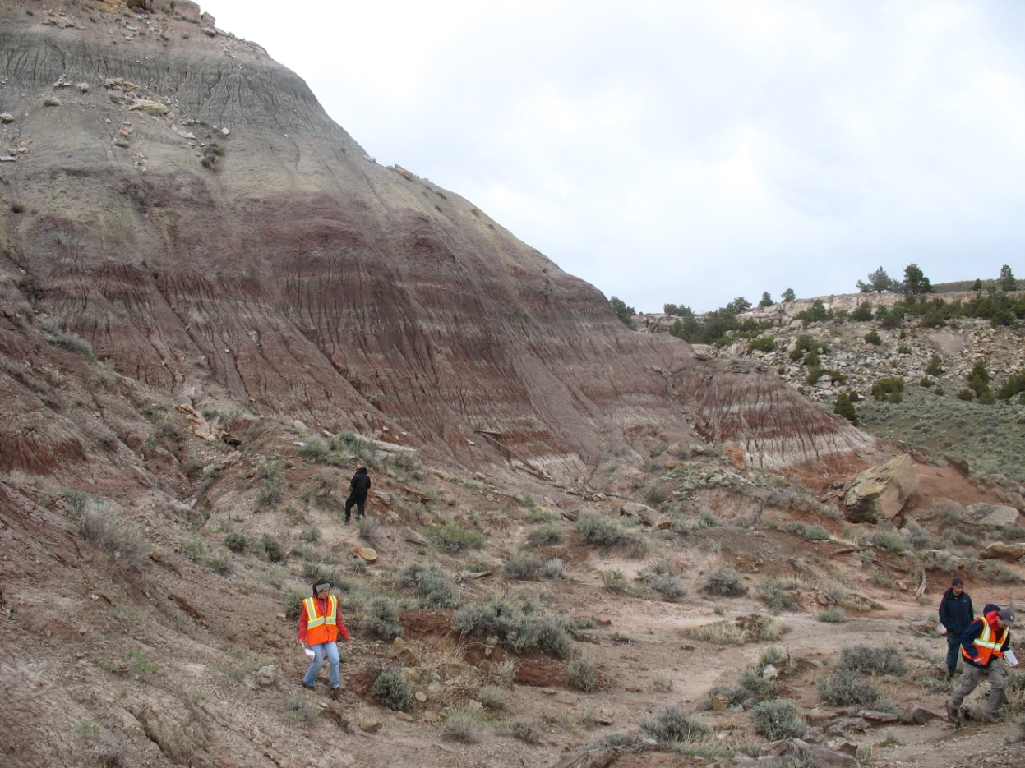
Morrison Fm.
Morrison – Generally poorly exposed here. Consists of interbedded red, yellow, and purple mudstone, sandstone and conglomerate.
Humid coastal plane? Dinosaur bones.

Slide 17
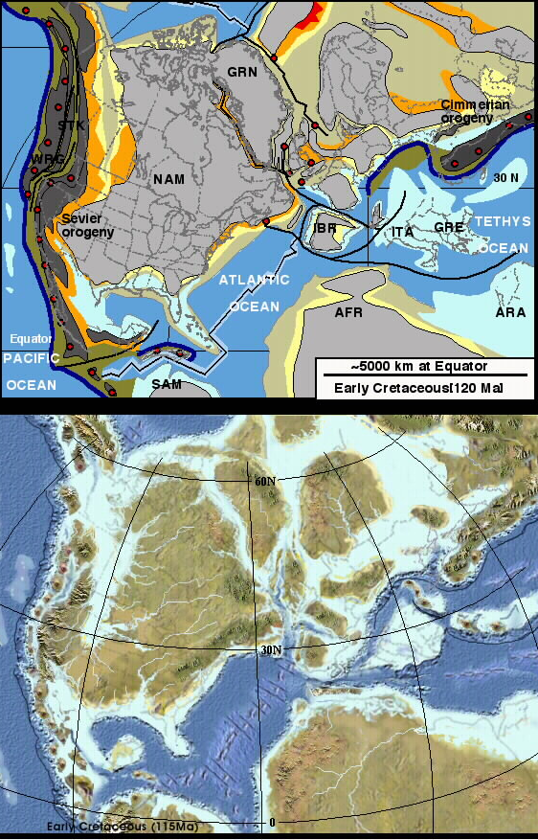
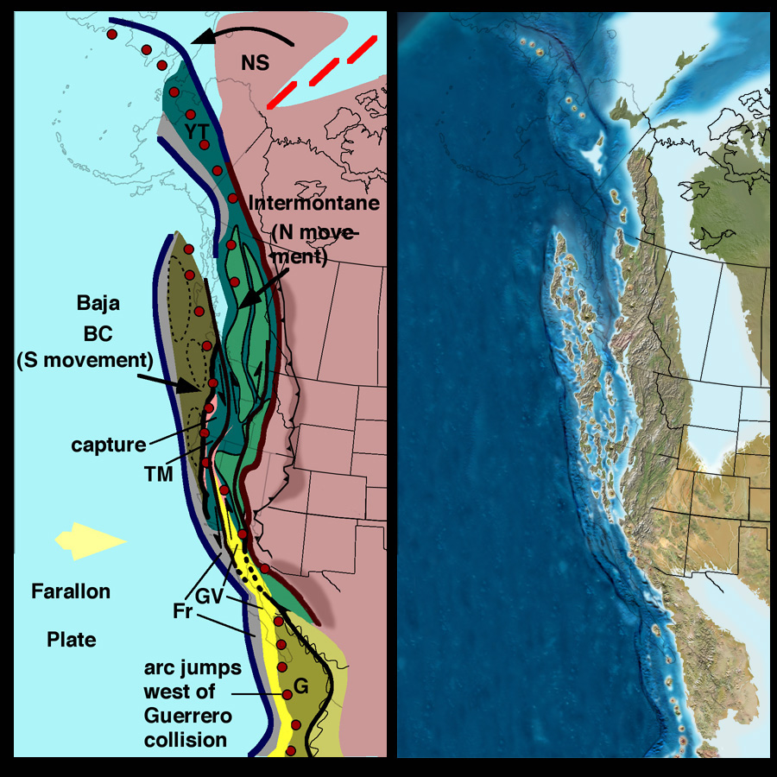
Early Cretaceous

Slide 18
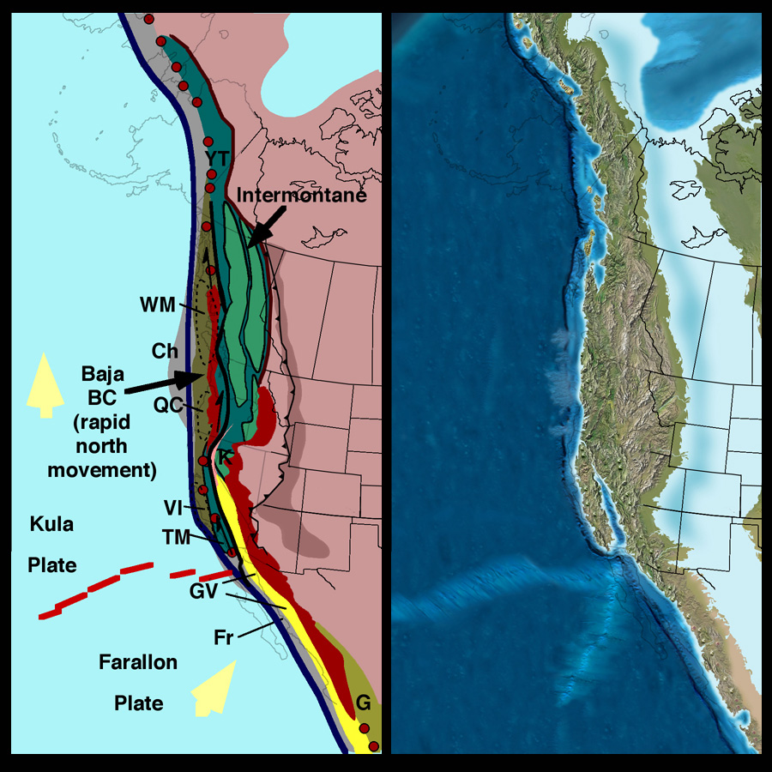
Late Cretaceous (85 Ma)
Major magmatic activity in two belts (110-85 Ma) followed by strong decline and null in magmatic activity (80-40 Ma)
Andean-style segmentation of Farallon arc from Central America to Southern California
Sevier thrusting continued and foreland basin shifted locus of subsidence southward in response to shallow Laramide subduction (shallow angle)

Slide 19
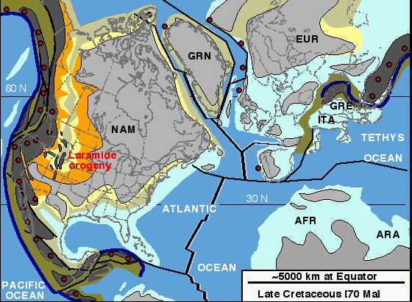
Late Cretaceous

Slide 20
Lower Cretaceous Series
Disconformably overlies the Jurassic System.
Cloverly Formation. Interbedded sandstone and shale. “Rusty Beds” locally form hogbacks. Deltaic system with channels, delta bay, and pro-delta facies.
Thermopolis Formation – Black marine shale similar to the Pierre.
Mowry Formation – Resistant silicified mudstone. Distinct silver-grey, rarely fully vegetated. Environment uncertain. Some bentonite beds in the Bighorn Basin are mined.

Slide 21
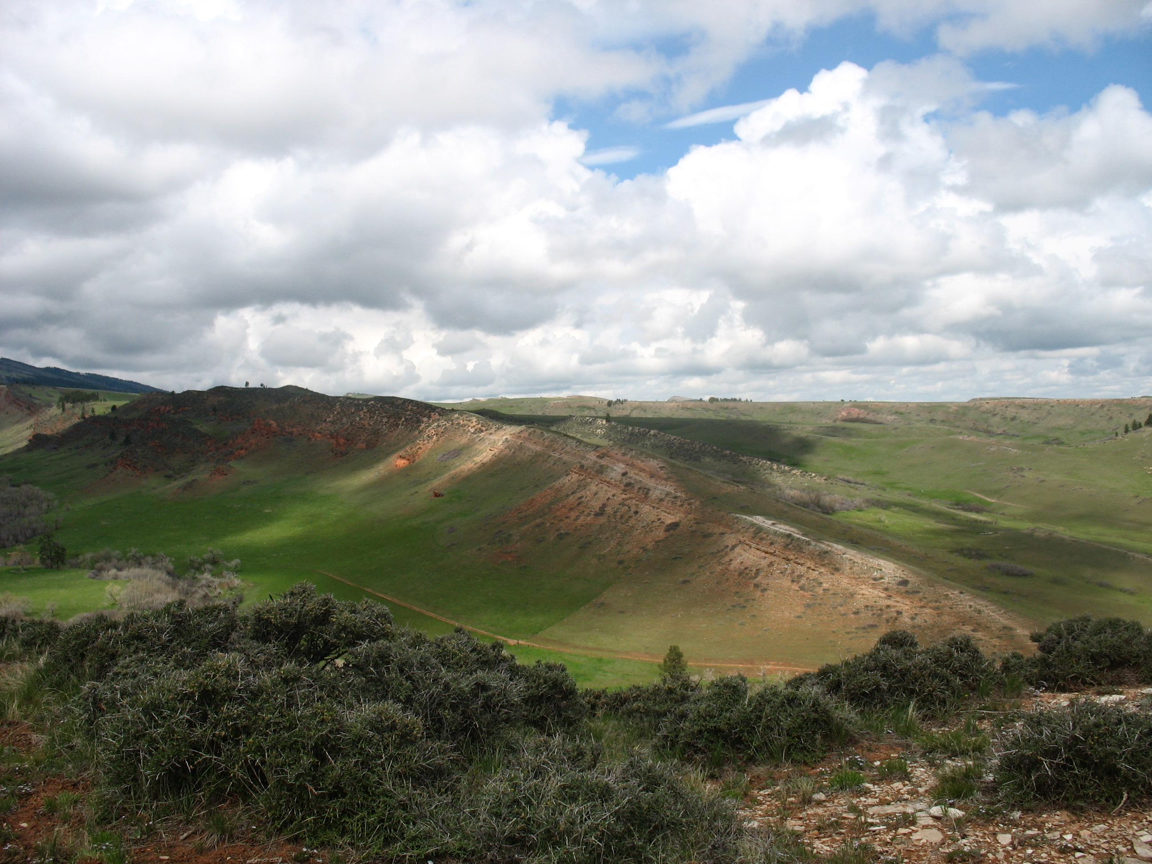
Cloverly Formation. Interbedded sandstone and shale. “Rusty Beds” locally form hogbacks. Deltaic system with channels, delta bay, and pro-delta facies.

Slide 22
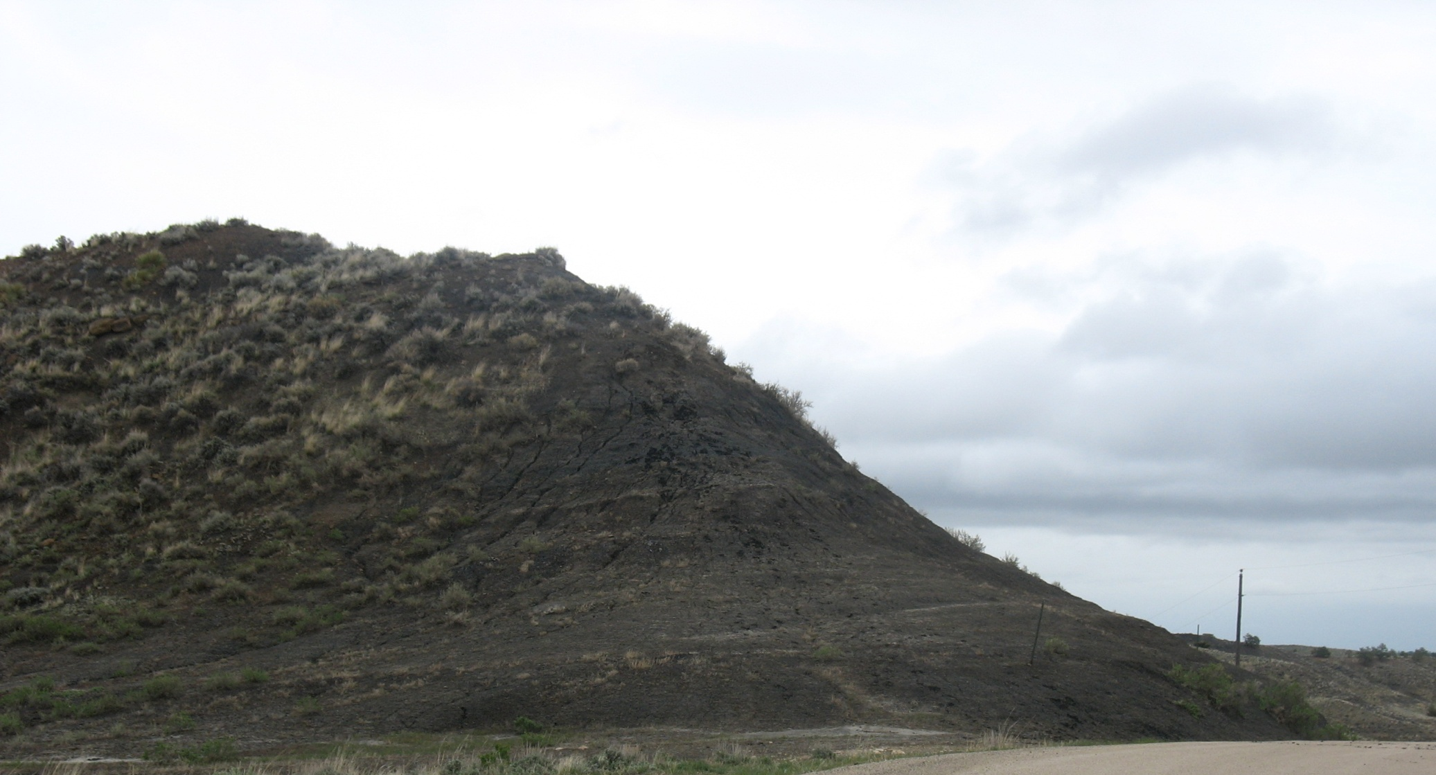
Thermopolis Shale

