Slide 1
Tomorrow
Pack for a four-day, three night field trip. All drafting for this project will be done here.
Breakfast at 630, pack a lunch (probably eaten tomorrow evening. We will have a late lunch in Cody, WY. Geology stops to follow.
~2 hour drive to first stop to review Mz stratigraphy
We are staying here.https://www.ddxranchwyoming.com/lodging
We will only have dinner on Tuesday. Plan to prepare your own breakfasts and lunches. Shop now. Nothing perishable. Two of our cabins have full kitchens. The others have kitchenettes.
We are an hour from town….plan on no trips. Field area is half-way back to town.
Hot and sunny…little shade. Plan accordingly.

Slide 2
South Fork Slide
South Fork Shoshone River Valley
>800 km2, NE-SW trending
Occurred between 52-49 Ma
Upper plate is complexly deformed Mesozoic strata-Sundance, Morrison, Cloverly, Thermopolis, Mowry, Frontier
Lower plate is flat-lying early Eocene Willwood Fm unconformably overlying the Cody Fm.
Gravity collapse of a major paleovalley wall or odd thin-skinned thrusting with no root oblique angle

Slide 3
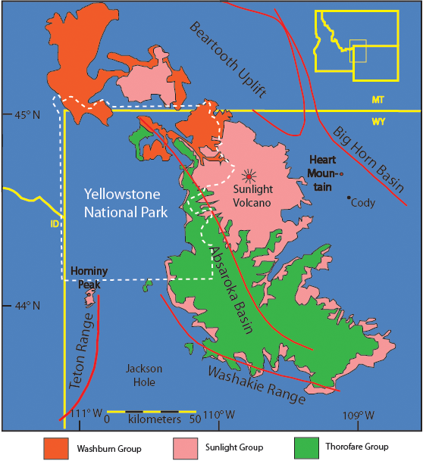
Absaroka
Volcanic
Field
Modified from Smedes and roska (1972)

Slide 4
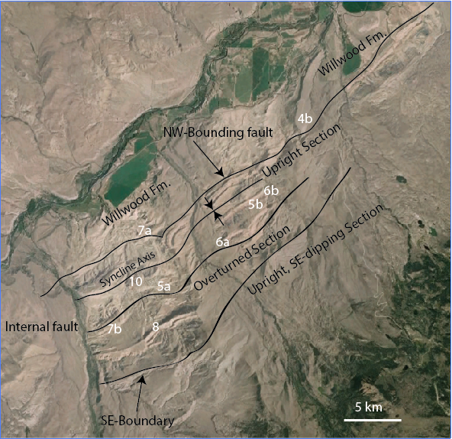

Slide 5
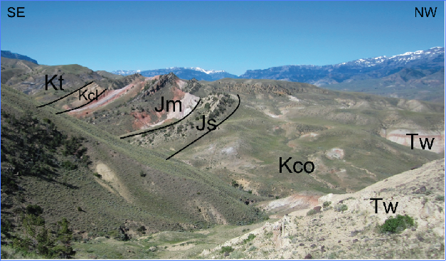

Slide 6
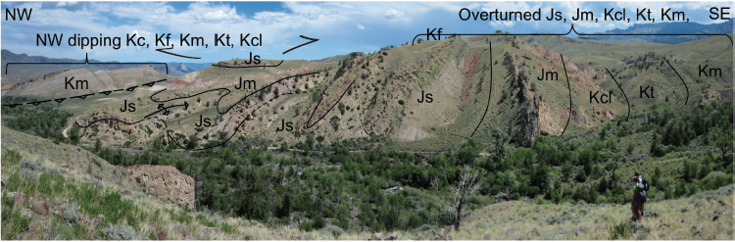

Slide 7
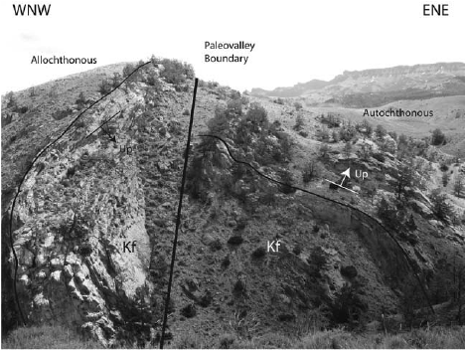

Slide 8
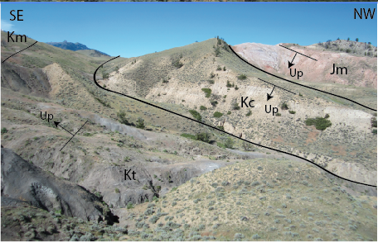

Slide 9
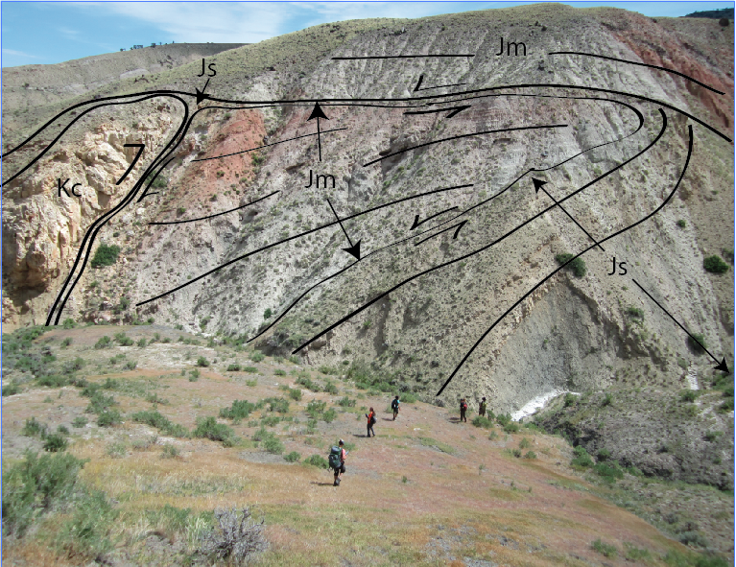

Slide 10
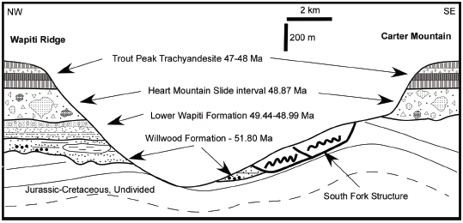

Slide 11
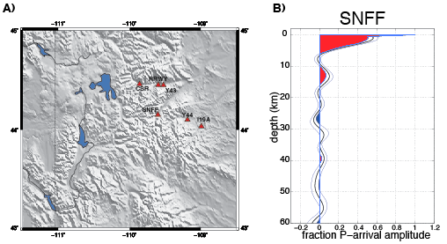

Slide 12
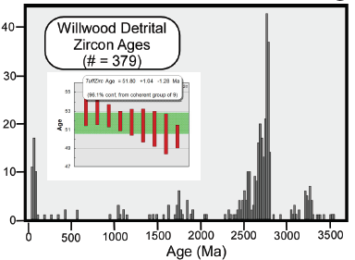

Slide 13
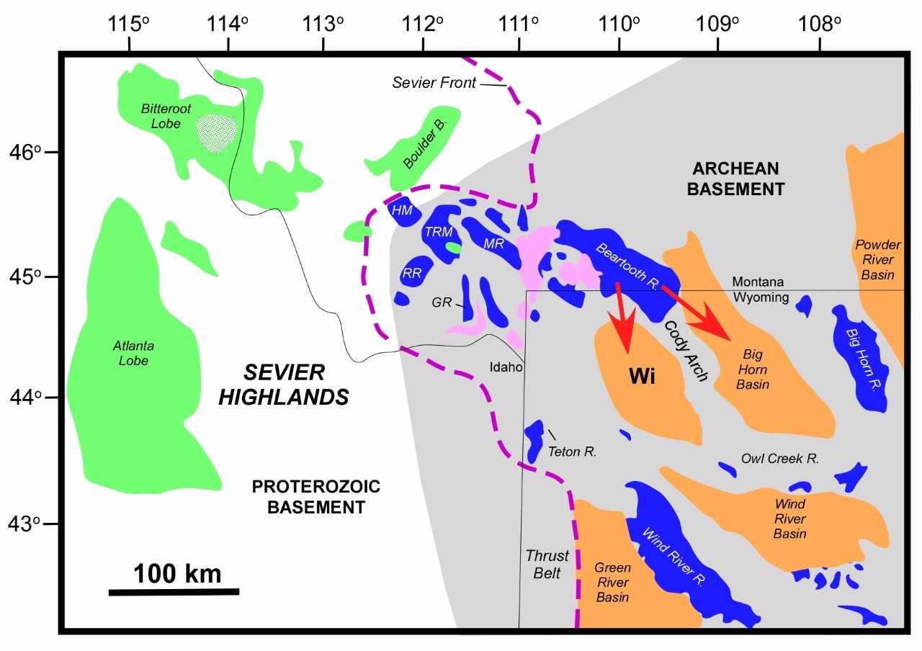
51-52Ma

Slide 14
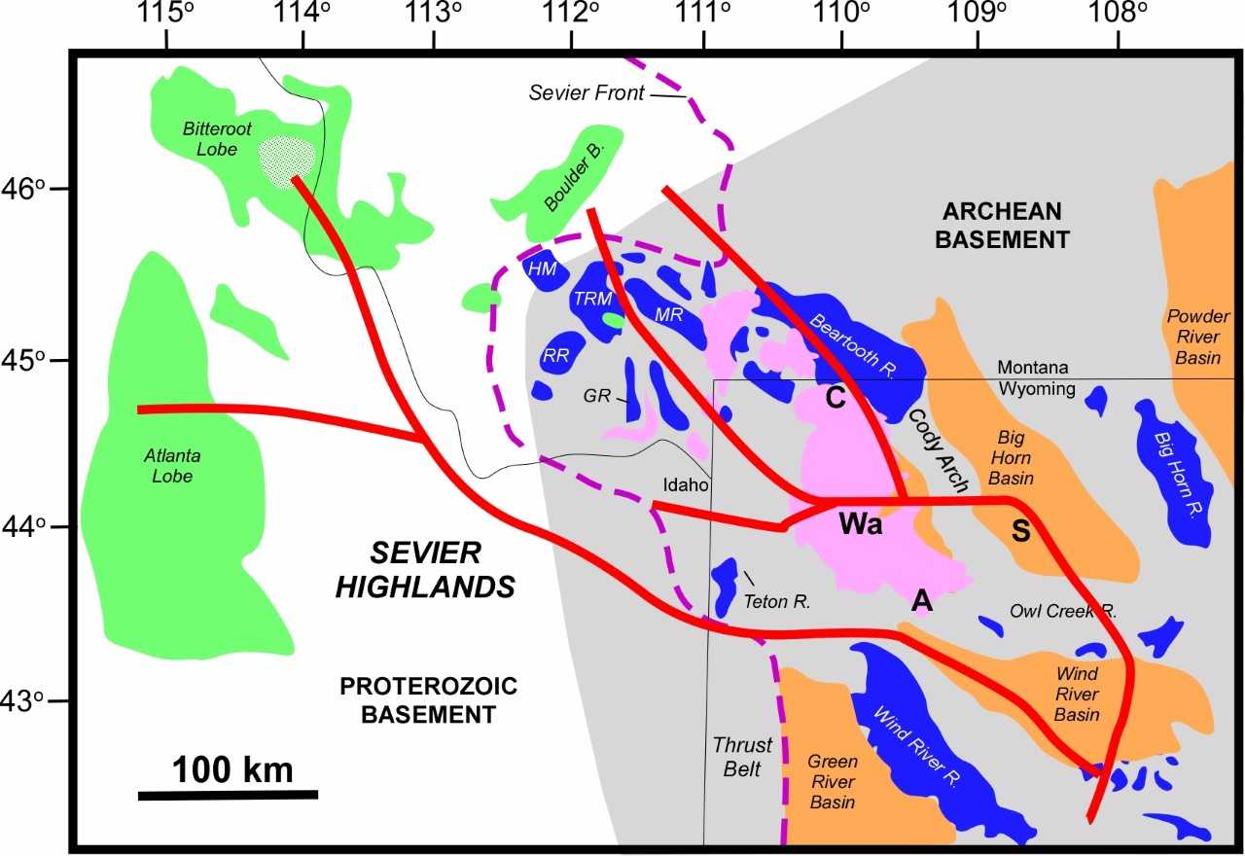
49-50 Ma

Slide 16
Willwood Formation
0-500 ft in thickness.
Overlies “Laramide” angular unconformity
Pink, grey, and brown mudstone with yellow standstone and conglomerate at the base.
May form “Badlands” topography.
Found at lower elevations

Slide 17
Sundance Formation
Thickness 300-400 ft.
Same as before. Green shale, glauconitic sandstone, lots of belemites any oysters

Slide 18
Morrison Formation
300 ft thick.
Forms barren landscapes
Purple, red, and grey shales. Some light grey sandstone.
Prominent chert pebble conglomerate in the middle
Lots of gastroliths and copralites

Slide 19
Cloverly-Thermopolis-Mowry
Cloverly =200-300 ft thick Grey shale and brown sandstone.
Thermopolis = 300-400 ft thick. Black shale with bentonite.
Mowry = 300-400 ft thick. Silver silicified mudstone.

Slide 20
Frontier Formation (New Unit)
Complex package of interbedded shale, sandstone, conglomerate, and coal in between the Mowry and Cody.
You will see mostly lithic arenite with chert and quartz for a distinct salt and pepper appearance

Slide 21
Tidbits and Morsels
Expect overturned rocks
There is no mappable alluvium
There is no mappable Wapiti Formation volcanic rocks although there is quite a bit of float on the pediments and higher up the hill
When you draw your cross section, think rootless.
This area is COMPLICATED. You are well trained. You are ambitious. You are ready to knock this out of the park.
Craddock et al. 2015 is in your field guide. Read it.
Malone et al. 1999 is in your field guide. Read it

