Slide 1
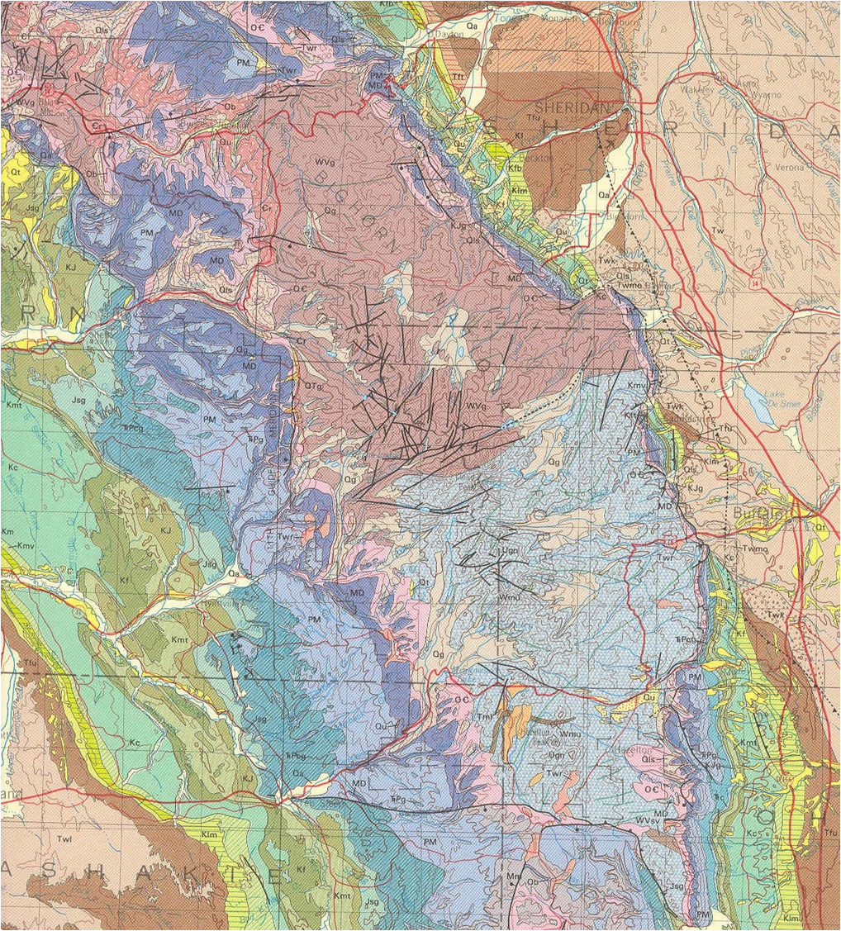
Paleozoic Stratigraphy Big Horn and Powder River Basins, Wyoming

Slide 2
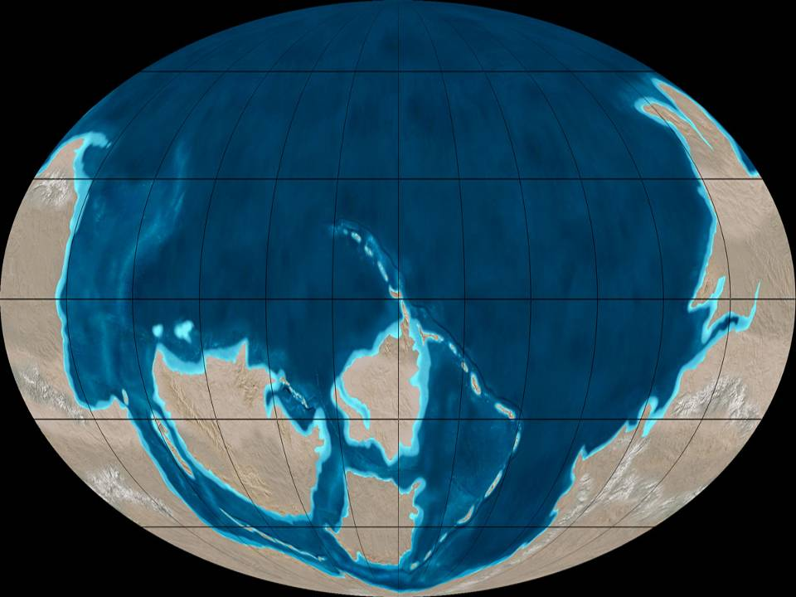
Rodinia rifted in Late Cryogenian to Early Ediacaran Neoproterozoic creating large Paleozoic continents
All continents had rifted passive margins, and developed broad continental shelves during the Cambrian through the middle Ordovician.
Growth of new ocean basins contributed to progressively higher sea level and flooding of cratons during the Cambrian
Panthalassian ocean
Siberia
Laurentia
Prototethys
Pannotia-Gondwana
Iapetus
Baltica

Slide 3
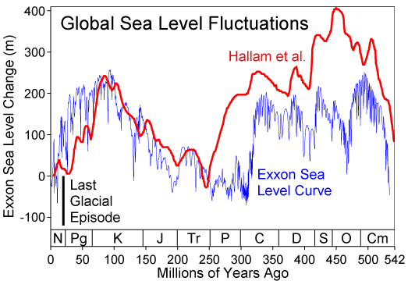
TIPPECANOE
Supersequence
KASKASKIA
Supersequence
SAUK Supersequence
Absaroka

Slide 4
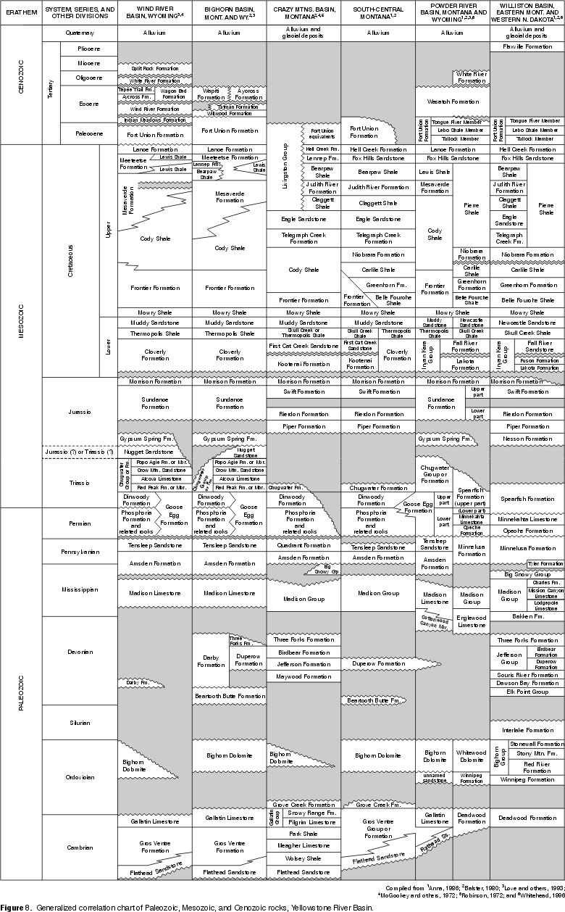

Slide 5
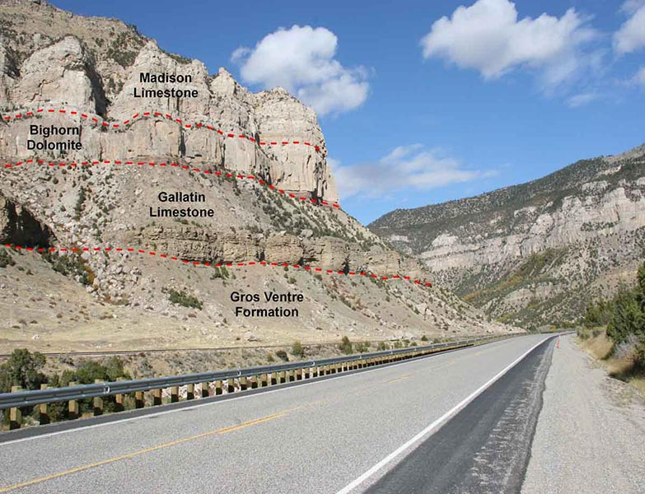
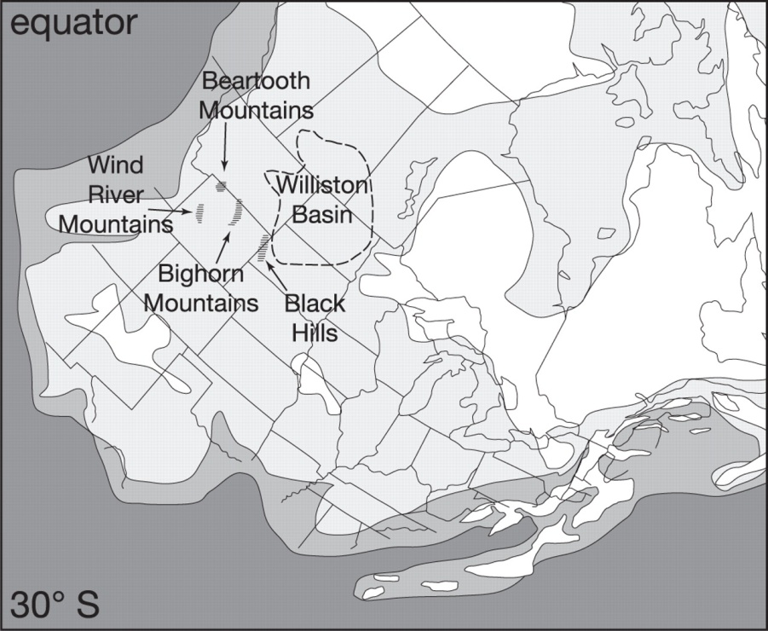
Ordovician-Bighorn Dolomite
Disconformably overlies the Gallatin Fm.
Massively bedded, light yellow-brown dolomite
Rough weathering surface
Extensive bioturbation-thallasiniform burrow systems common
Micrite to grain dominated carbonates-dolomitized
Typical Ordovician-Early Paleozoic Fossil assemblages, moldic preservation
Local quartz sandstone (Lander Fm.) at base overlying disconformity at Gallatin-Bighorn contact
Accumulated in cratonic carbonate platform setting.

Slide 6
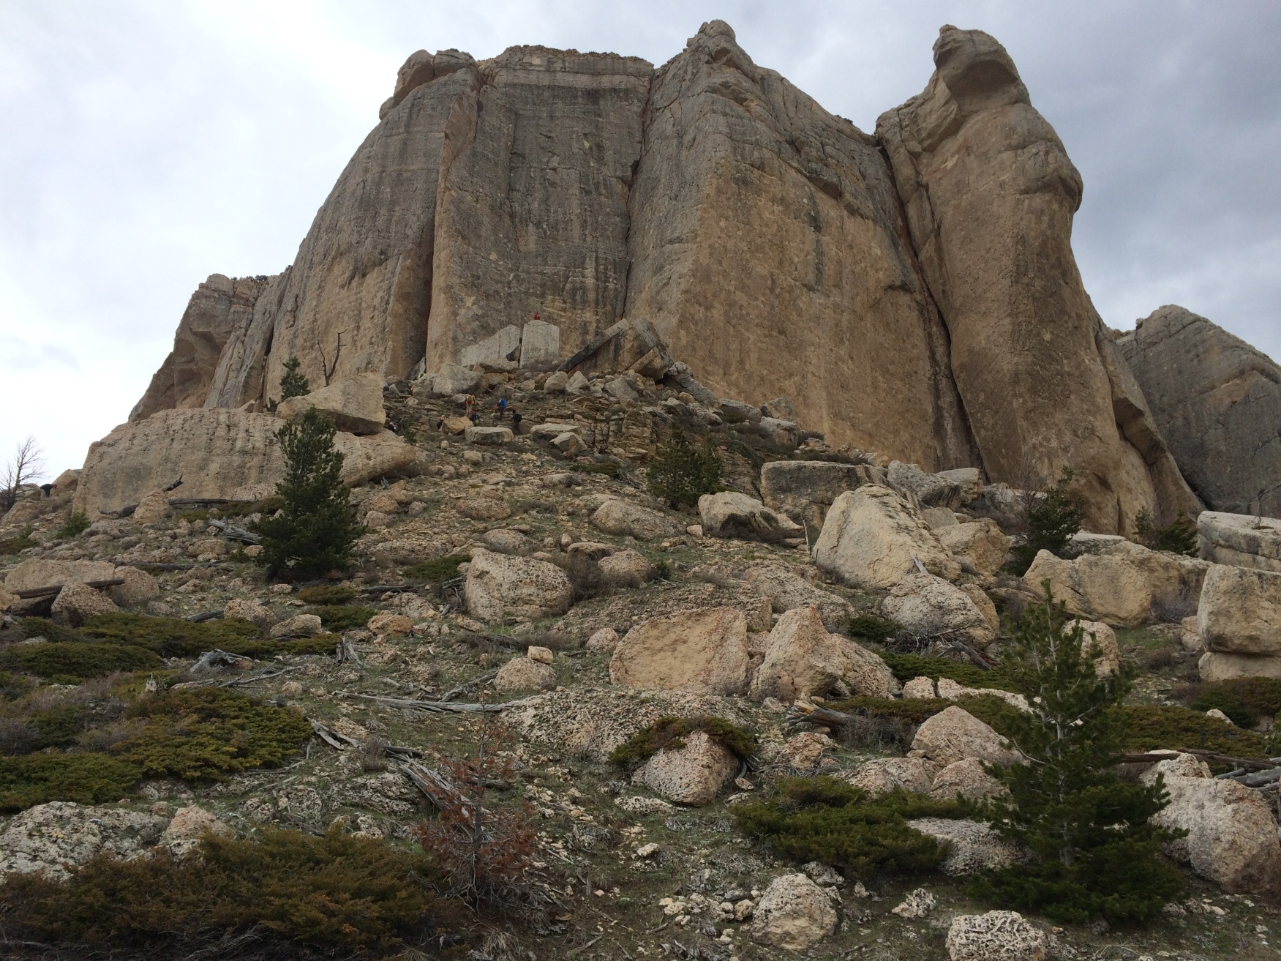
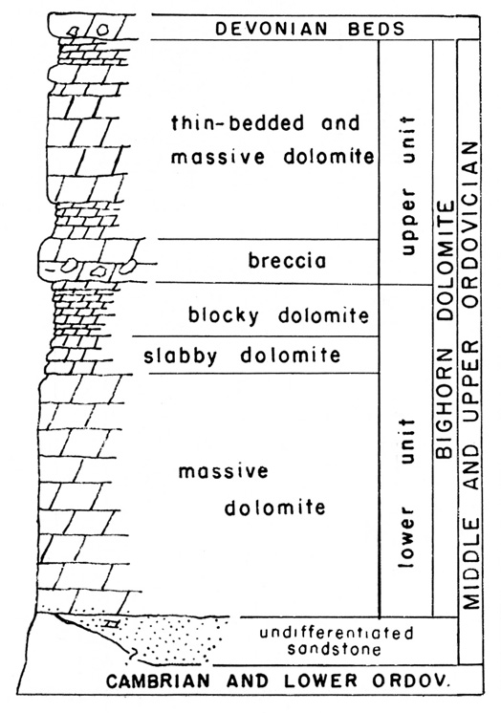
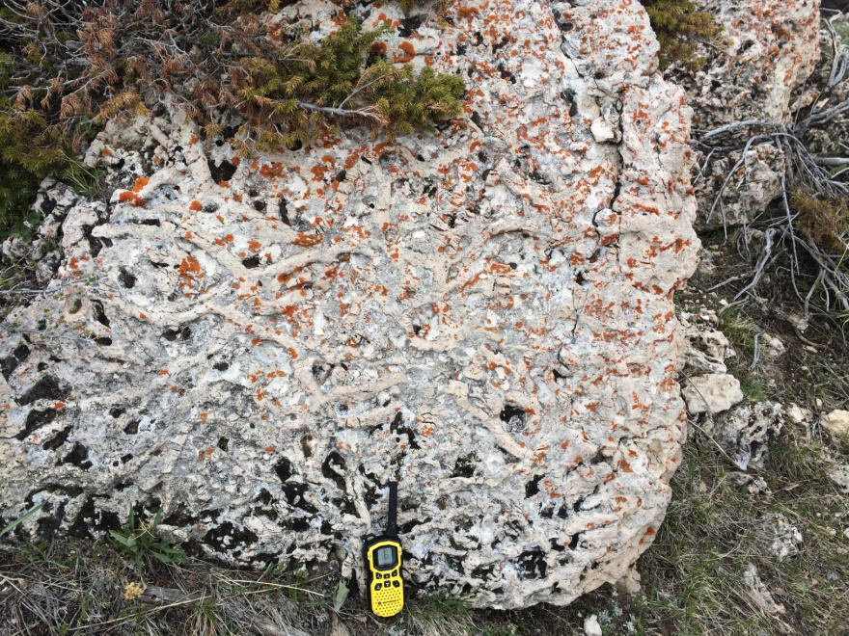

Slide 7
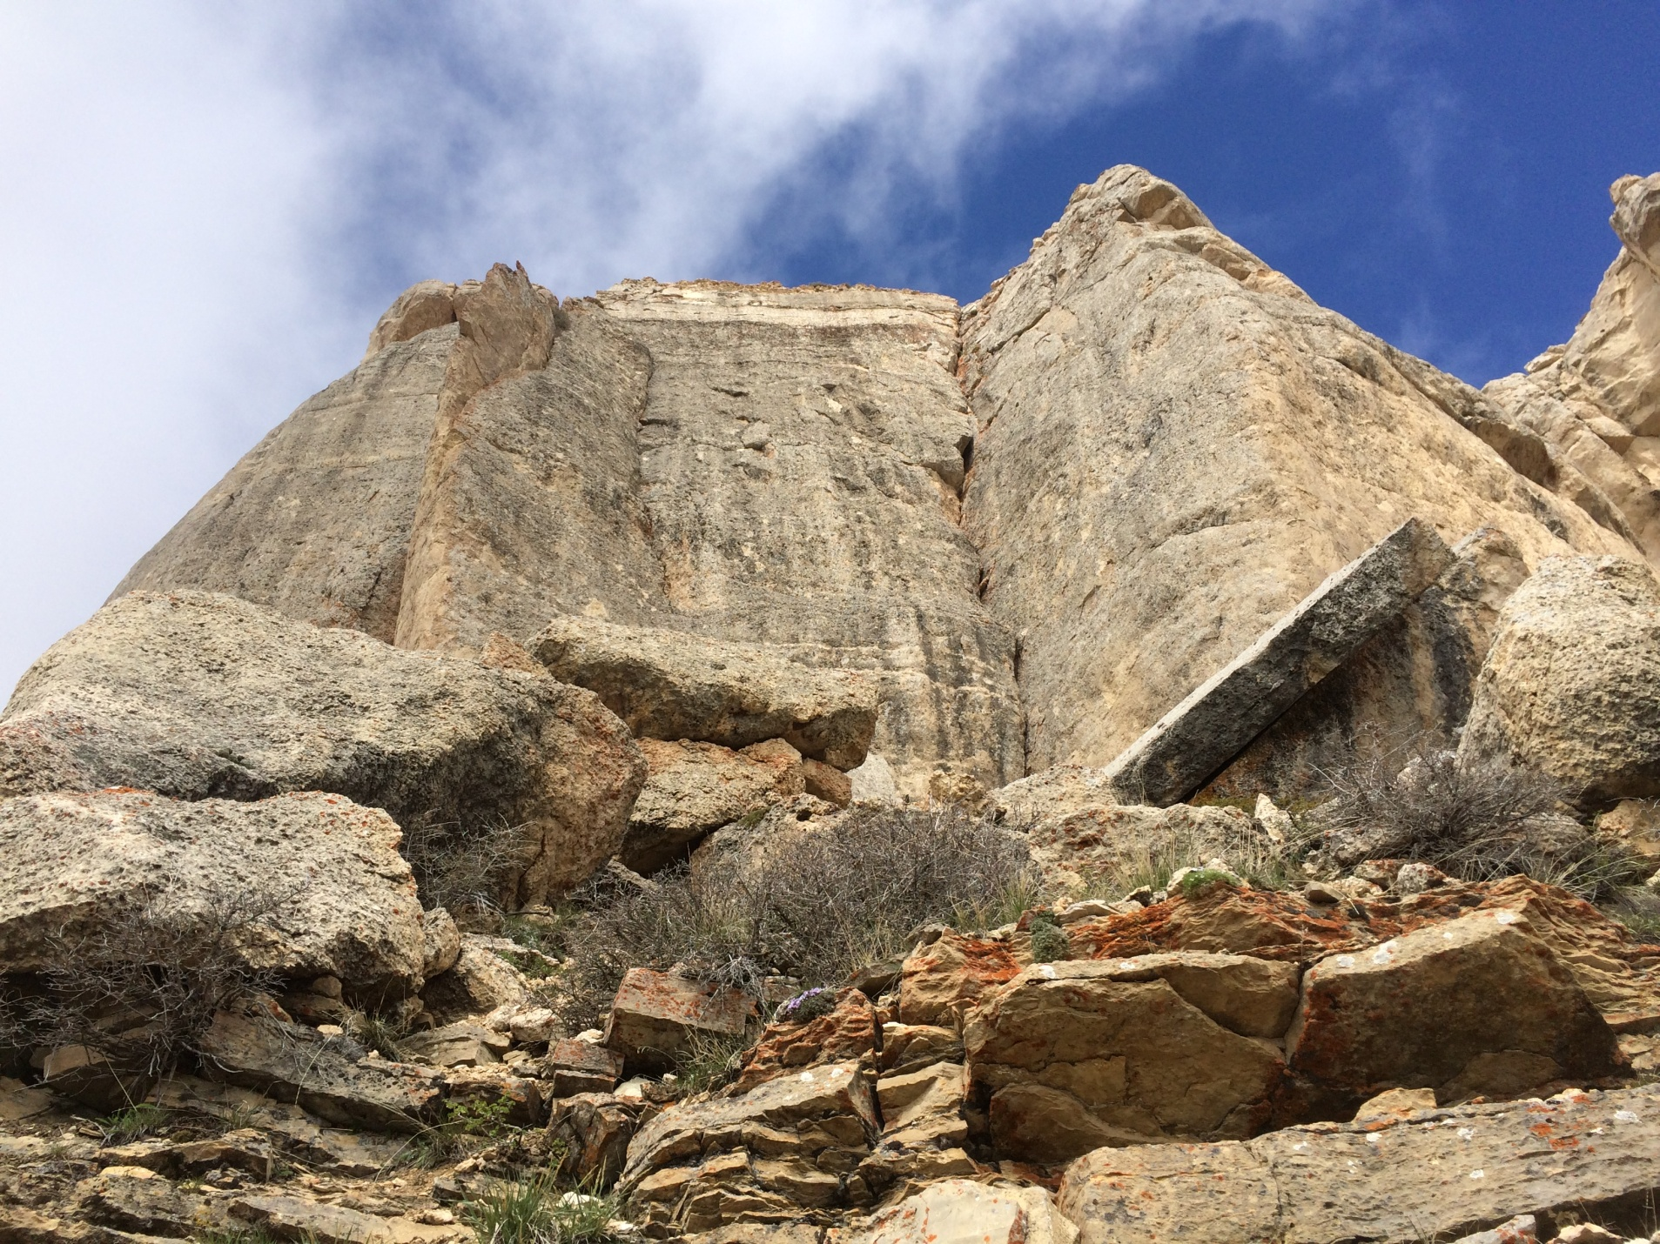
Cambrian Gallatin Formation, overlain by Ordovician Bighorn Dolomite

Slide 8
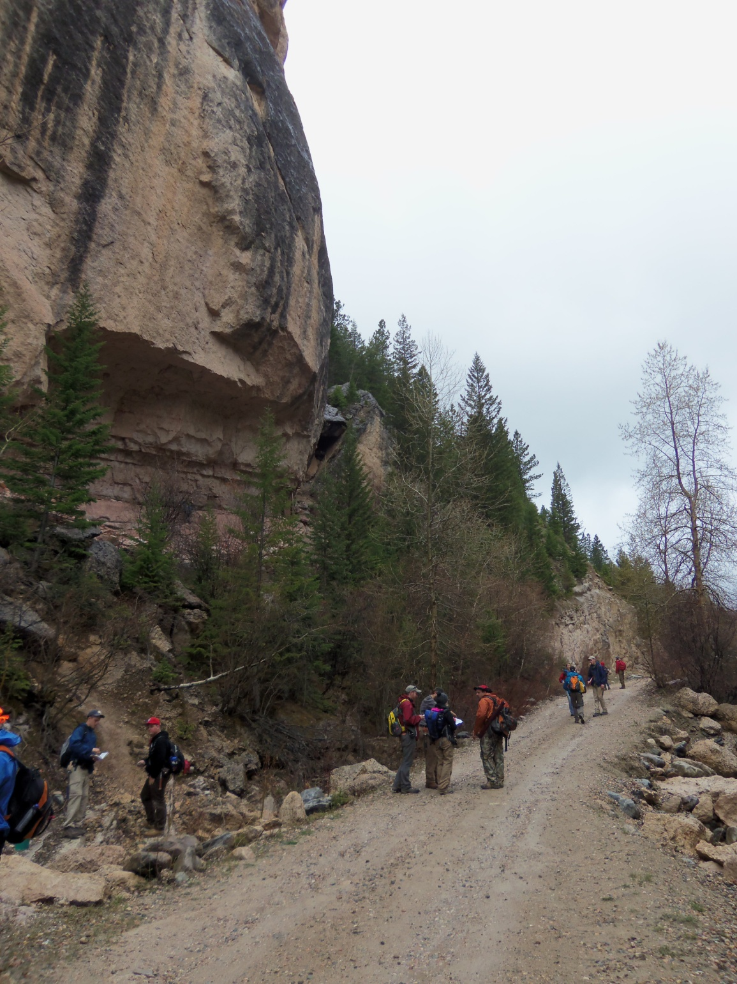
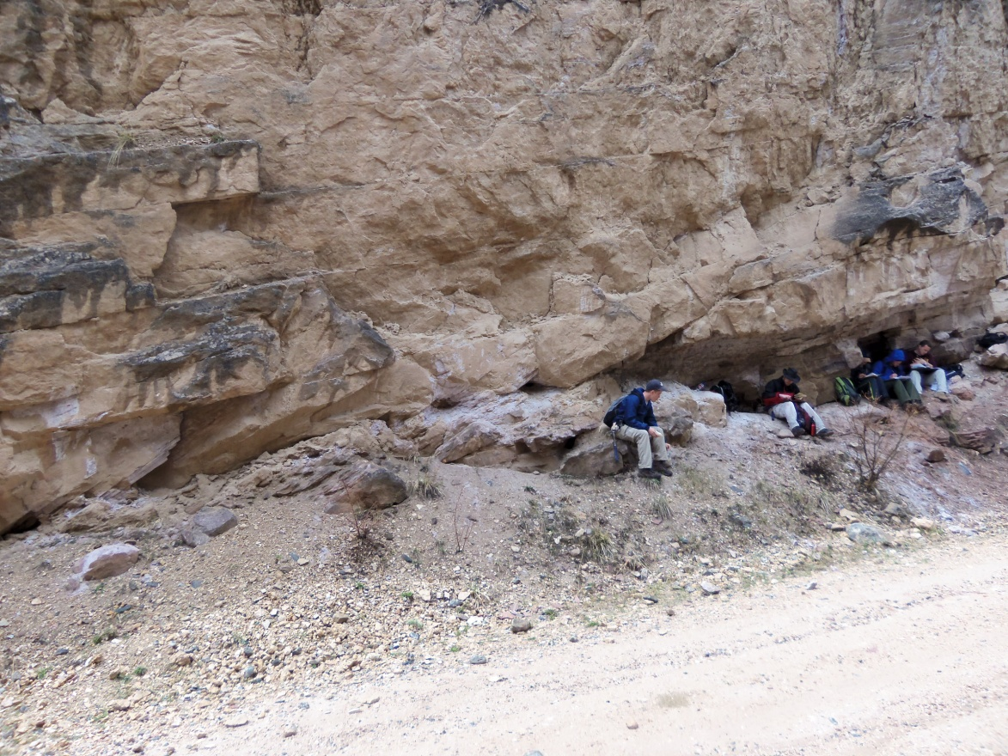
Sandstone ravinement and nearshore shoreface and inner shelf sandstones make up lower 5-10 m of the Bighorn above its contact with the Gallatin
(photos from section in Crazy Woman Canyon 2012).

Slide 9
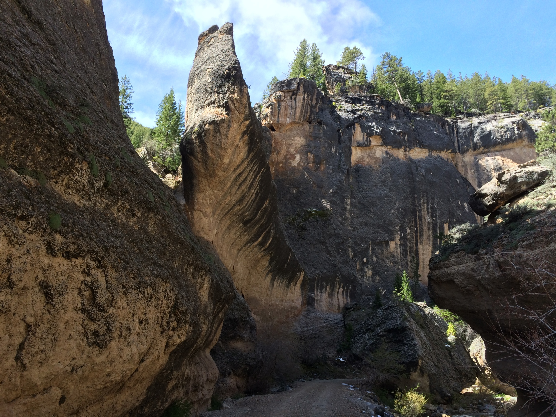

Slide 10
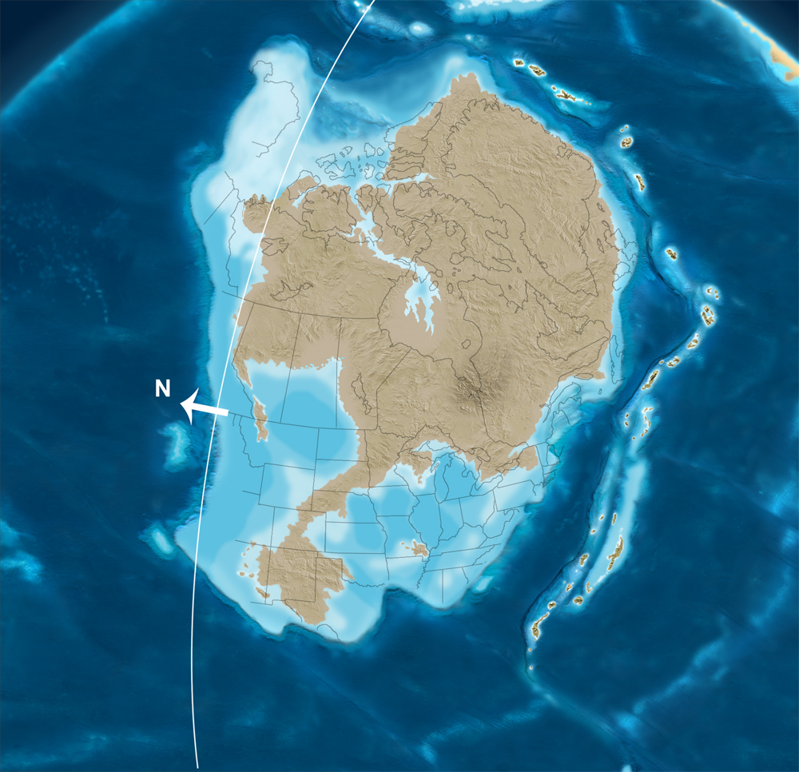
Early Ordovician: Peak extent of Sauk Cratonic seaways prior to terminal Sauk Sequence Regression

Slide 11
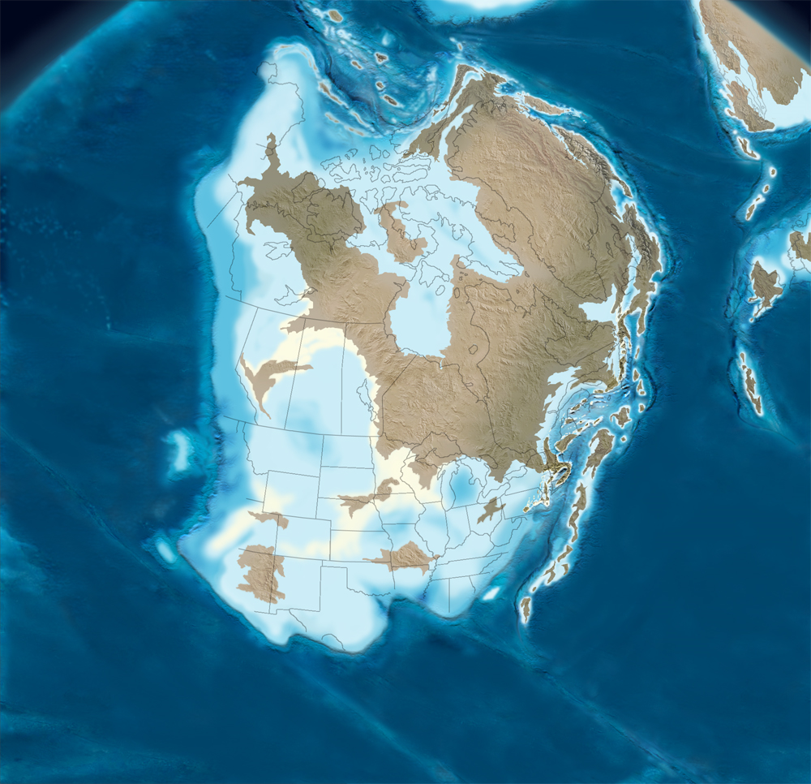
Middle Ordovician-Tippicanoe I Sequence sea level rises initiate cratonic & passive margin carbonate platform deposition-Bighorn Deposition throughout Wyoming

Slide 12
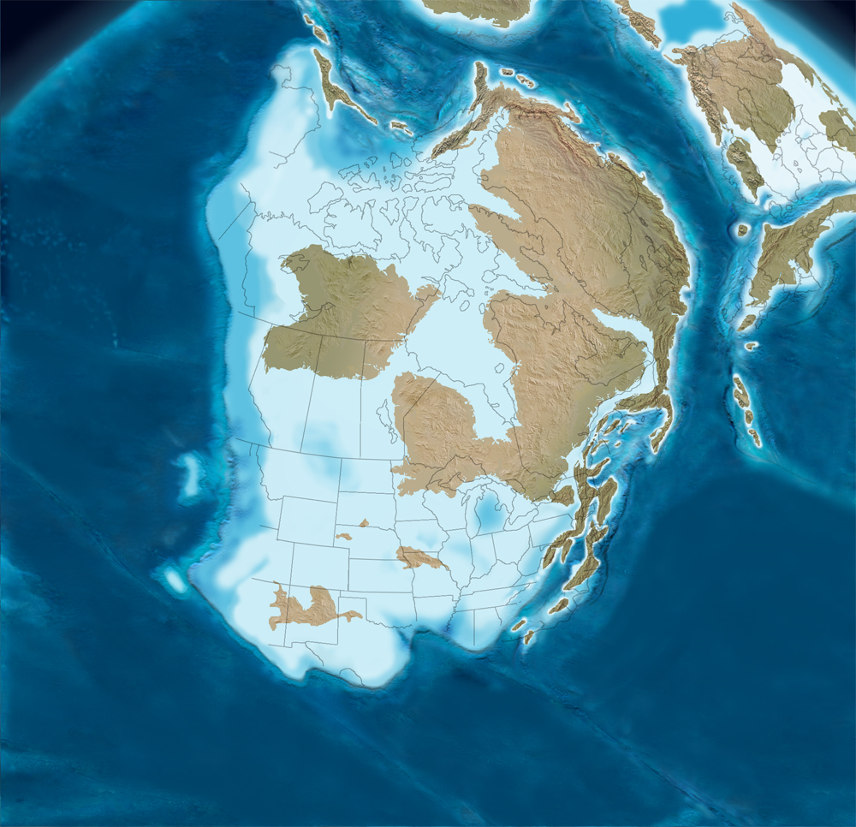

Late Ordovician-Sea Level at Phanerozoic Peak flooding prior to Hirnantian Glaciation

Slide 13
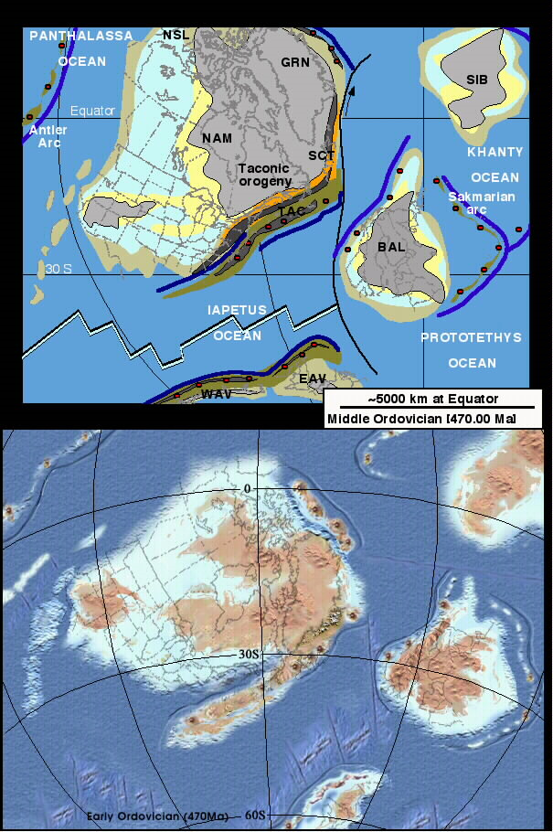

Mid-Late Ordovician-Tippicanoe I Sea Level Rises flooded the craton from Cordilleran Continental Margin-Bighorn Accumulates in cratonic carbonate platform

Slide 14
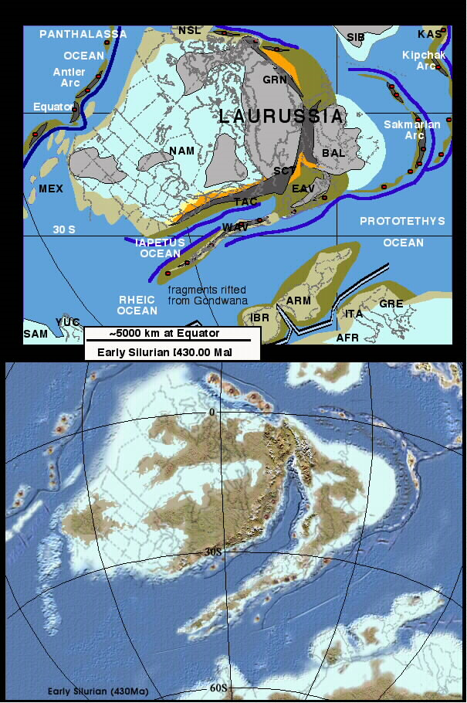
Post-Hirnantian Sea Level Rise of Tippicanoe II Sequence re-established extensive interior seaways in the Early Silurian
Silurian platform carbonates were present but extensively eroded in Colorado, Wyoming, Montana & Alberta-B.C.

Slide 15
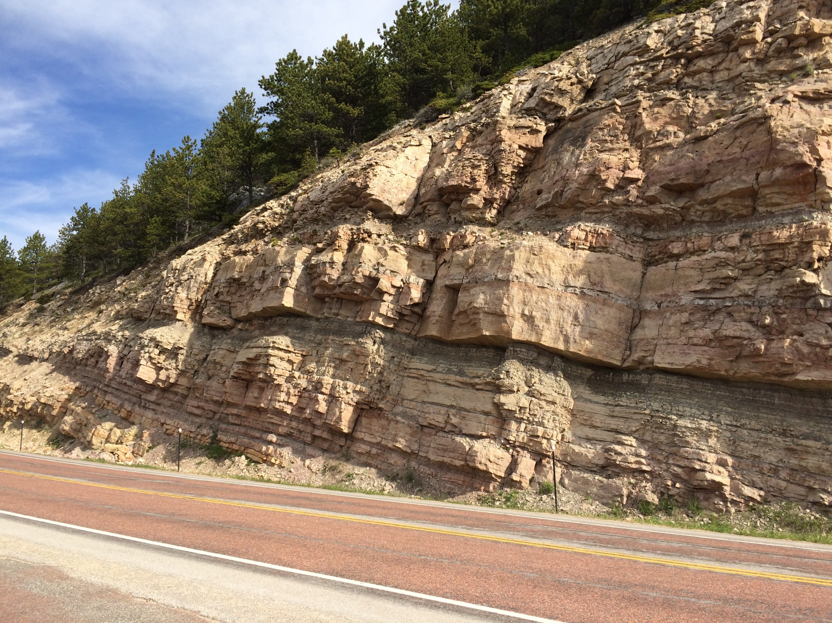


Slide 16
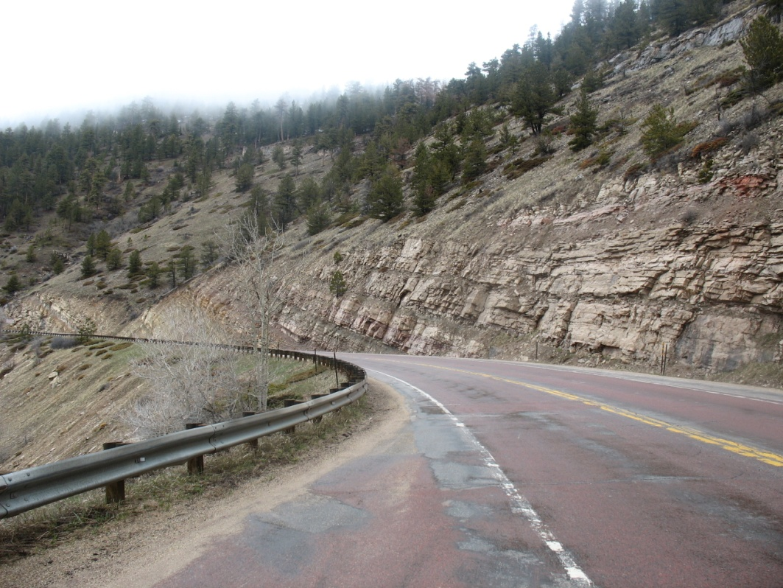
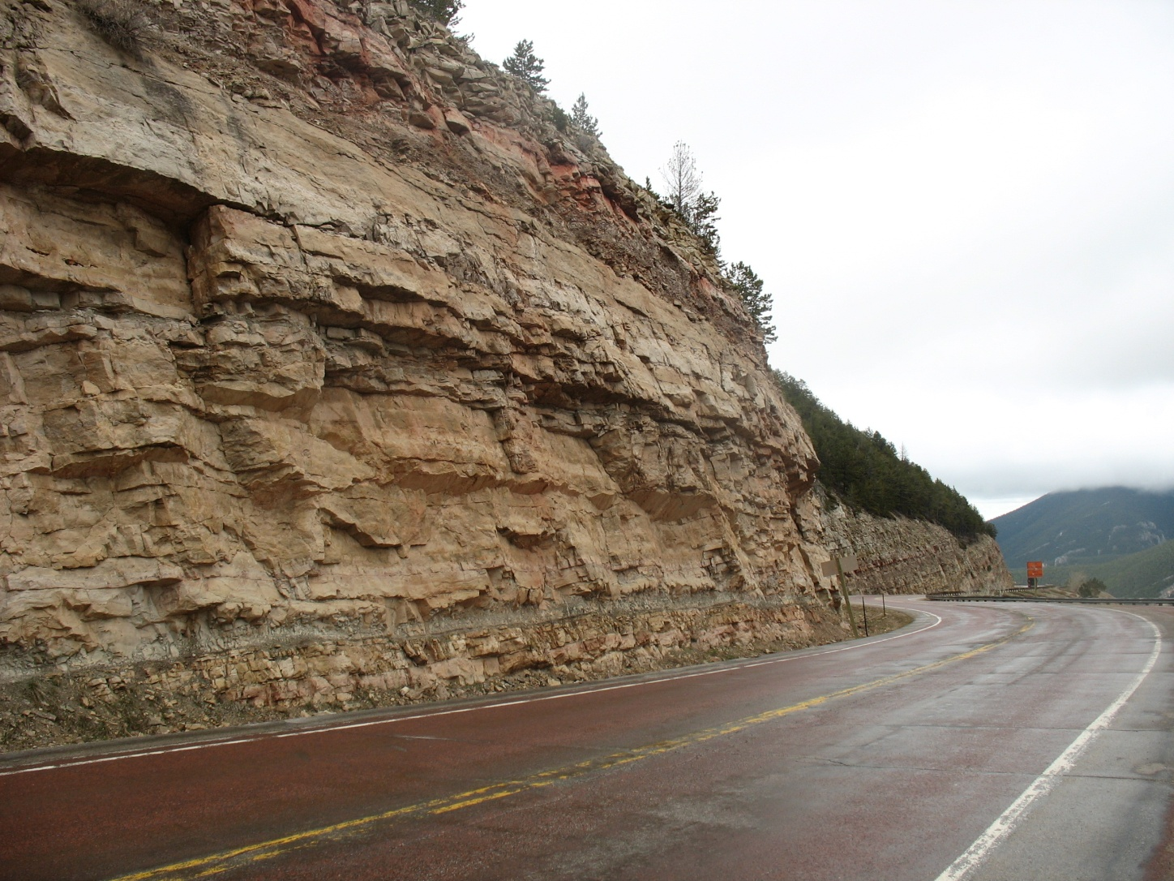
Roadcut exposures of the Upper Devonian Darby Formation on US Highway 14 just east of Steamboat Point

Slide 17
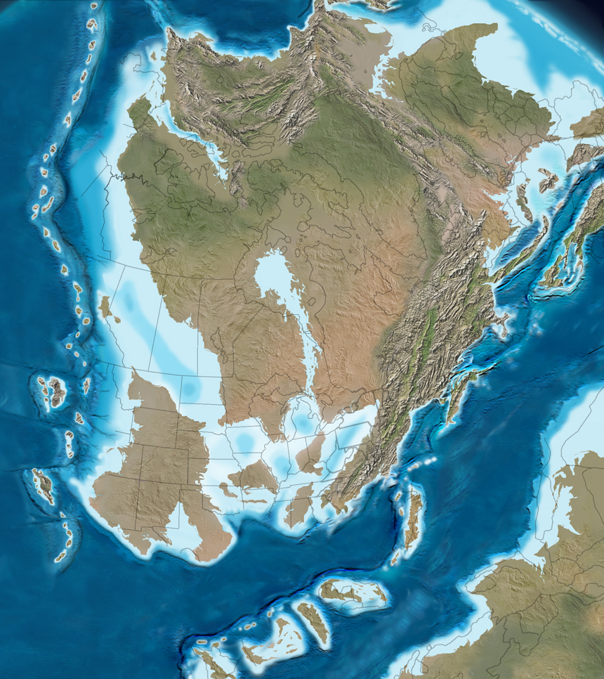
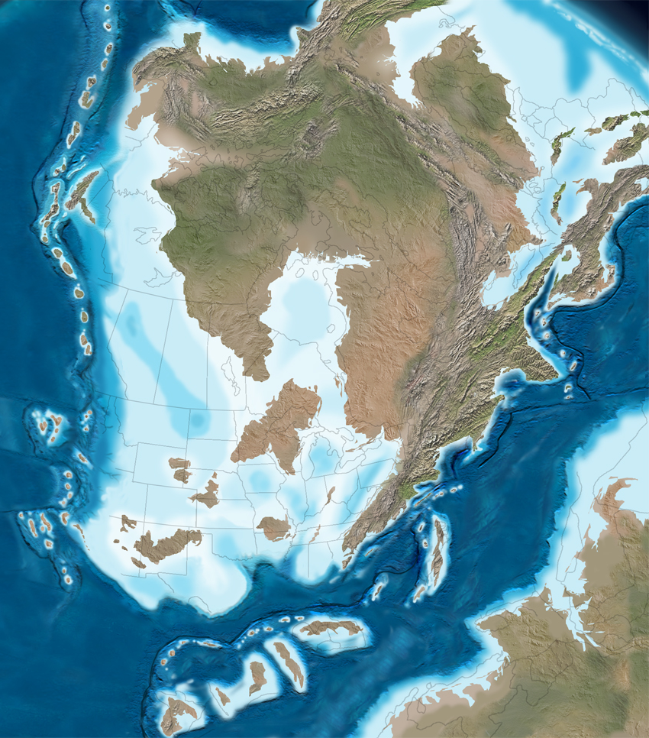
Sea Level Rises begin in Middle Devonian, Wyoming emergent at that time-no rocks this age
Peak Sea Level high in the Late Devonian-cratonic seaway covers Wyoming. Antler and Klamath Arcs collide with Cordilleran Margin initiating Antler Orogeny
Darby

Slide 18
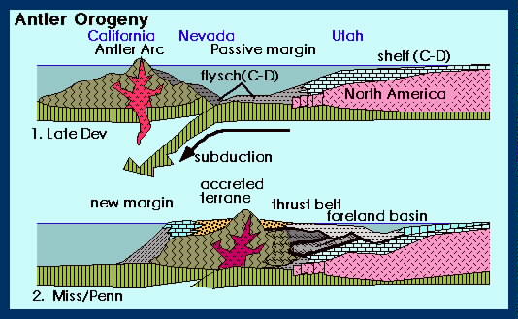

Slide 19
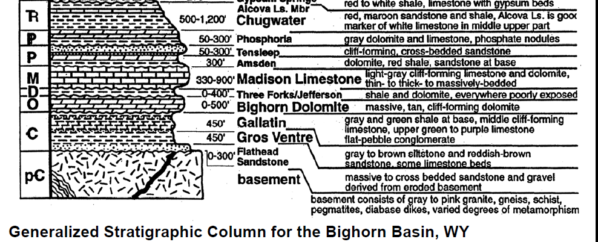

Slide 20
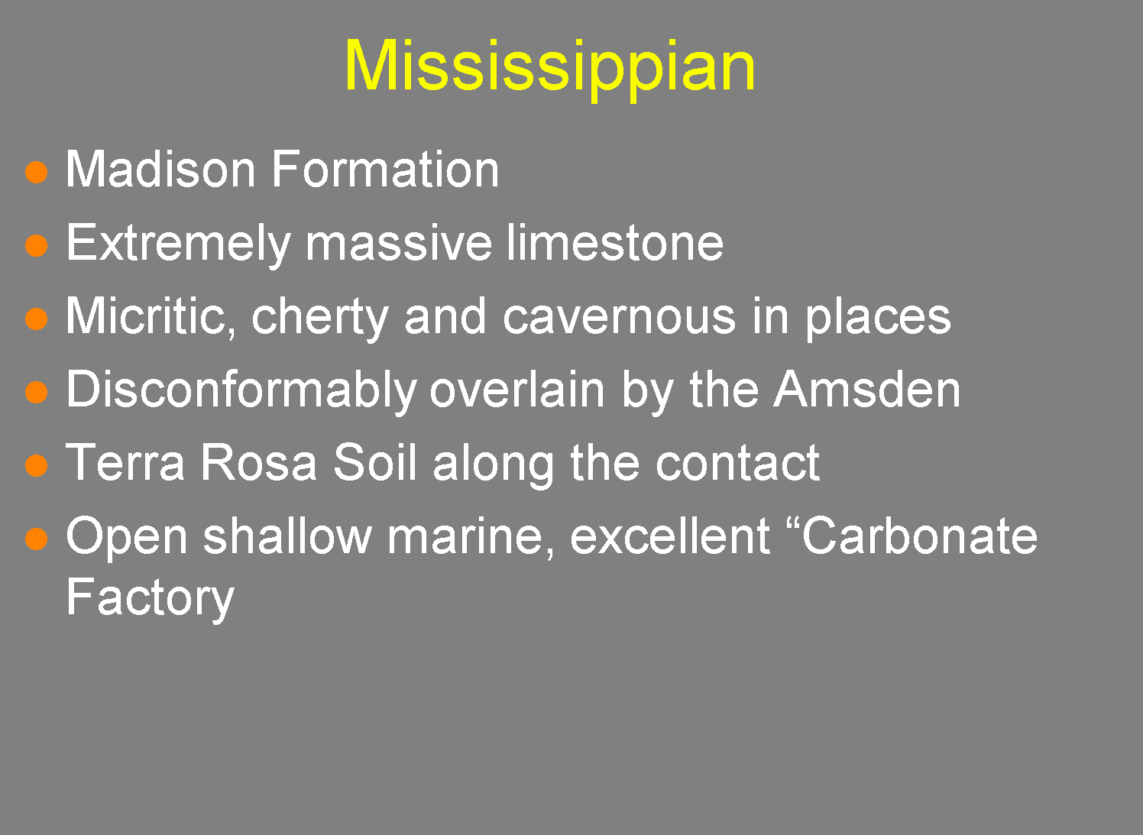
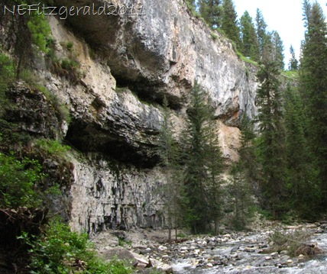
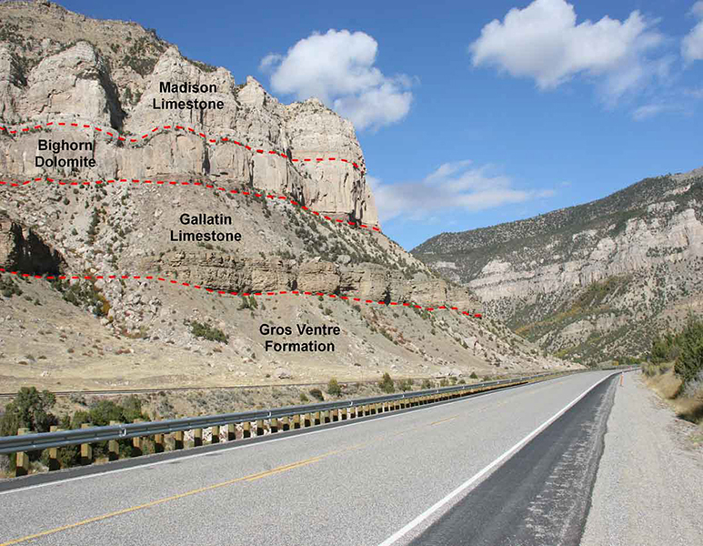

Slide 21
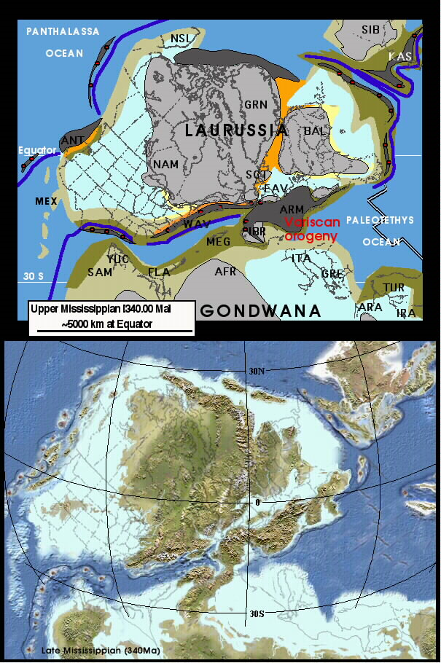
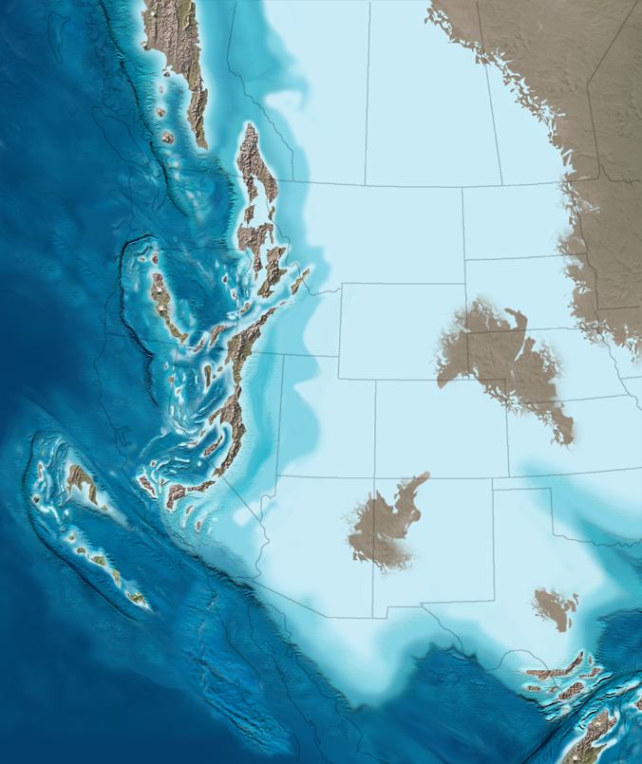
Tournaisian-Visean: Early Mississippian
Madison Fm./Group
Joanna
Redwall
Lake Valley Group

Slide 22
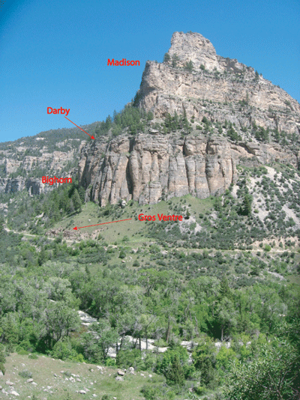

Slide 23


Slide 24
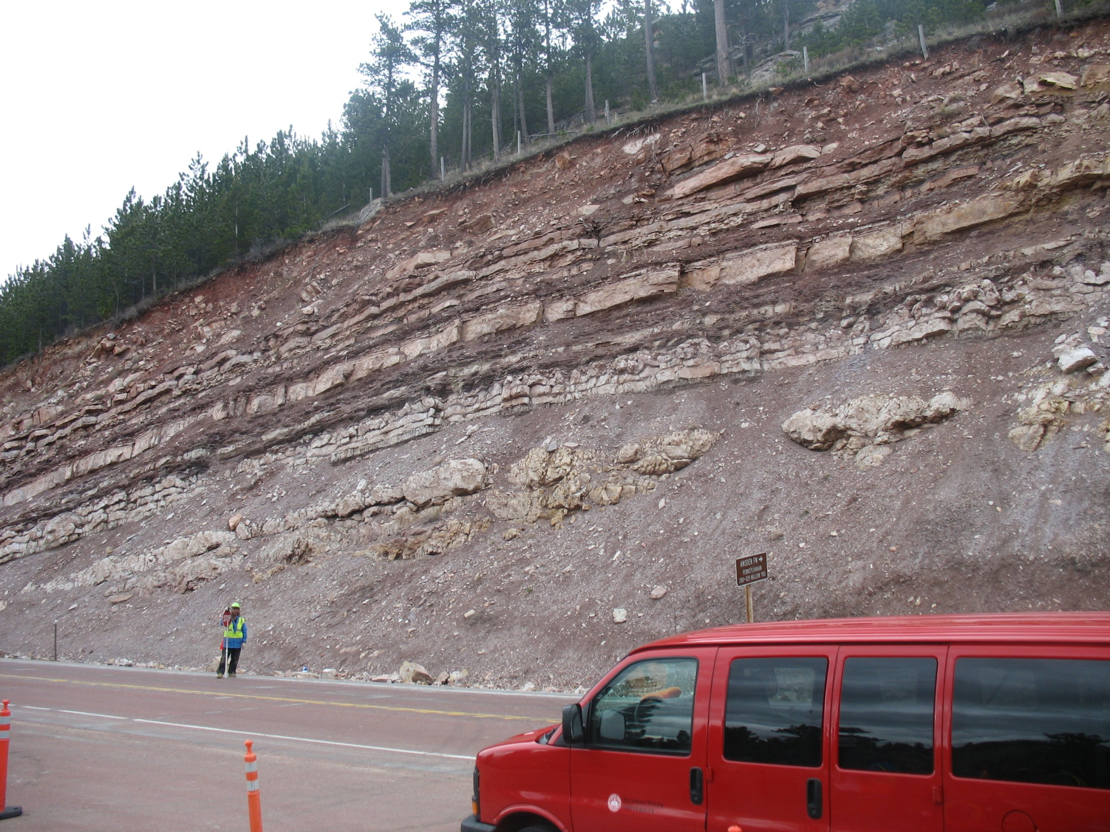
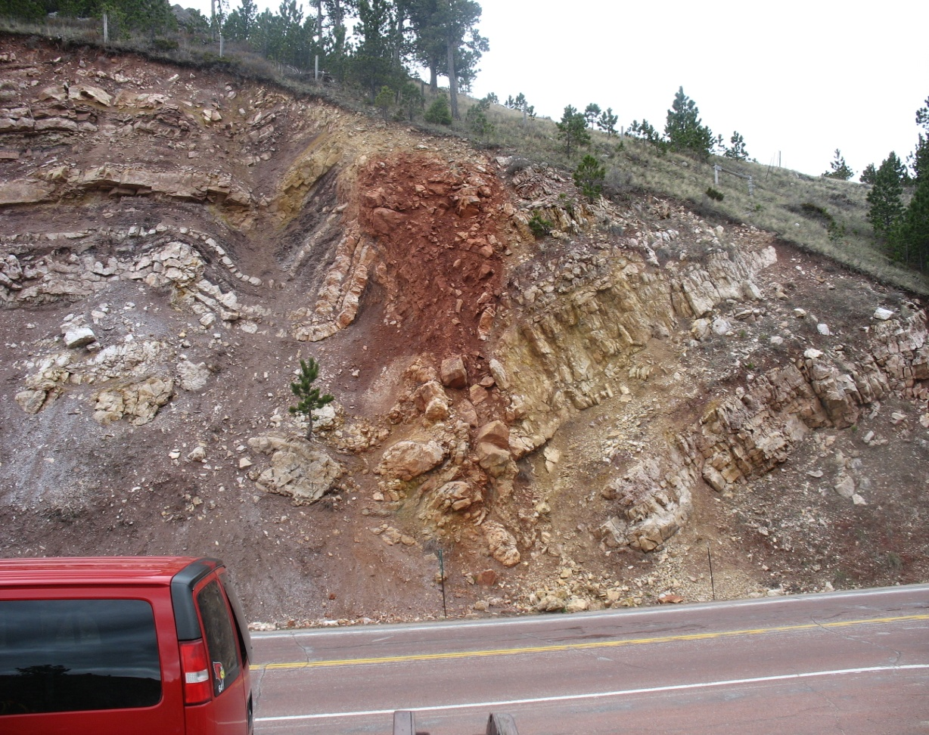
Amsden Fm., Hwy 14

Slide 25
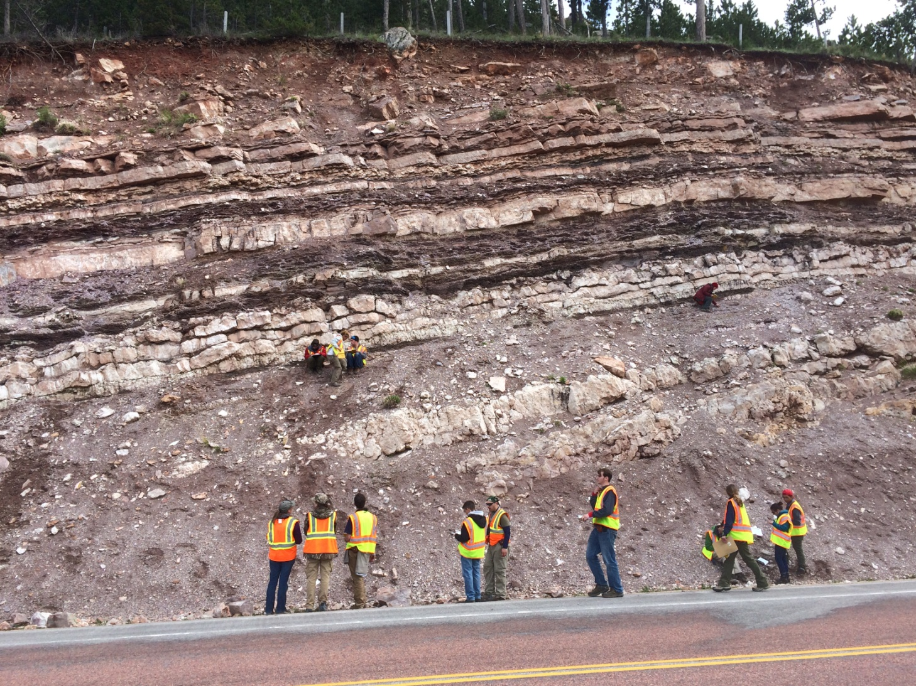
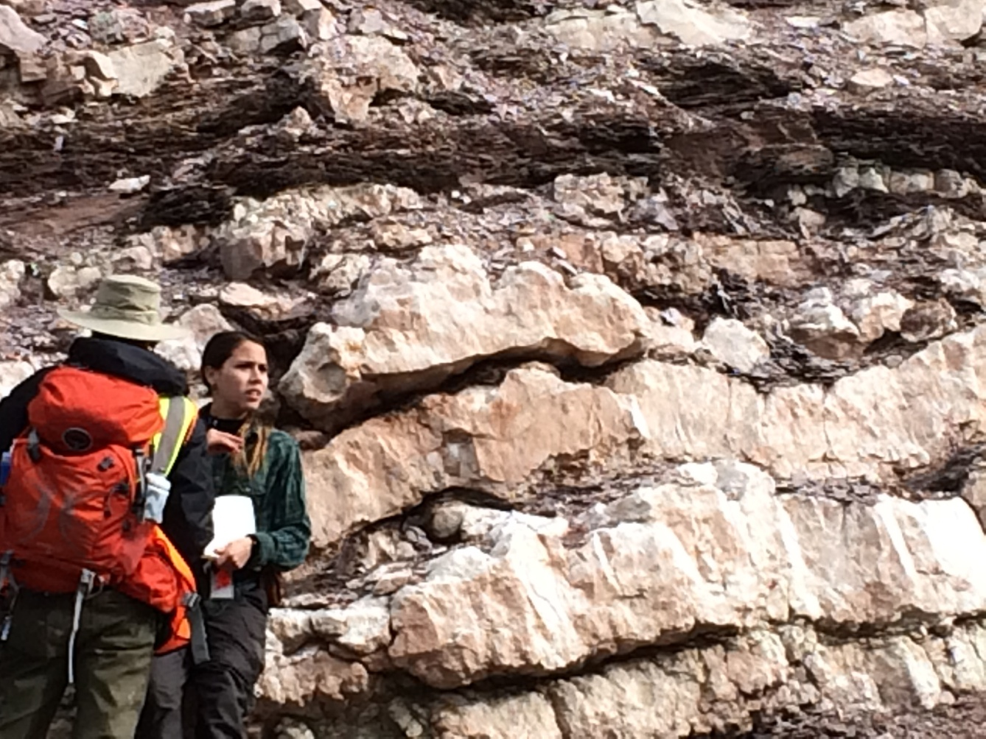
Upper Amsden Fm., Hwy 14

Slide 26
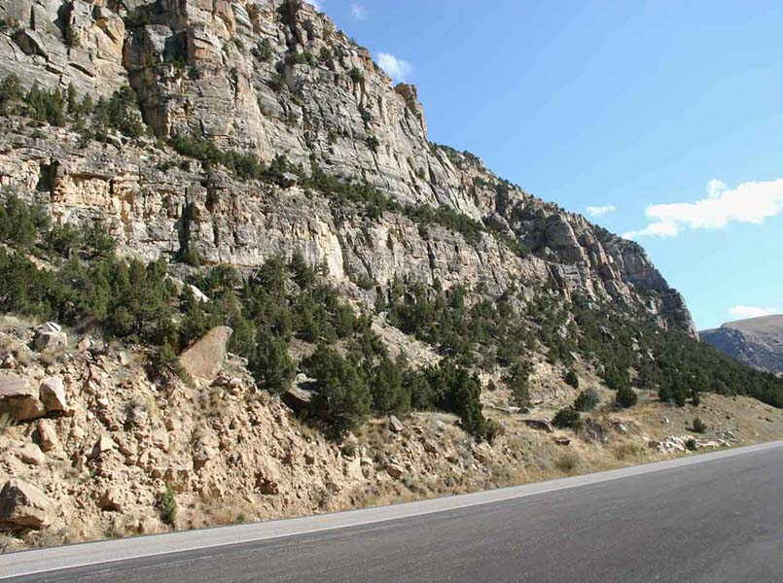
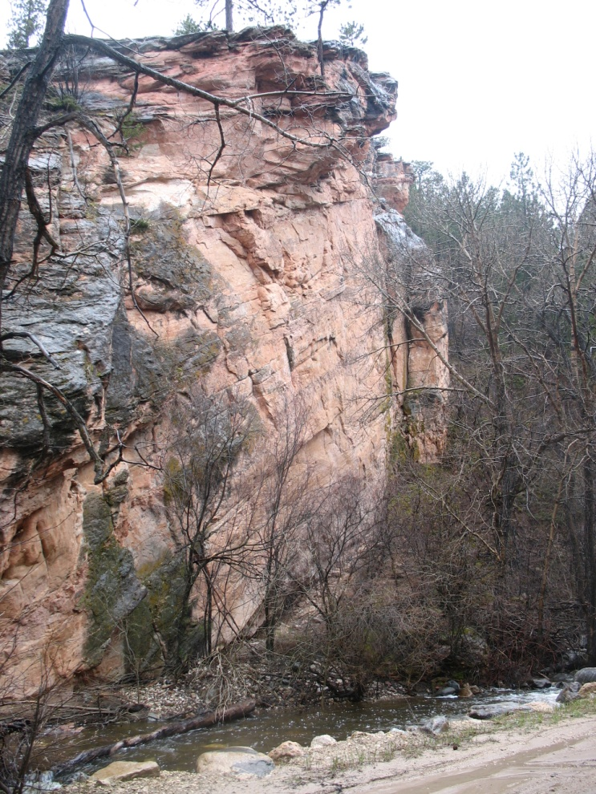
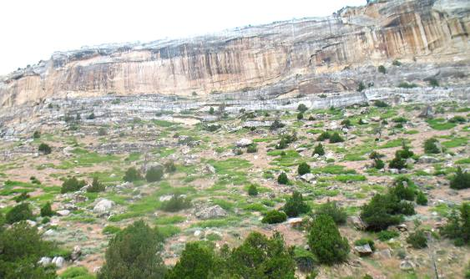
Tensleep Fm.,
Highway 20 roadcut-Wind River Canyon
Sinks Canyon near Lander, Wyoming

Slide 27
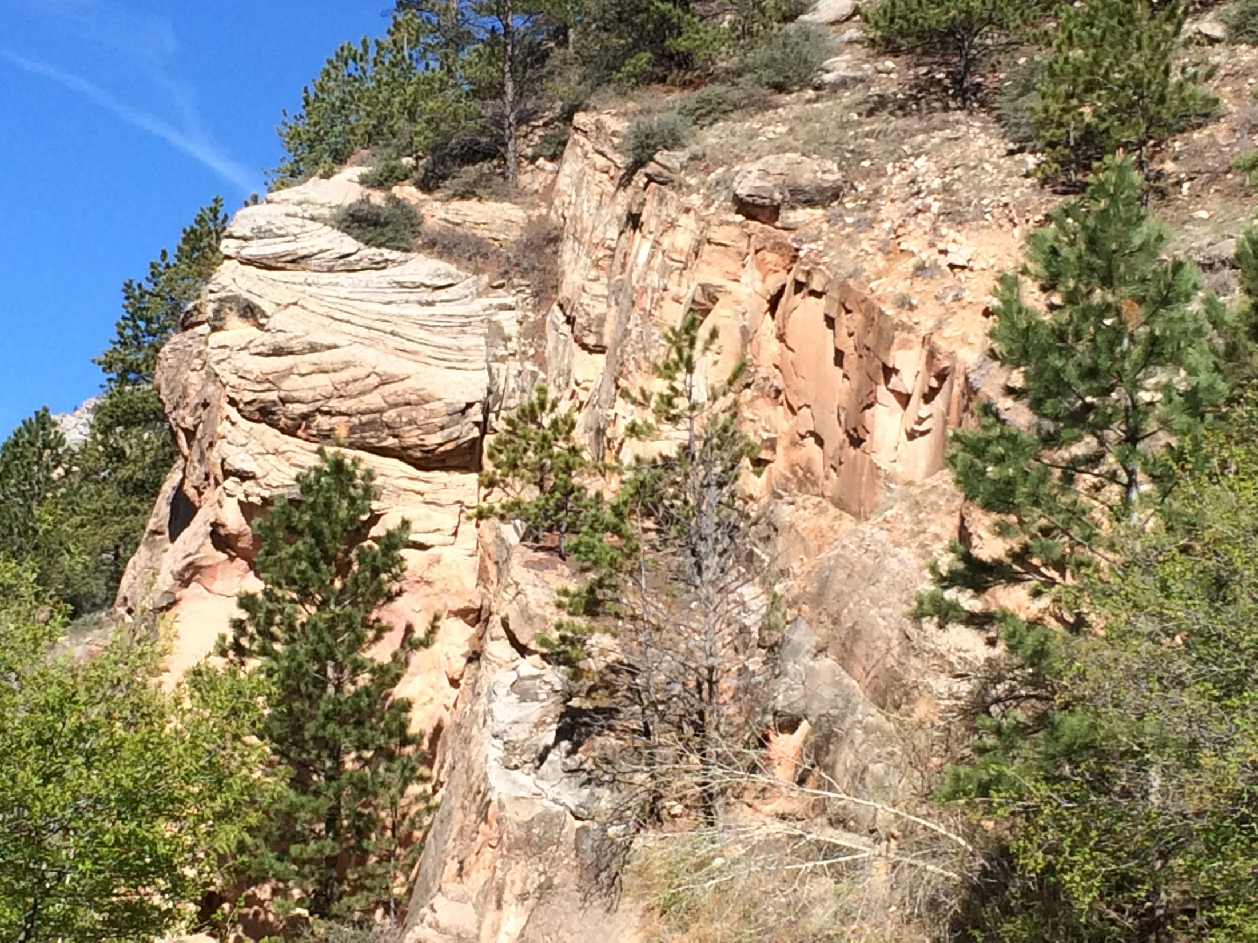

Slide 28
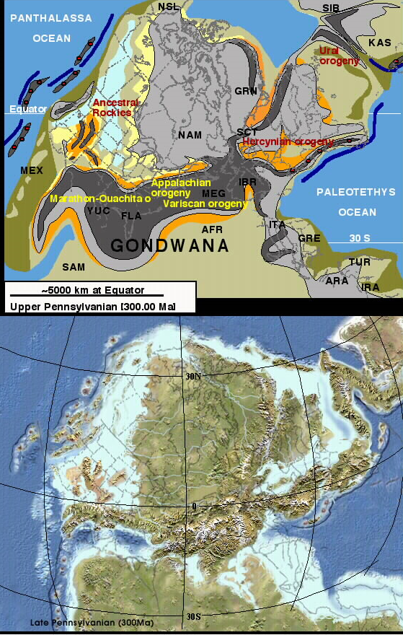
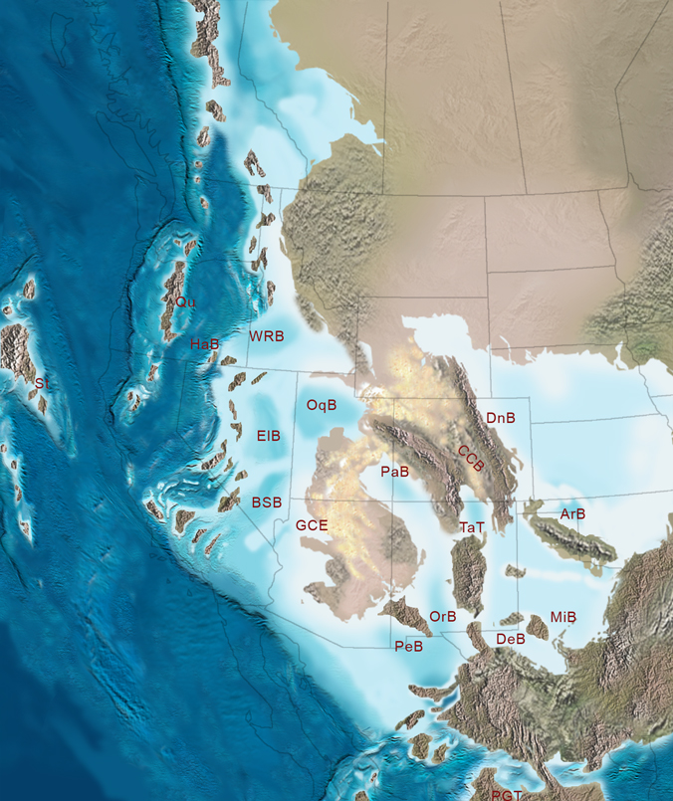
Tensleep & Amsden Fms. deposited in restricted basin connected to central interior basins

Slide 29
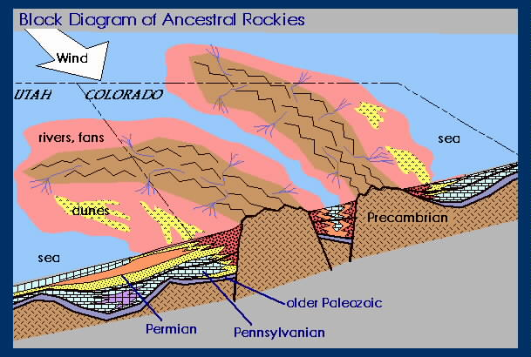

Slide 30
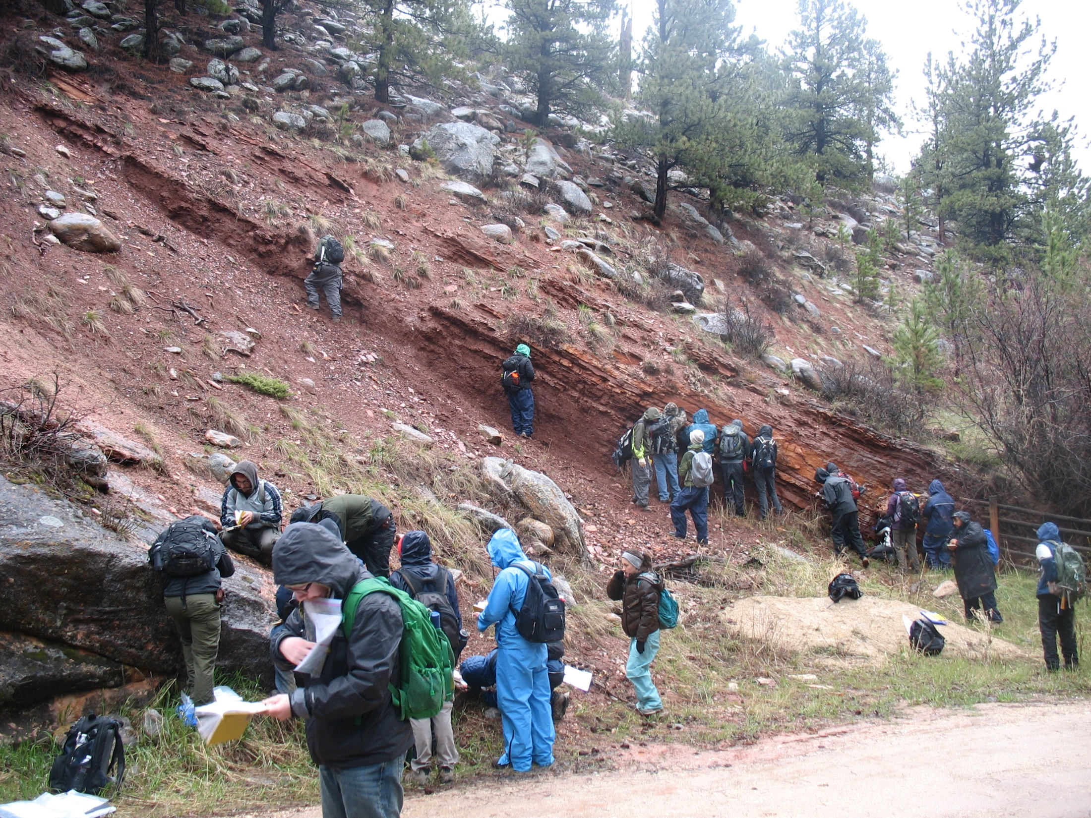

Slide 31
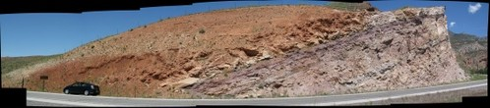
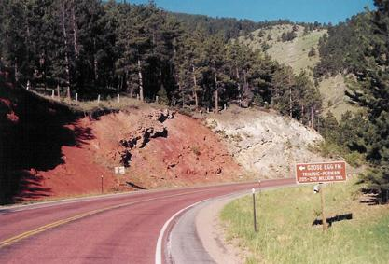
Goose Egg Fm.
Permian-Early Triassic
Continental Red beds (sahbka coastal plane sediments) including evaporites, evaporitie solution breccias, thin stromatolitic carbonates

Slide 32
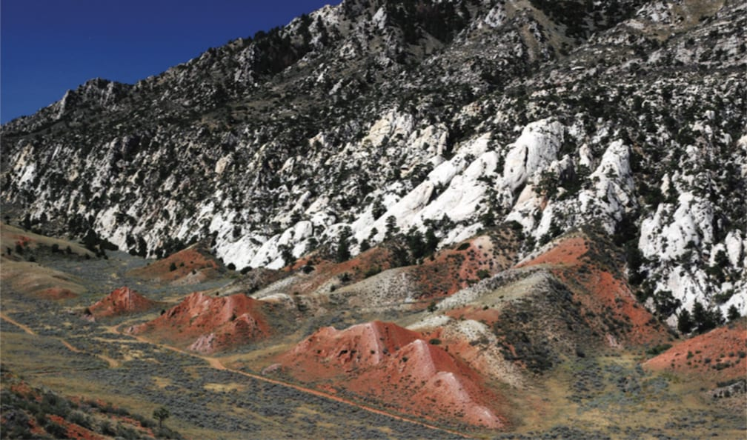
Goose Egg formation in contact with Tensleep Formation at Seminoe State Park, WY

Slide 33
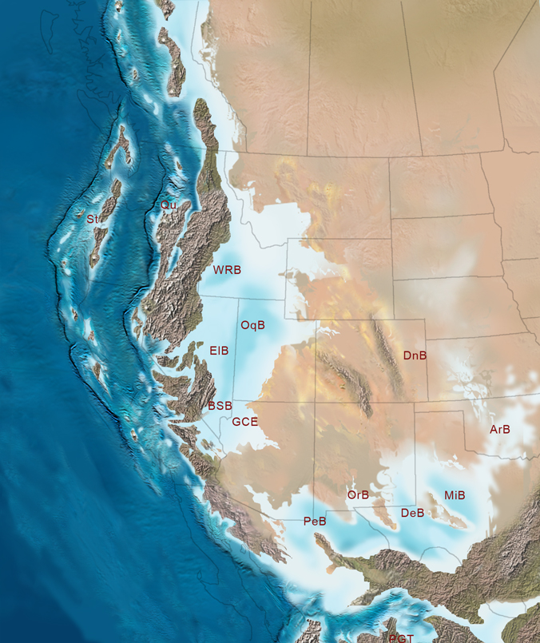
Goose Egg Fm.
Permian-Early Triassic
Continental Red beds and sahbka coastal plain sediments

