Slide 1
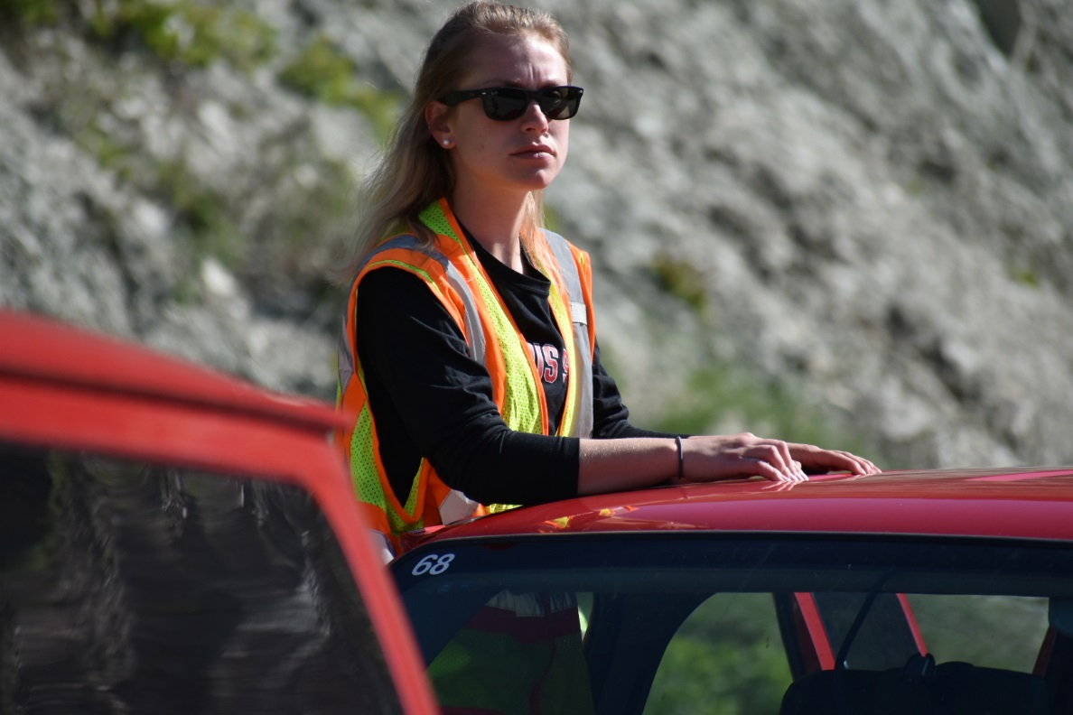
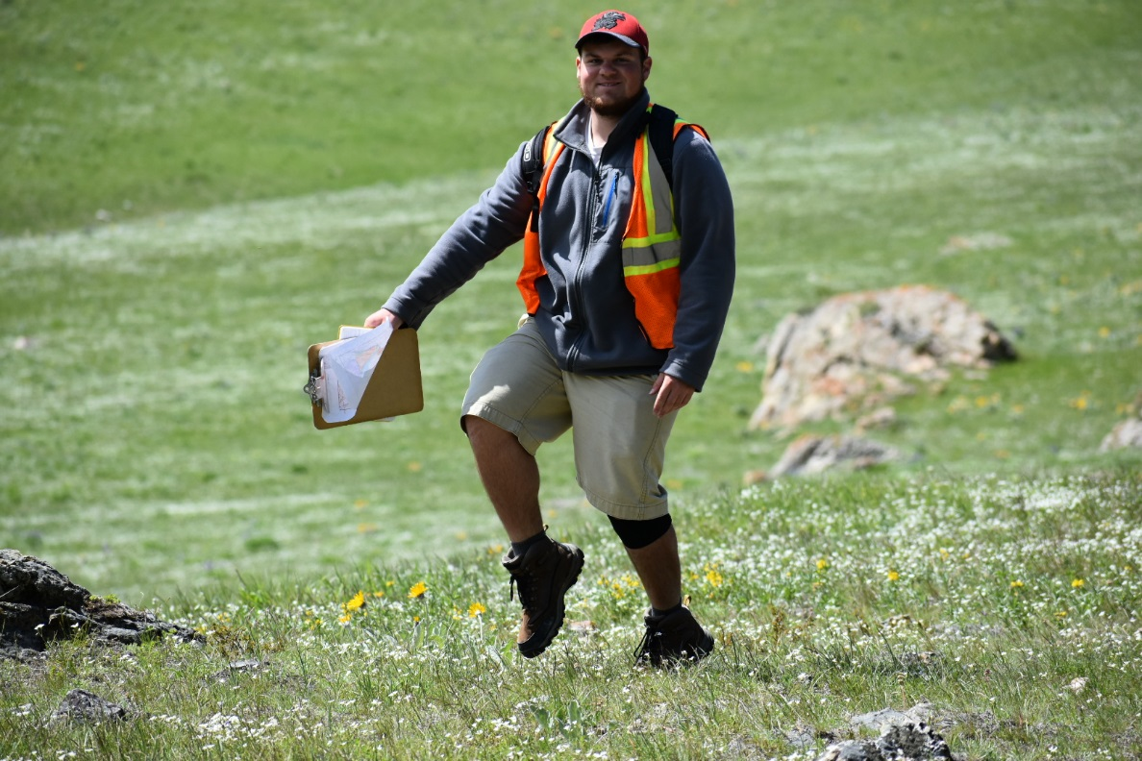
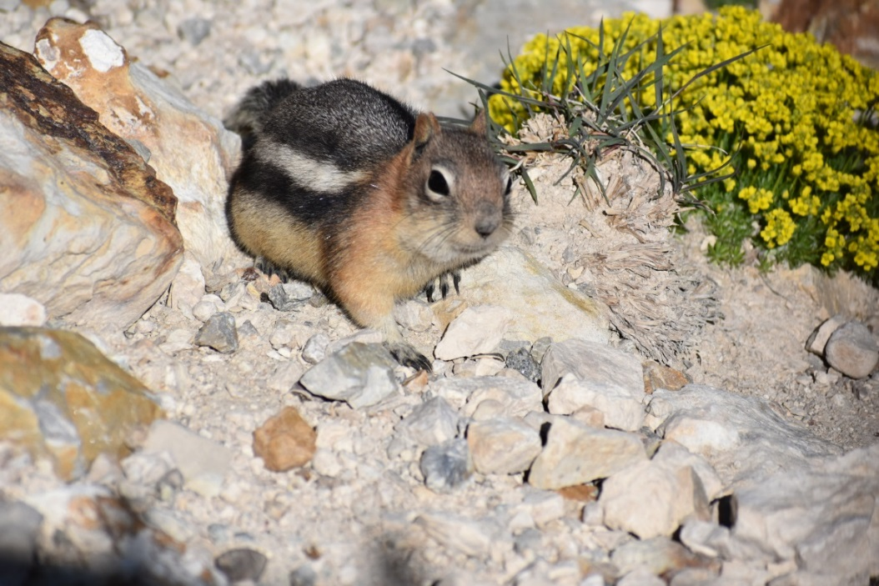
Field Notes
An introduction to styles of field notes and their importance

Slide 2
Why Take Them?
Organization of your thoughts
  Insight into your thought process
Document what you see
  You don’t always have the luxury of returning to a specific site so careful observations are key!
A way to record your preliminary interpretations
Communicate with other Geologists

Slide 3
Types of Field Notes
The style of Field notes that you take depend on the project
  Reconnaissance (aka Vanology)
    Taken during reconnaissance
  Stratigraphic Column
    Usually a scaled sketch of the column on one side and notes on the other
  Geologic Mapping
    These notes document everything needed to complete a geologic map and cross section. They are a record of where you were, what you saw, and your interpretations.
    SKETCHES ARE VITAL!
  Data Collection
    Just as it says, usually in table format

Slide 4
Must Haves
Daily information
  Date, Weather, Purpose
Stop Information
  Numbered or labeled somehow to distinguish stops
  Geographic Location
  Geologic Location (when applicable)
Observations!!!!!!!!!
Interpretations
Sketches
  Must include title, scale, labels, color is good also

Slide 5

Vanology Example
Somewhere in South Dakota
5-22-18
Weather: sunny ~65º.
Location: Today will consist of regional reconnaissance in the Black Hills area.
Continuing ~east toward main north-south drainage valley. Should
find exposure of older St. Peter Ss in valley.
CC-02
Mile 12 on Boulder Hill Road
Purpose: To assist in identifying the lithologies and structural complexities for the Moonshine Mapping Project
20’ down into the valley at about the 1400’ contour line,
the soil becomes sandy. There is an outcrop of sandstone
about another 30’ below. Looks like a good place for S-D.
500 feet North of Hwy marker 29 on Hwy 385 Northbound is an exposure of
CC-03
Mile 16 on Boulder Hill Road (St. Peter Ss).
CC-01
S-D/Bed
Nick point which exposes about 15 vertical feet over a length
Limestone along the northern side of the road. The outcrop
of 10’ at the bottom and narrowing to about 5 feet at the top.
S-D/Bed
is about 25’ long, 4‘ high in the middle, and tapers down at
N38ºW, 16ºN
There are tangentially truncated cross-beds which range in
N35ºW, 20ºN
thickness from 1.5’ to 2.0’ with the thinner beds near the top.
both ends. Bedding is thin, 1.5” – 2.5” and dipping to the
The upper most bed is oxidized dark brown and provides a
Slightly to the north. The beds thicken with height.
resistant ledge.
Rock Description: St Peter Ss
Rock Description: Fossiliferous Biomicrite
Well rndd, well srtd, med. grnd, calcareous Q-arenite.
Lt. brn. on weathered surface, med. gray on fresh. Fossils
Weathered surface is med. brn, fresh is light yellow. All
grains are frosted.
of crinoids and brachiopods account for 5-10% of the rock
and are matrix supported. This is the (Minnikata Formation)
N
S
“Cross-section along dirt road showing exposure of Minnikata limestone”
Stratigraphic Column of St. Peter Ss
E
W
15’
exposure near valley bottom
4’
25’
Note: Beds thicken higher in this outcrop.

Slide 6
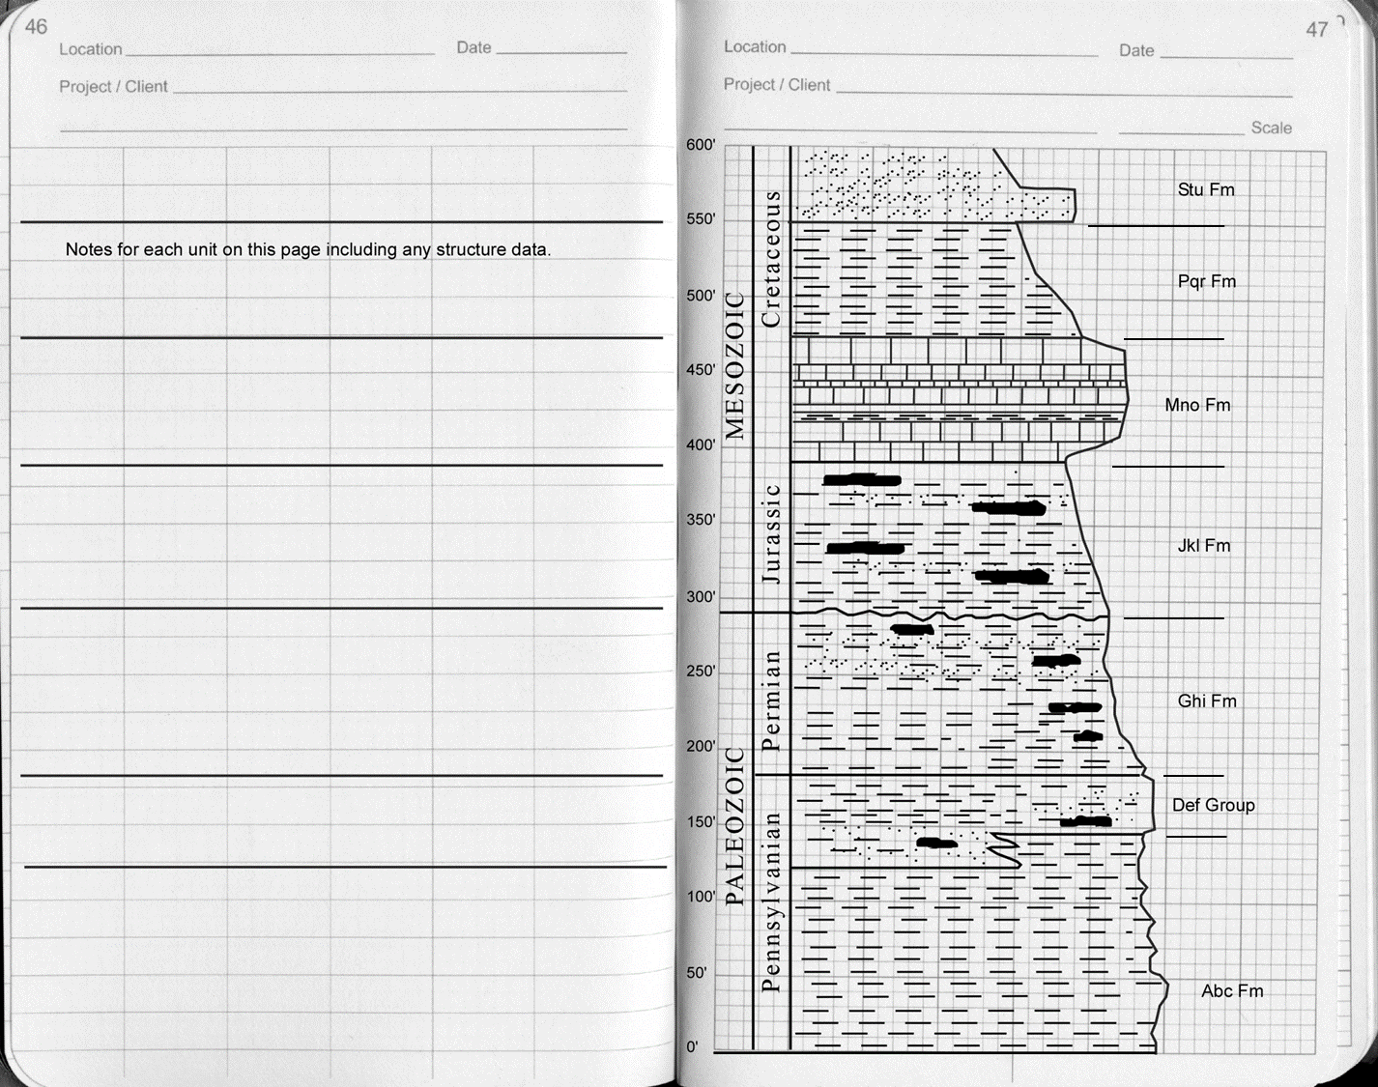
Strat Column Example

Slide 7
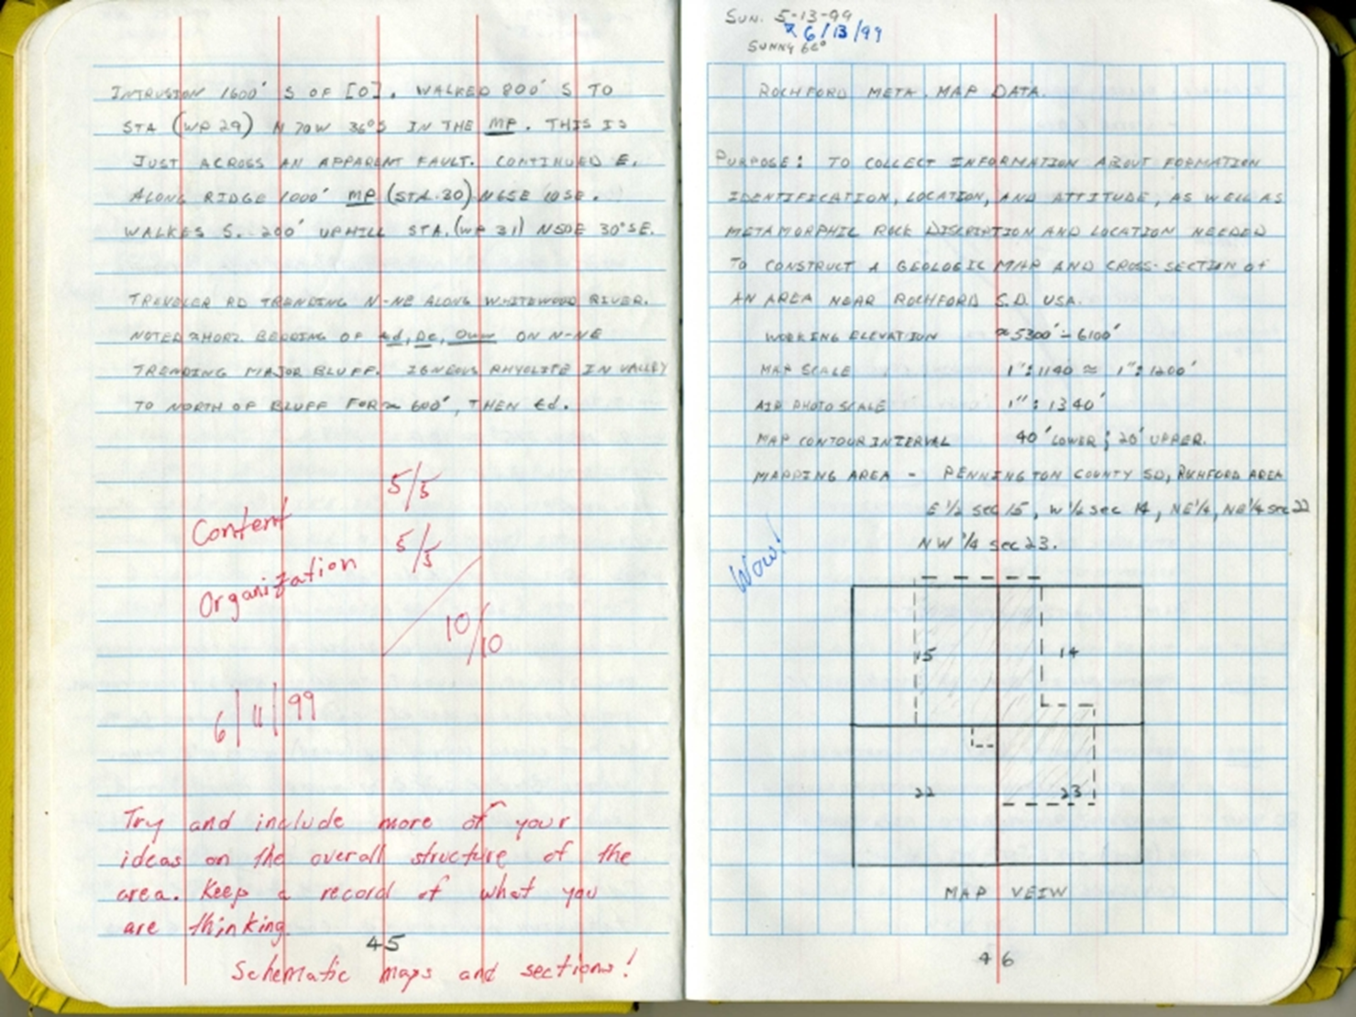
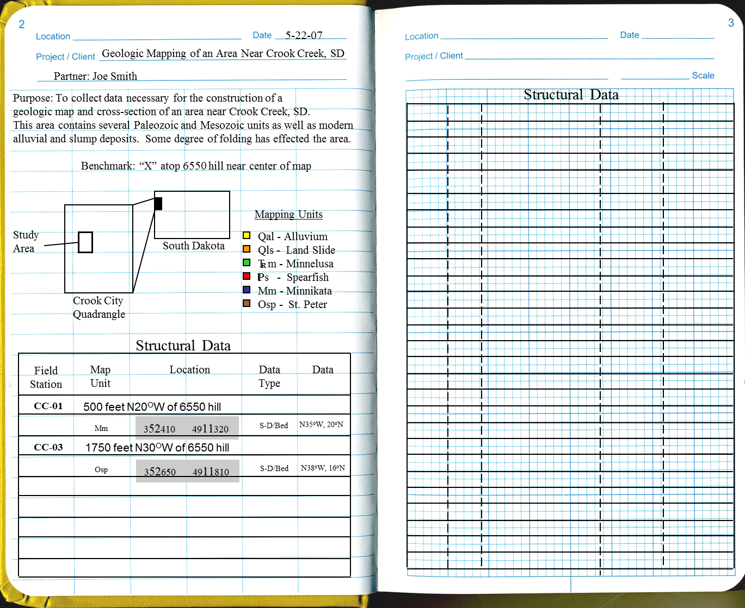
Geologic Mapping Example

Slide 8
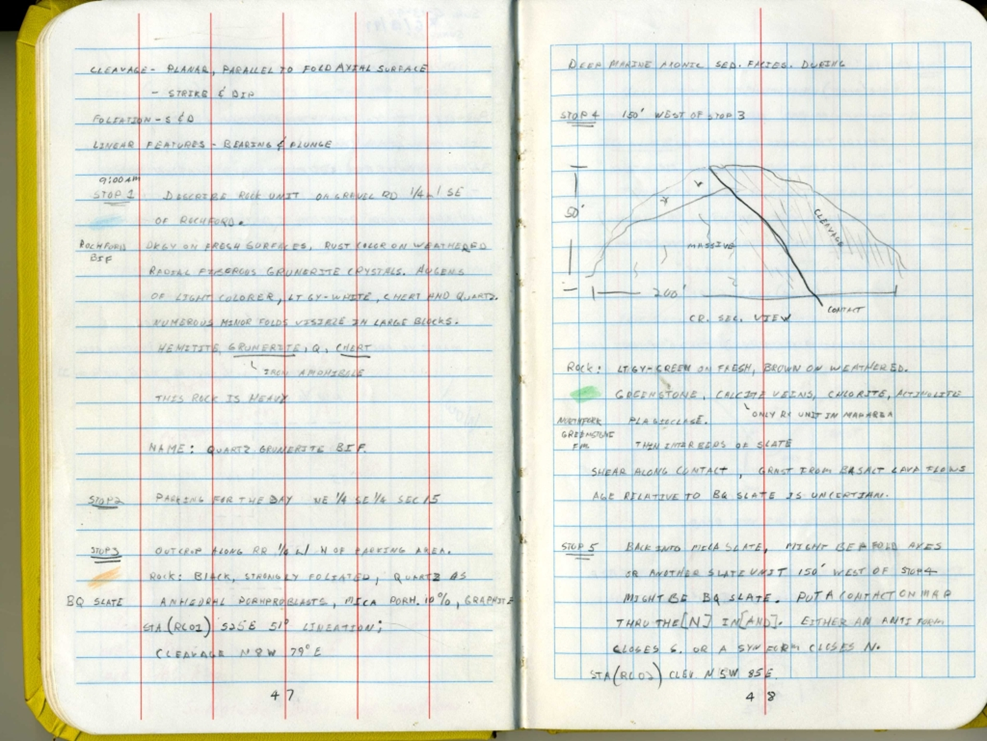

Slide 9
Data Collection Example

Slide 10
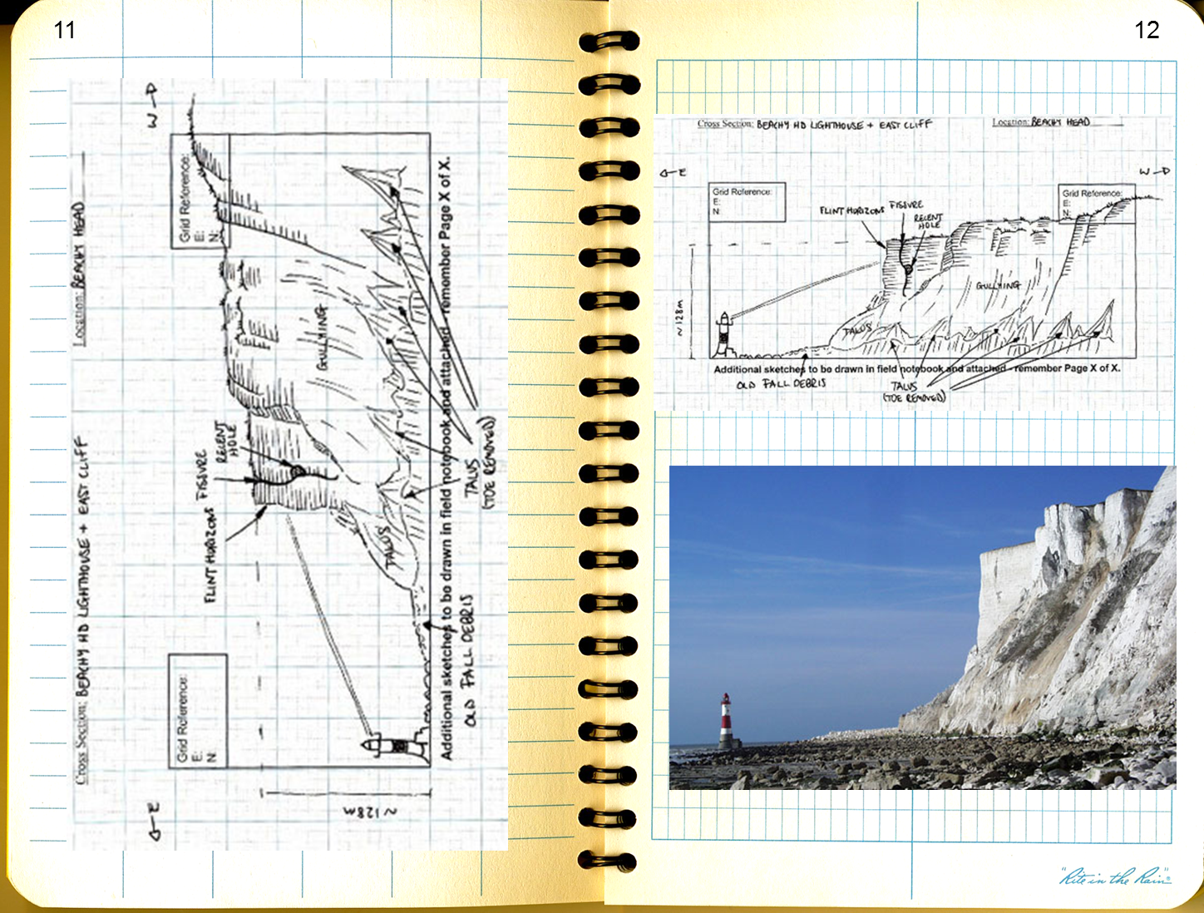
Sketches
Title
Scale
Labels
Orientation

Slide 11
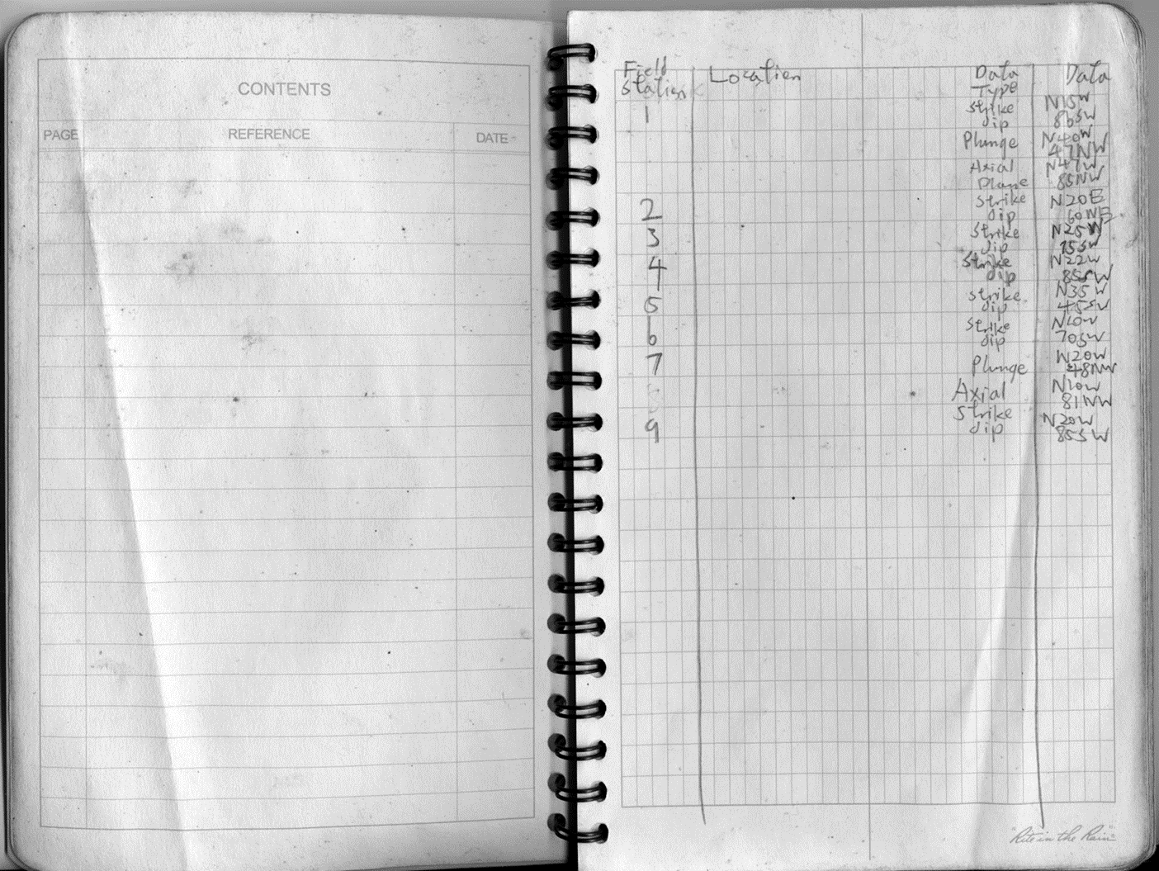
Bad

Slide 12
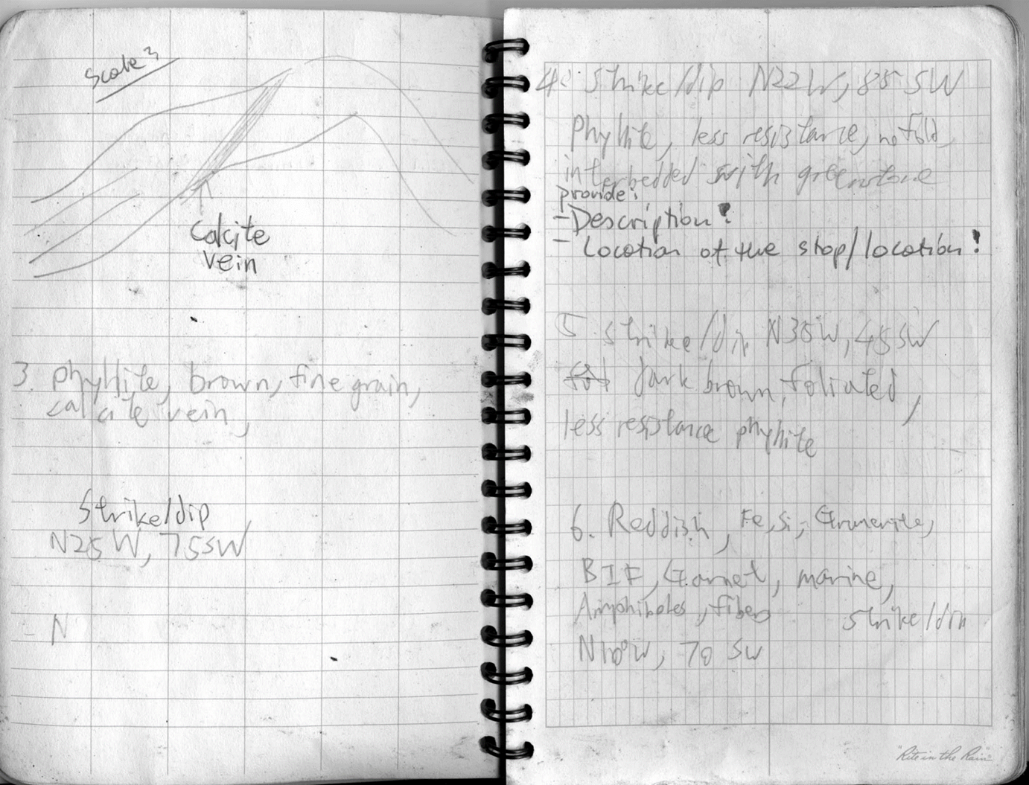

Slide 13
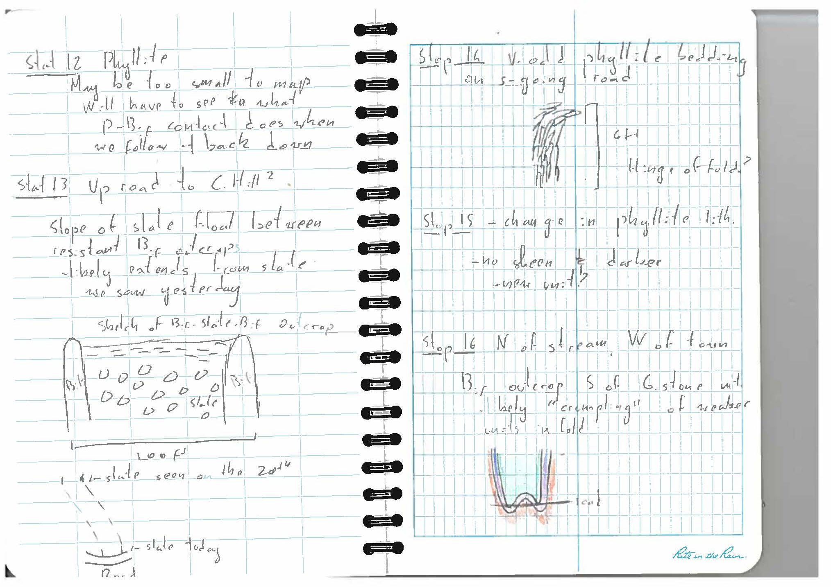

Slide 14
Helpful Hints
Make sure your name address and phone number is inside the book
Number all pages after the table of contents
Use a high quality writing utensil that does not smear
Write neatly and legibly
Use both sides of the book
For large scale sketches use the whole page and draw in landscape view

Slide 15
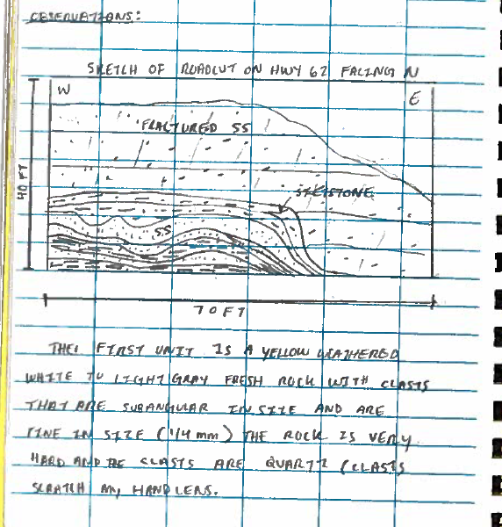
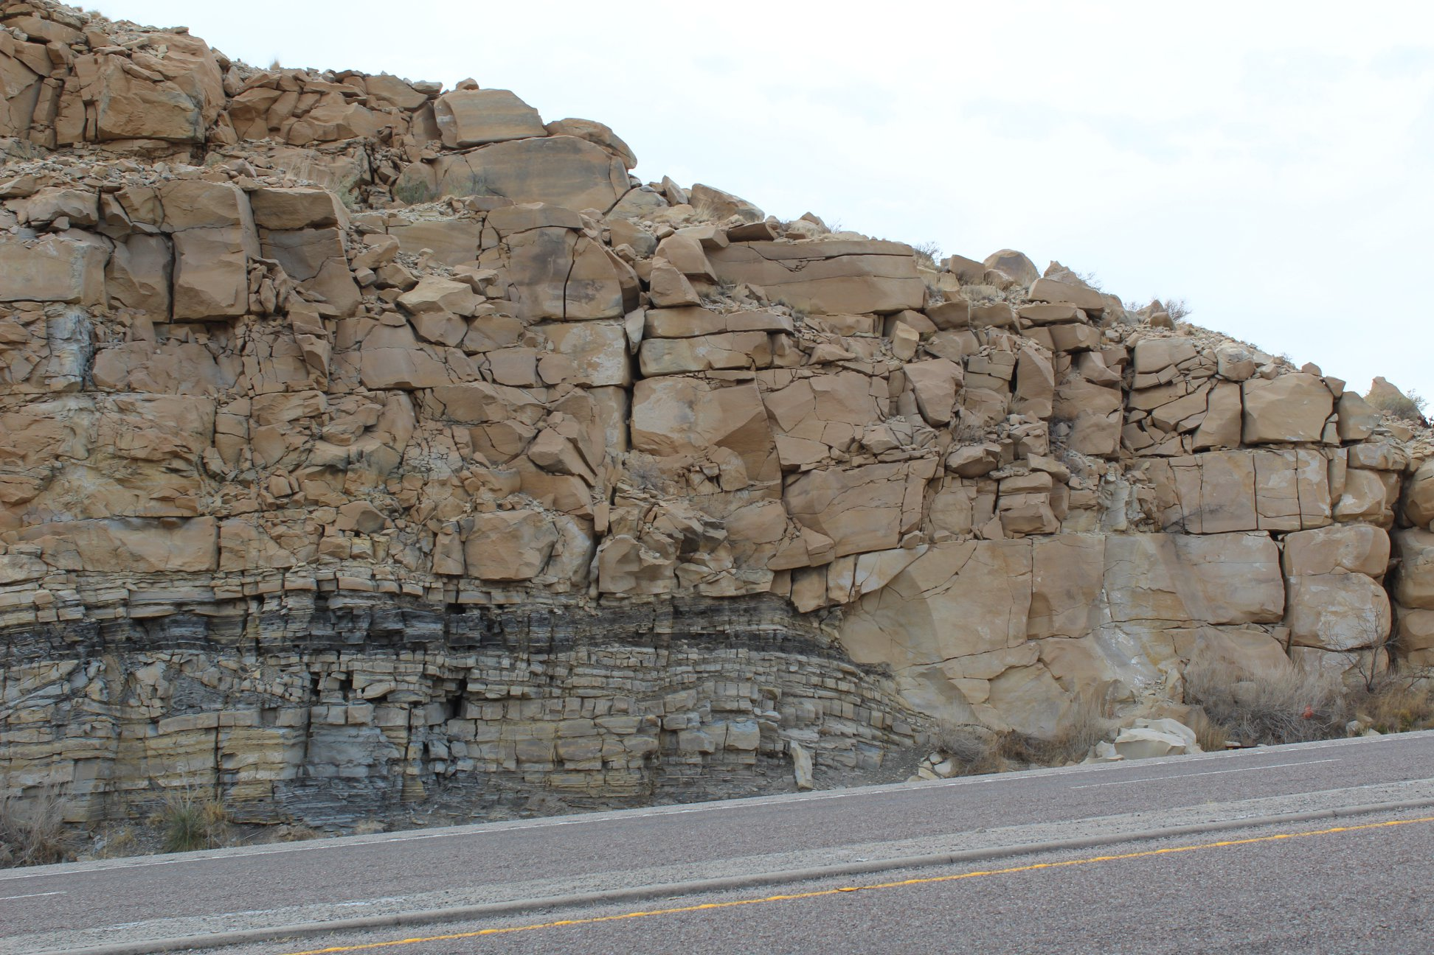

Slide 16
