Slide 1
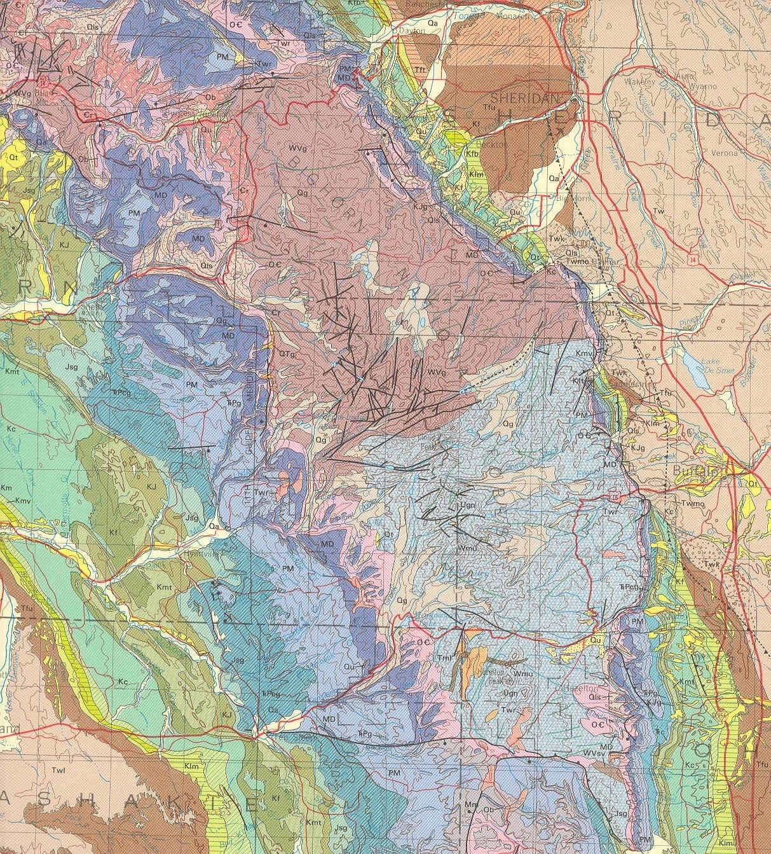
The Cambrian & Ordovician Systems of Wyoming

Slide 2
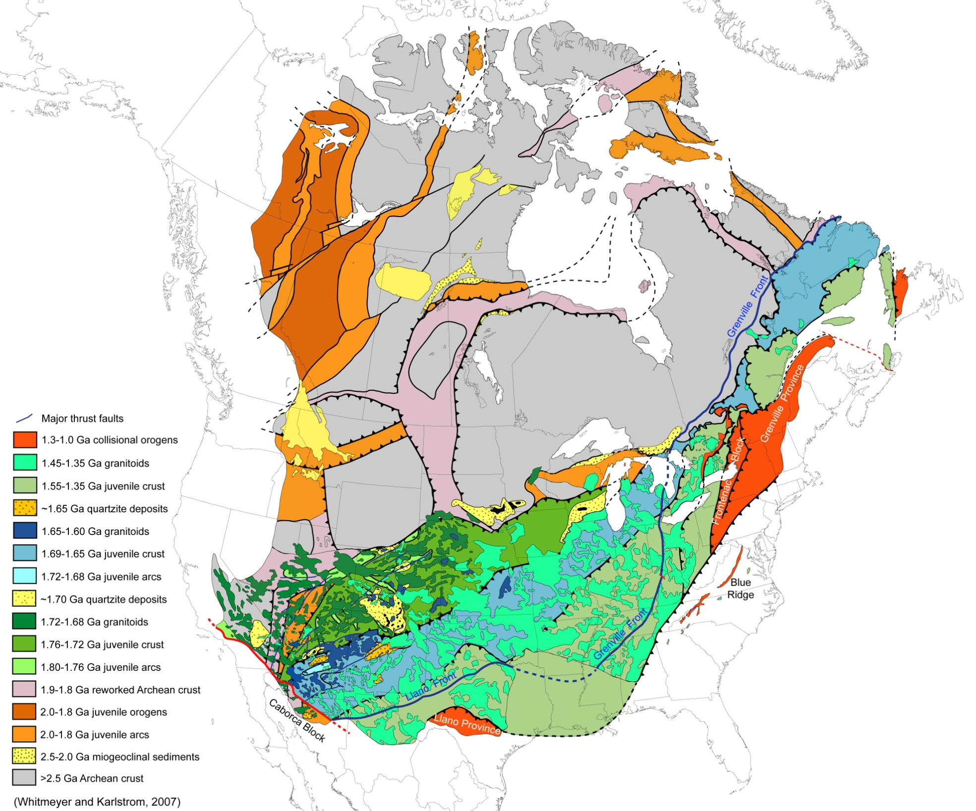
Grenville Orogen:
Continent-continent collision
of Laurentia with African and
South American cratons;
SE transfer of Caborca block
Grenville culminates in the assembly of the supercontinent of Rodinia
1.3-1.0 Ga

Slide 3

1.3-0.95 Ga
Grenville orogen:
Granitoids intrude juvenile
belts as far west as Colorado

Slide 4
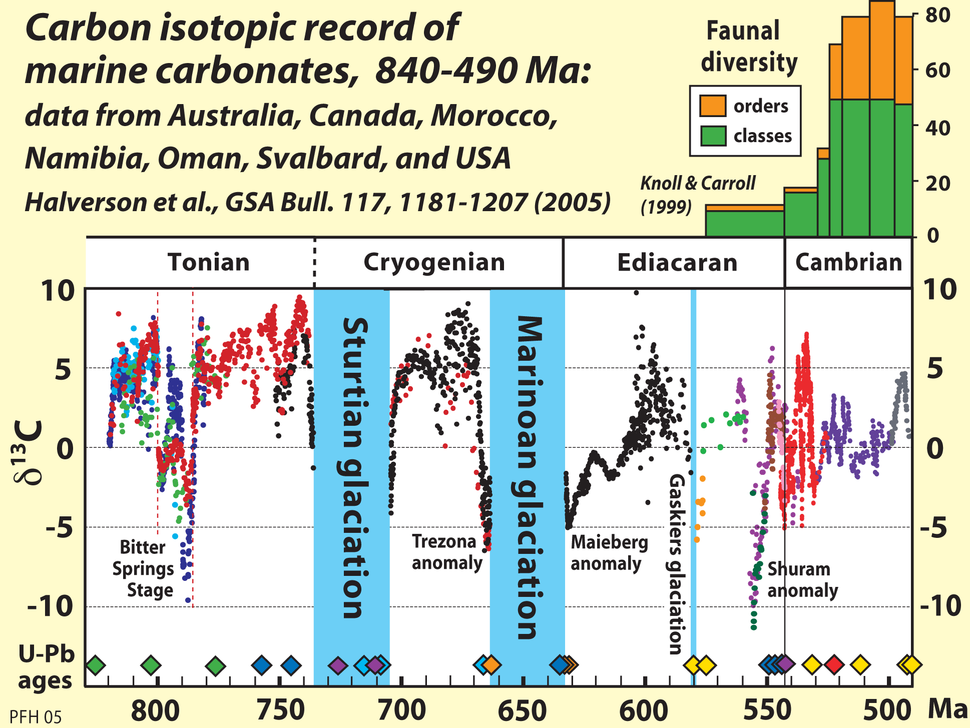

Slide 5
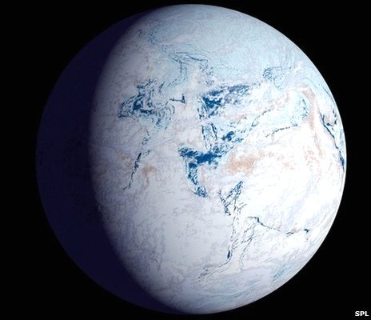
Snowball Earth as hypothesized during the Sturtian Glaciation 720 million years ago

Slide 6
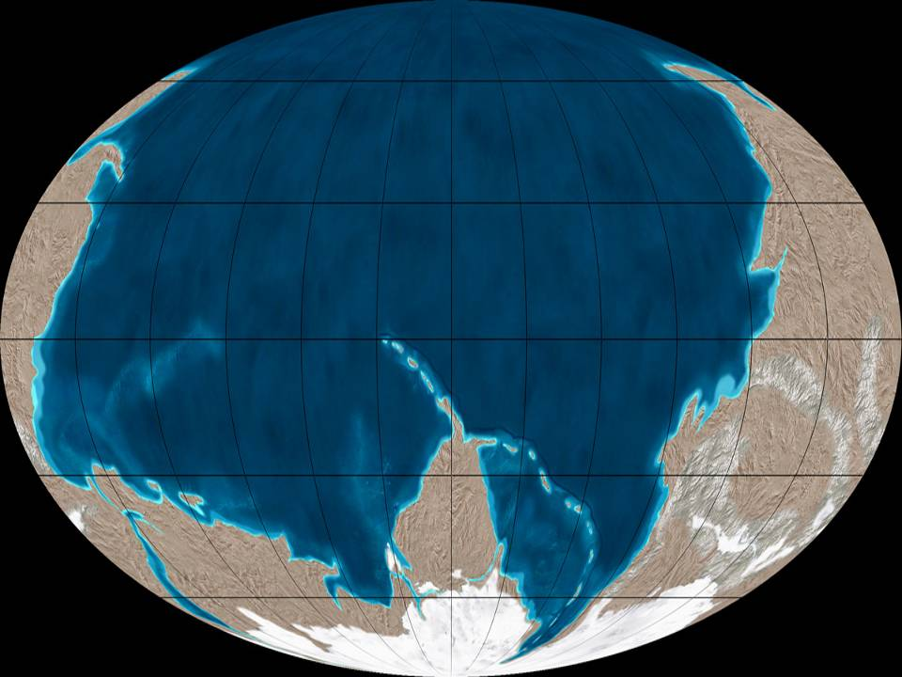
Ediacaran reconstruction of Rodinia centered on Panthalassian Ocean
Future Baltica
Future Laurentia

Slide 7
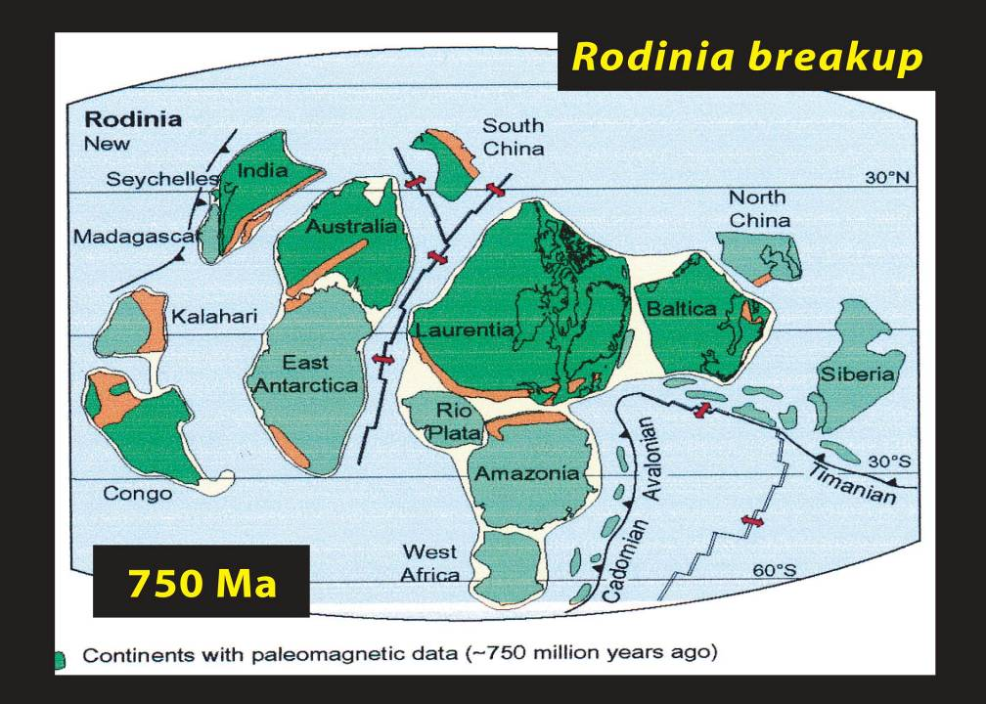

Slide 8
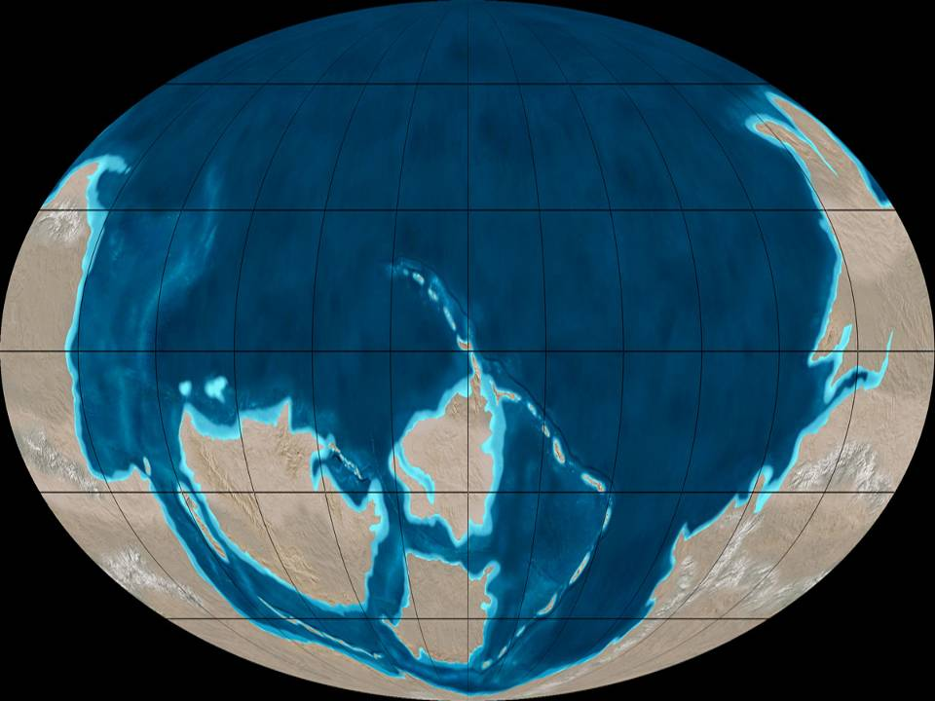
Rodinia rifted in Late Cryogenian to Early Ediacaran Neoproterozoic creating large Paleozoic continents
All continents had rifted passive margins, and developed broad continental shelves during the Cambrian through the middle Ordovician.
Growth of new ocean basins contributed to progressively higher sea level and flooding of cratons during the Cambrian
Panthalassian ocean
Siberia
Laurentia
Prototethys
Pannotia-Gondwana
Iapetus
Baltica

Slide 9
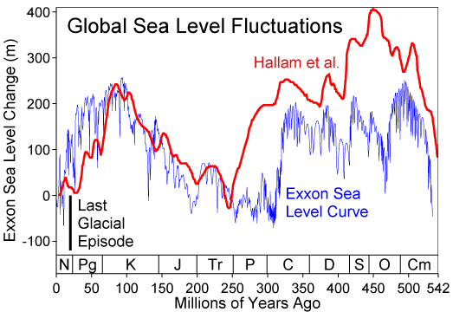
Rifting Pangea in Jurassic-K
Final Assembly of Pangea in Permian
TIPPECANOE
Supersequence
KASKASKIA
Supersequence
SAUK Supersequence

Slide 10
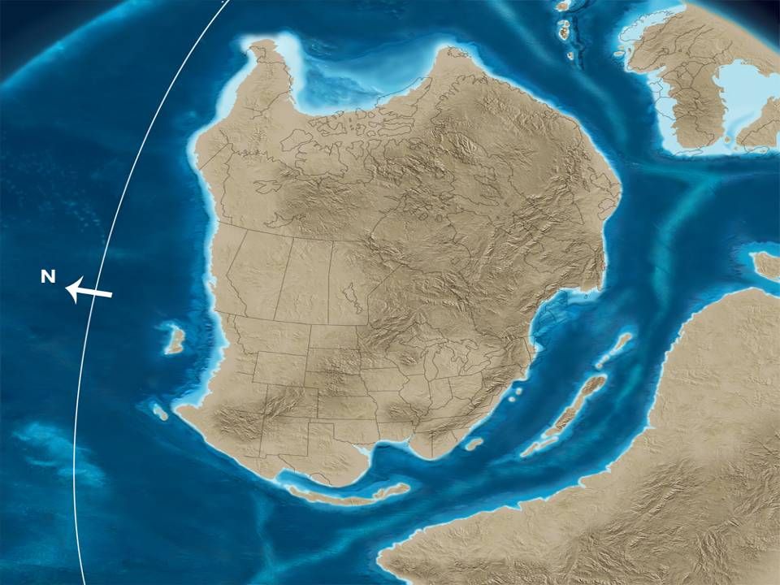
Baltica
Laurentia
Iapetus
Gondwana
Late Neoproterozoic (Ediacaran) 600 mya

Slide 11
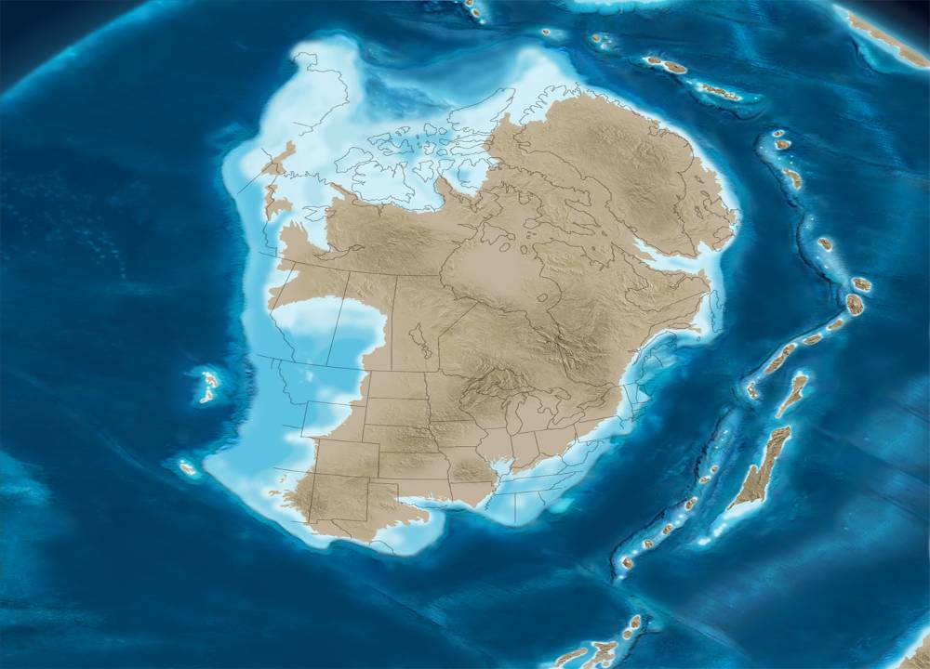
Middle Cambrian 530 mya
Global Sea level rise began in the Ediacaran Period and continued throughout the Cambrian, flooding interiors of continents, including Laurentia, depositing continental shelf and epicontinental sea deposits of the North American Sauk Supersequence.
Laurentia

Slide 12
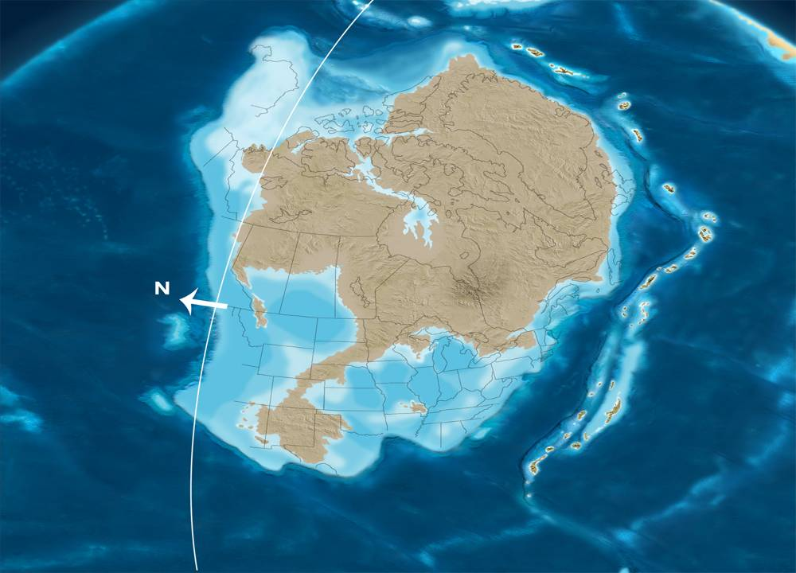
Late Cambrian 500 mya
Global Sea level rise continues through the Cambrian, flooding interiors of continents, including Laurentia, depositing continental shelf and epicontinental sea deposits of the North American Sauk Supersequence.
Laurentia

Slide 13
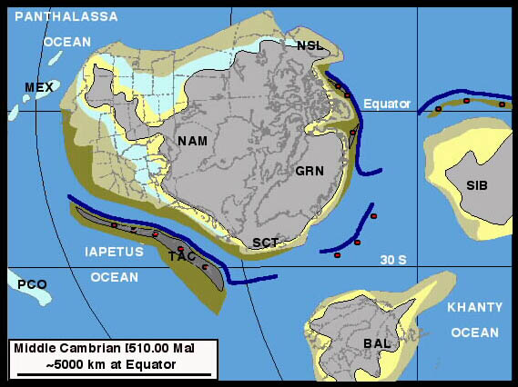
Cordilleran Region:
Cambrian passive margin

Slide 14
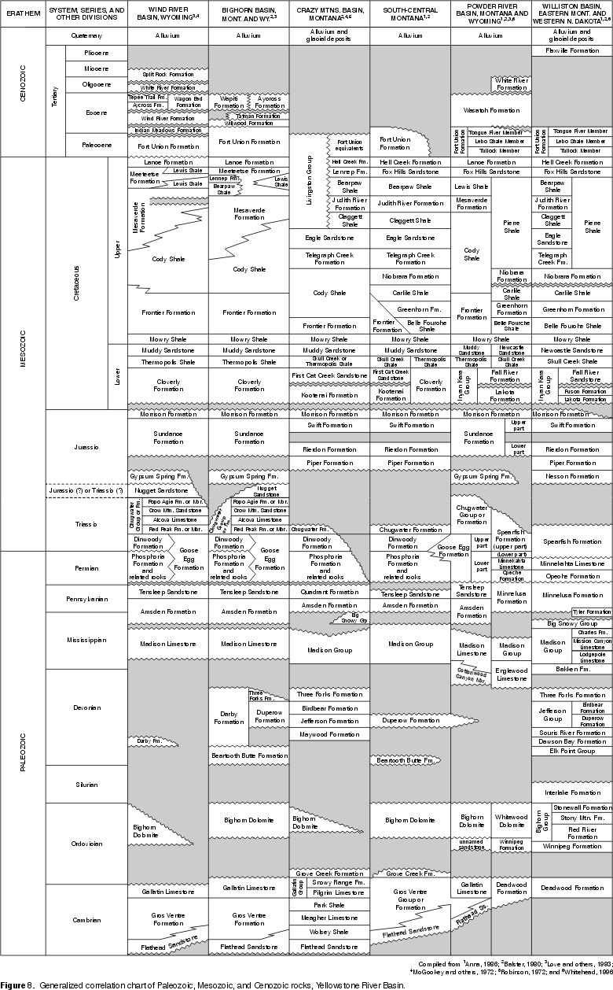

Slide 15
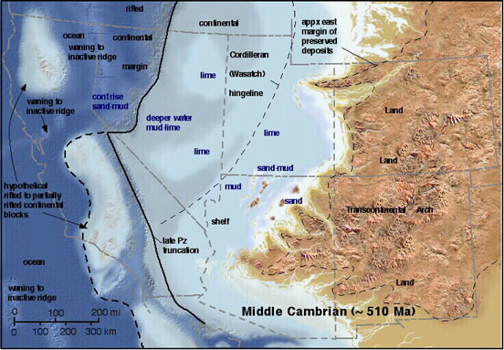

Slide 16
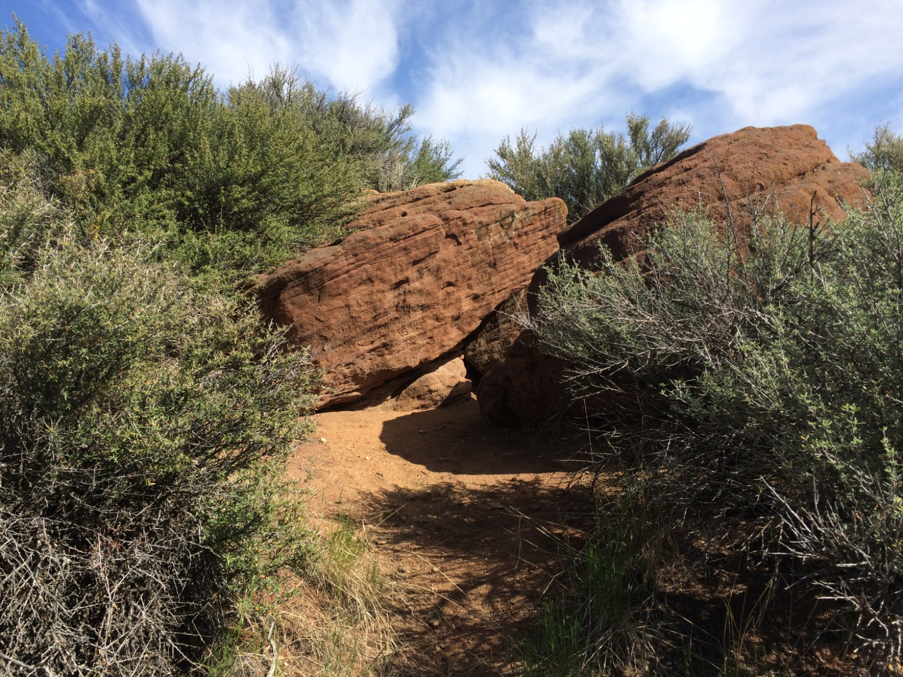
Flat Head Formation
Brown Sandstone
Quartz Arenite, Medium Bedded, Cross bedded.
Lesser Green Shale and Mudstone
Lesser Micritic Limestone
Some Glauconite
Linguloid Brachiopods, Trilobites

Slide 17
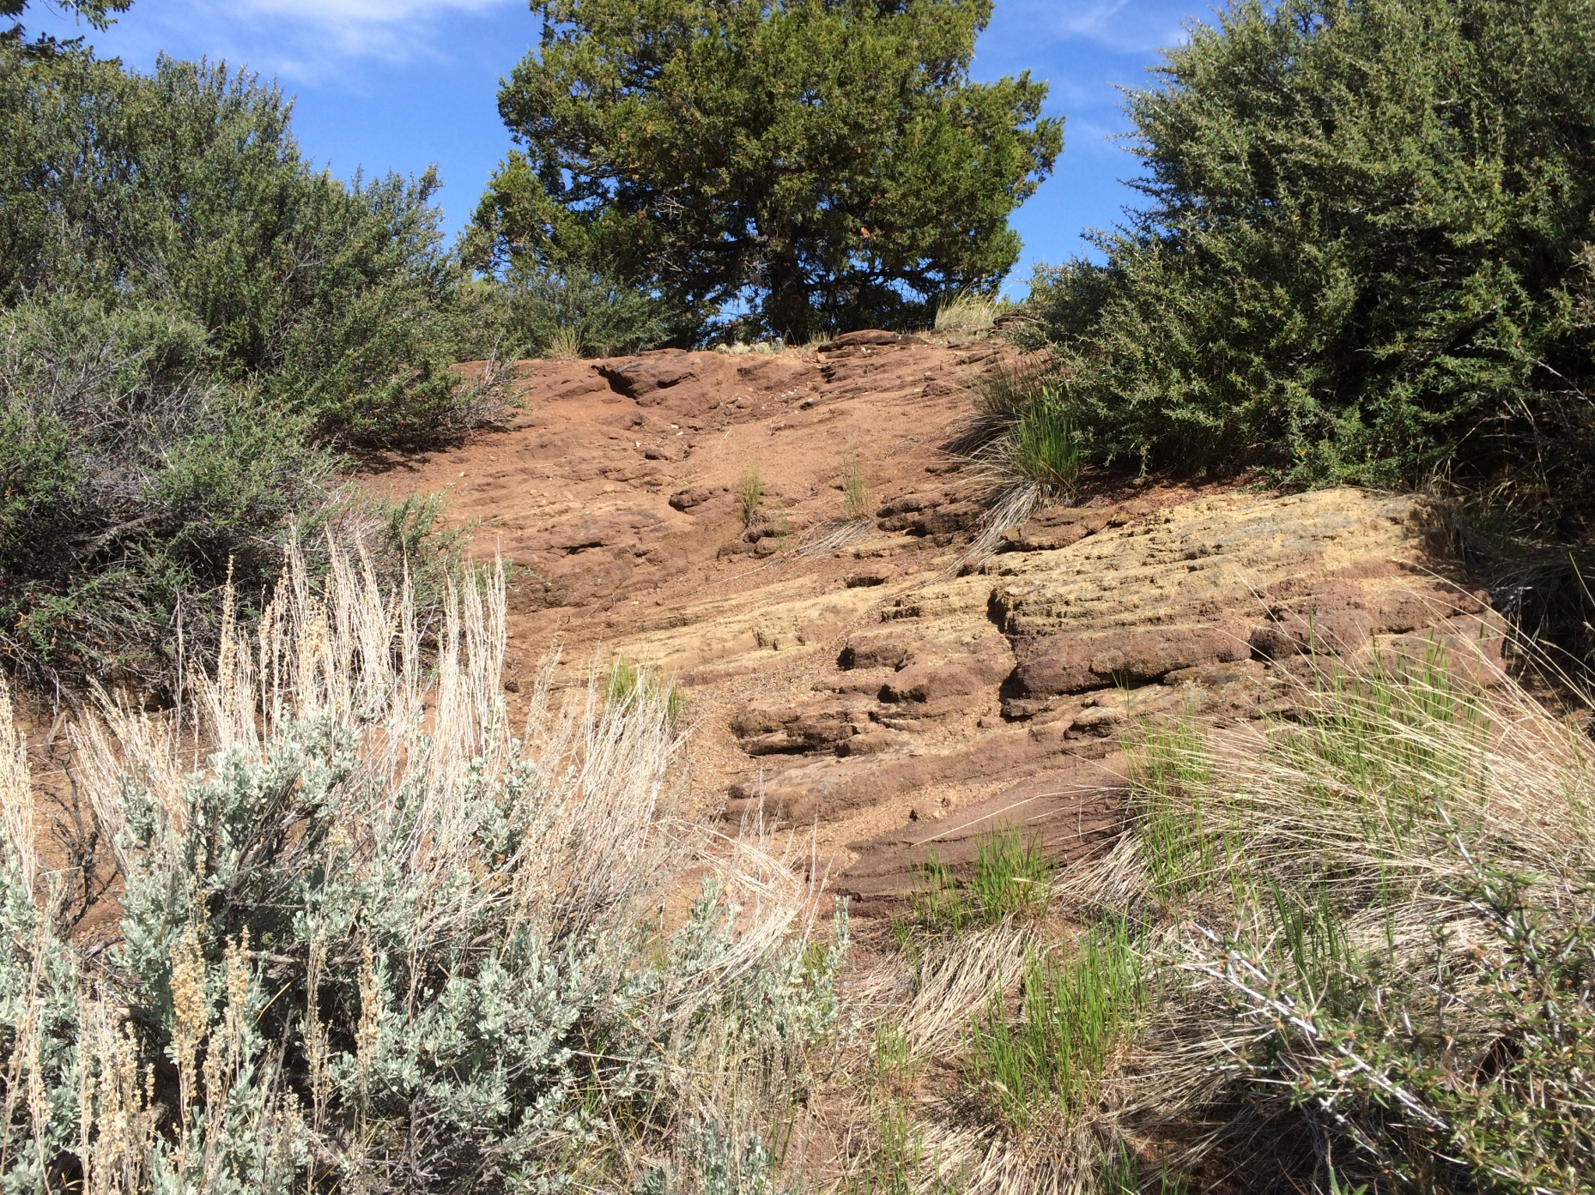
Flat Head Formation

Slide 18
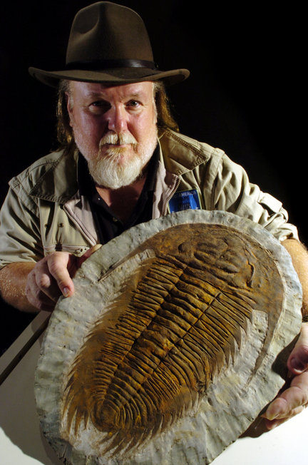
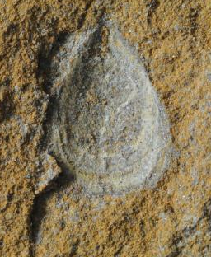
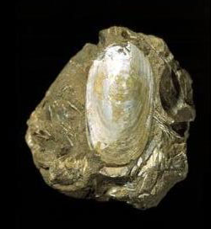
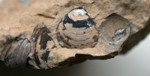

Slide 19
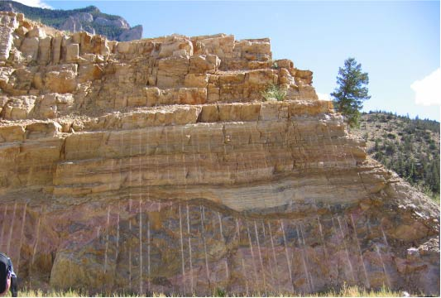
Flat Head Formation

Slide 20
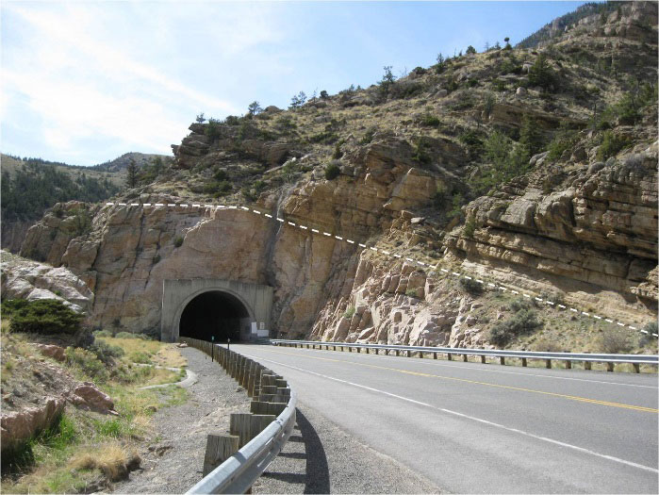
Shoshone Canyon west view at Tunnel #1. Unconformity shown by white dashed line.
Image from: Fisher, M.P., 2016, Shoshone Canyon

Slide 21
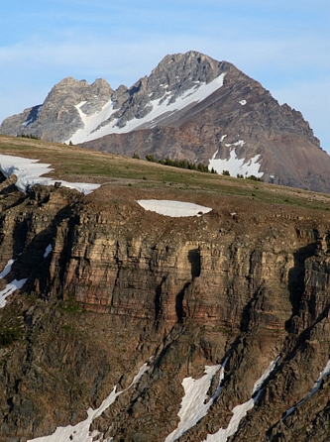
Flat Head Formation

Slide 22
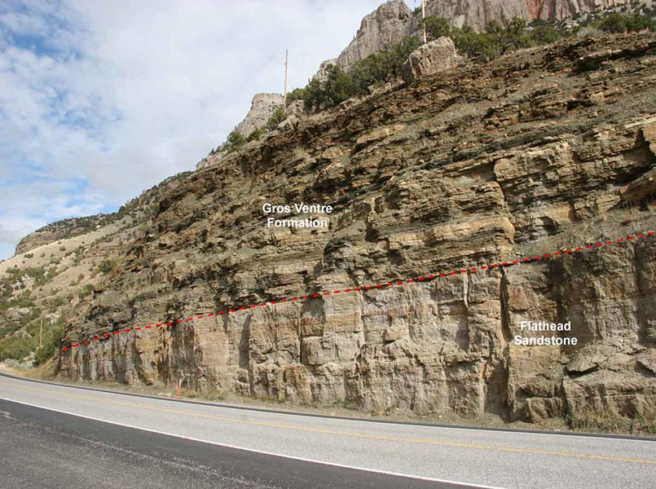

Flat Head overlain by Gros Ventre Formation

Slide 23
Gallatin and Gros Ventre Formations
Poorly exposed, valley former between resistant Paleozoic and Basement rocks.
Thin bedded, structurally incompetent.Interbedded shale, limestone, and sandstone
Limestones are micritic, trace fossils are common, lots of intraclasts.
Greener at the base (Gros Ventre), Pinker at the top (Gallatin).

Slide 25
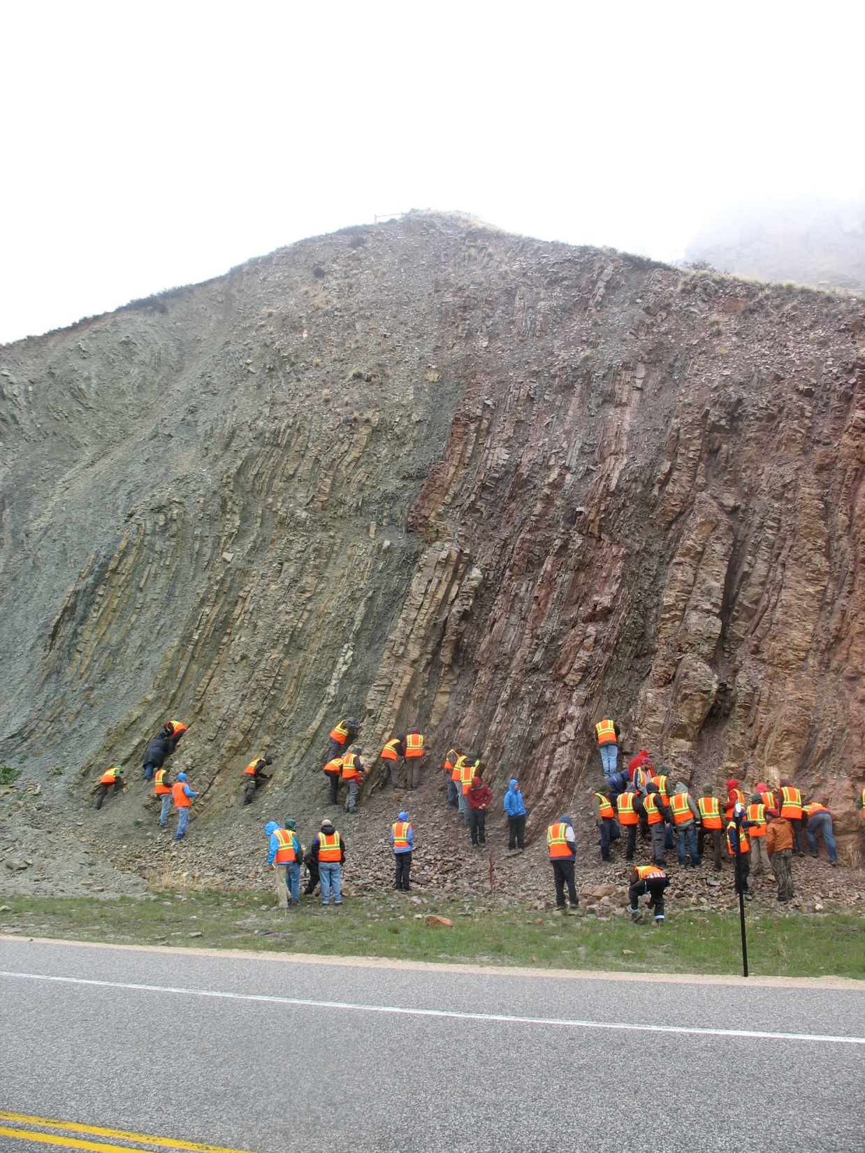
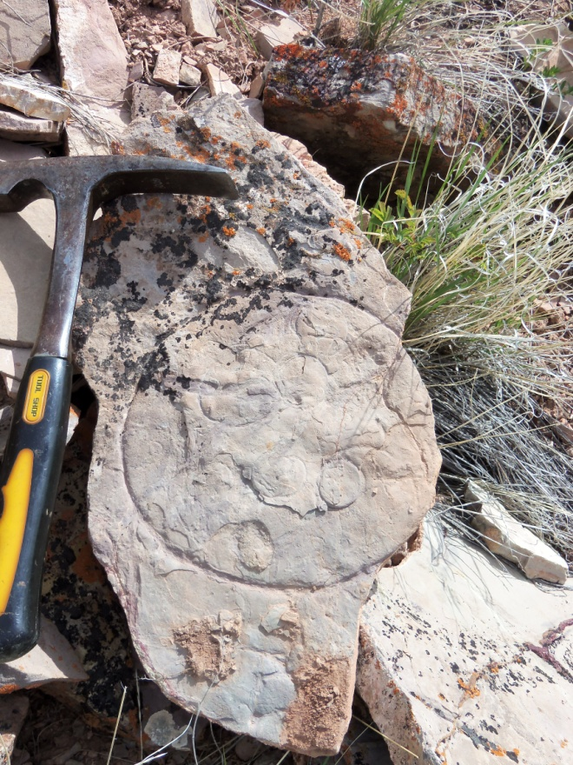

Slide 26
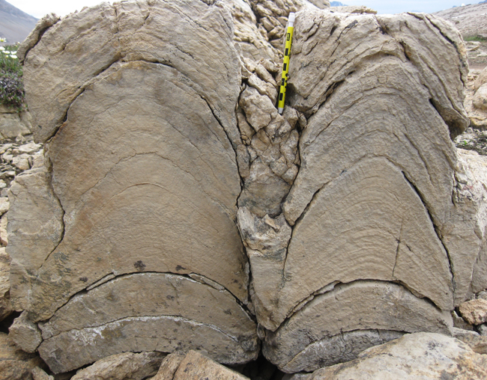
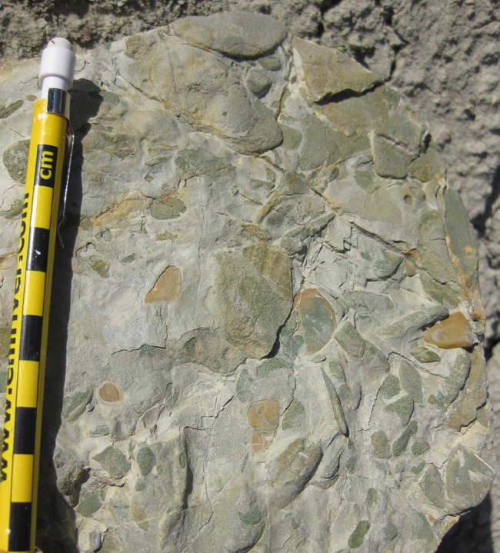
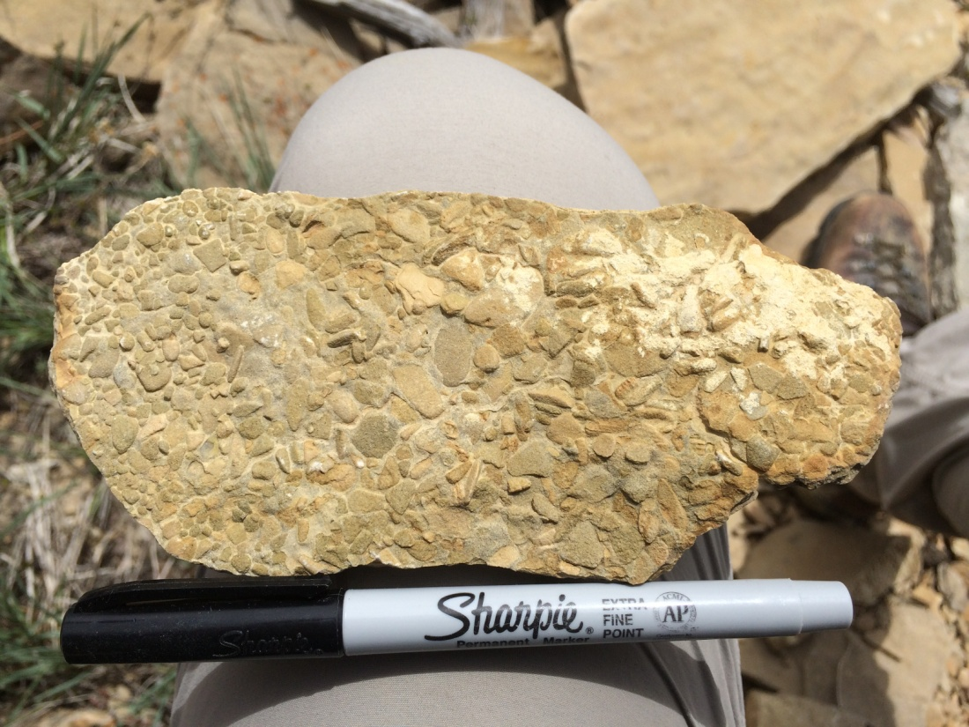

Slide 27
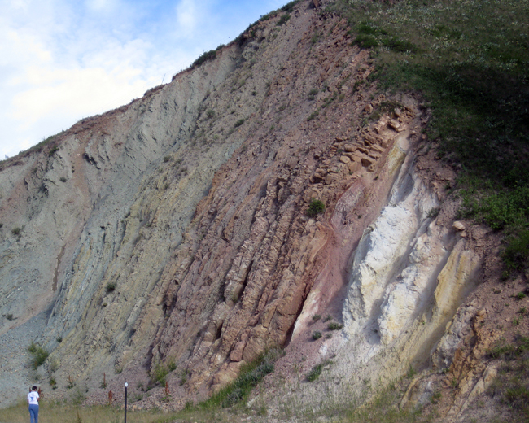
Gros Ventres
Gallatin

Slide 28
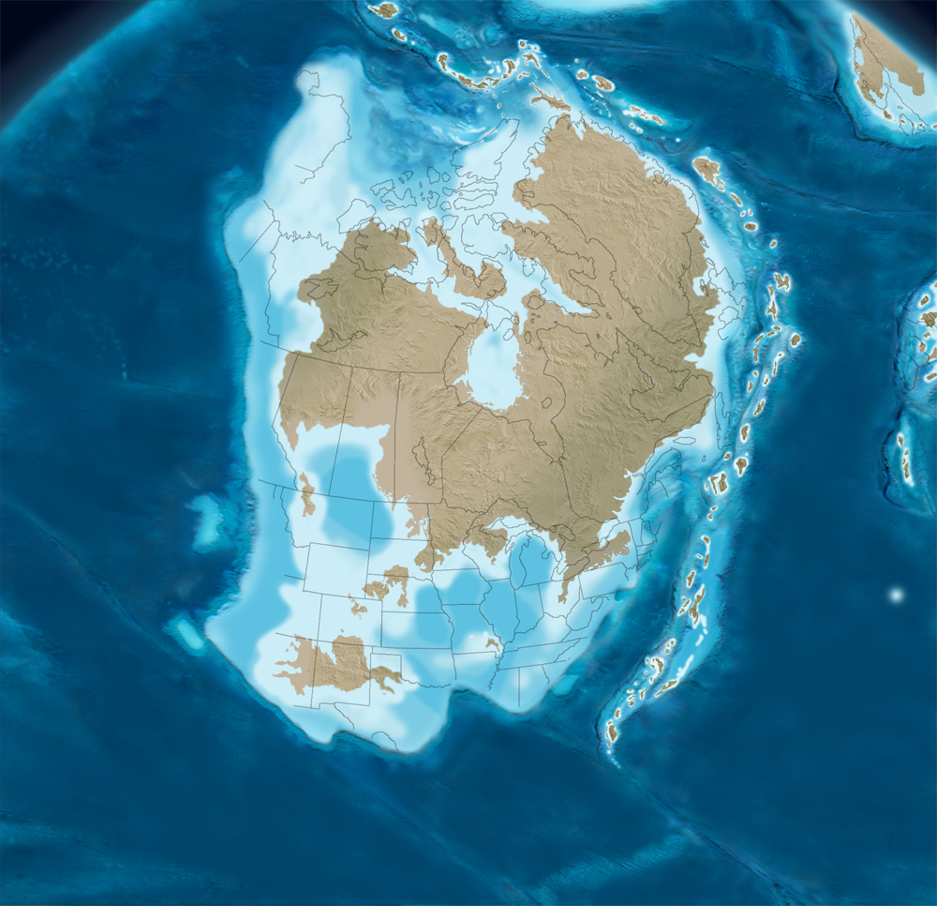
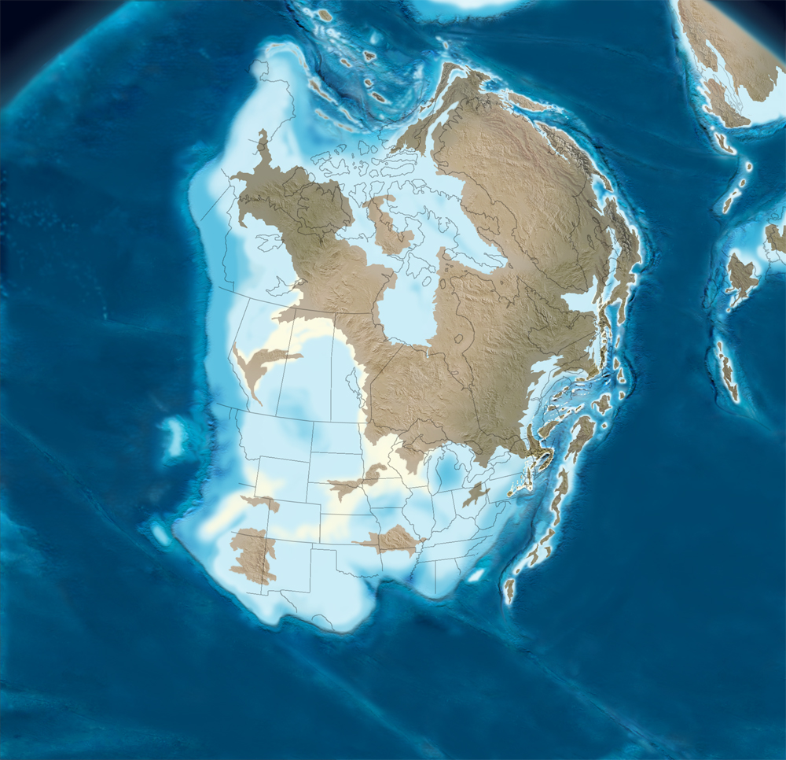
Early Ordovician just prior to terminal Sauk Supersequence regression
Middle Ordovician during Tippecanoe Supersequence 1 sea level highstand. Note Taconic Arc – Laurentia collision in progress (Taconic Orogeny)

Slide 29
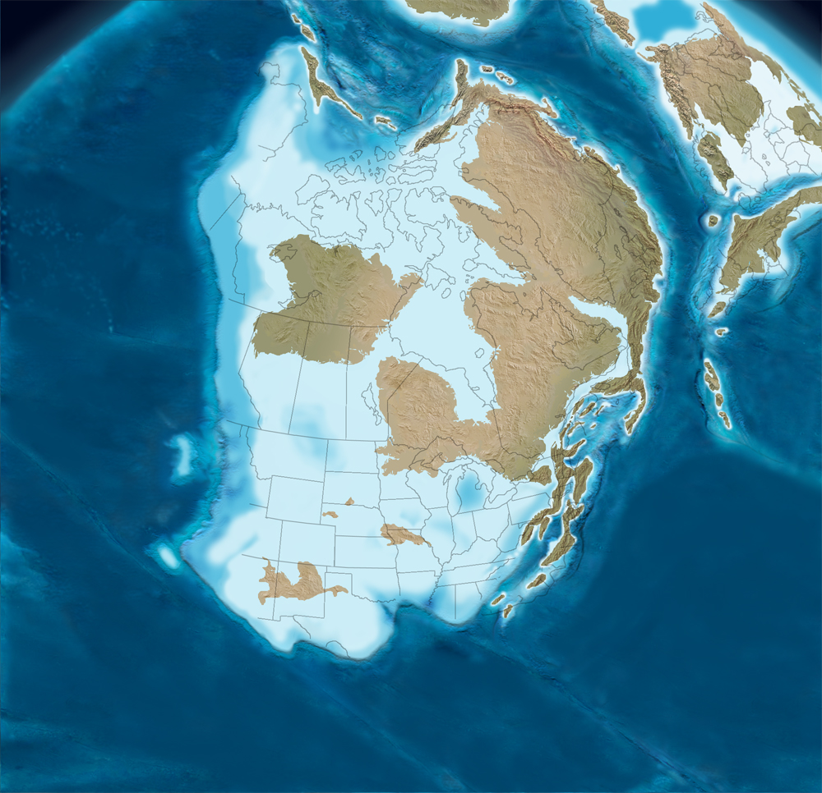
Late Ordovician sea level highstand just prior to Hirnantian Glaciation- Taconic Orogeny

Slide 30
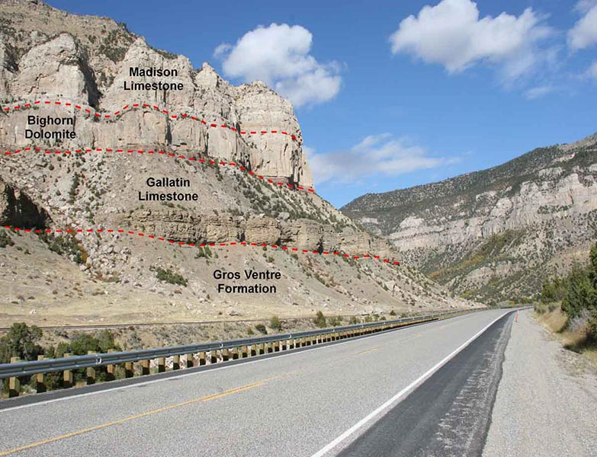
Paleozoic Succession –Wind River Canyon

Slide 31
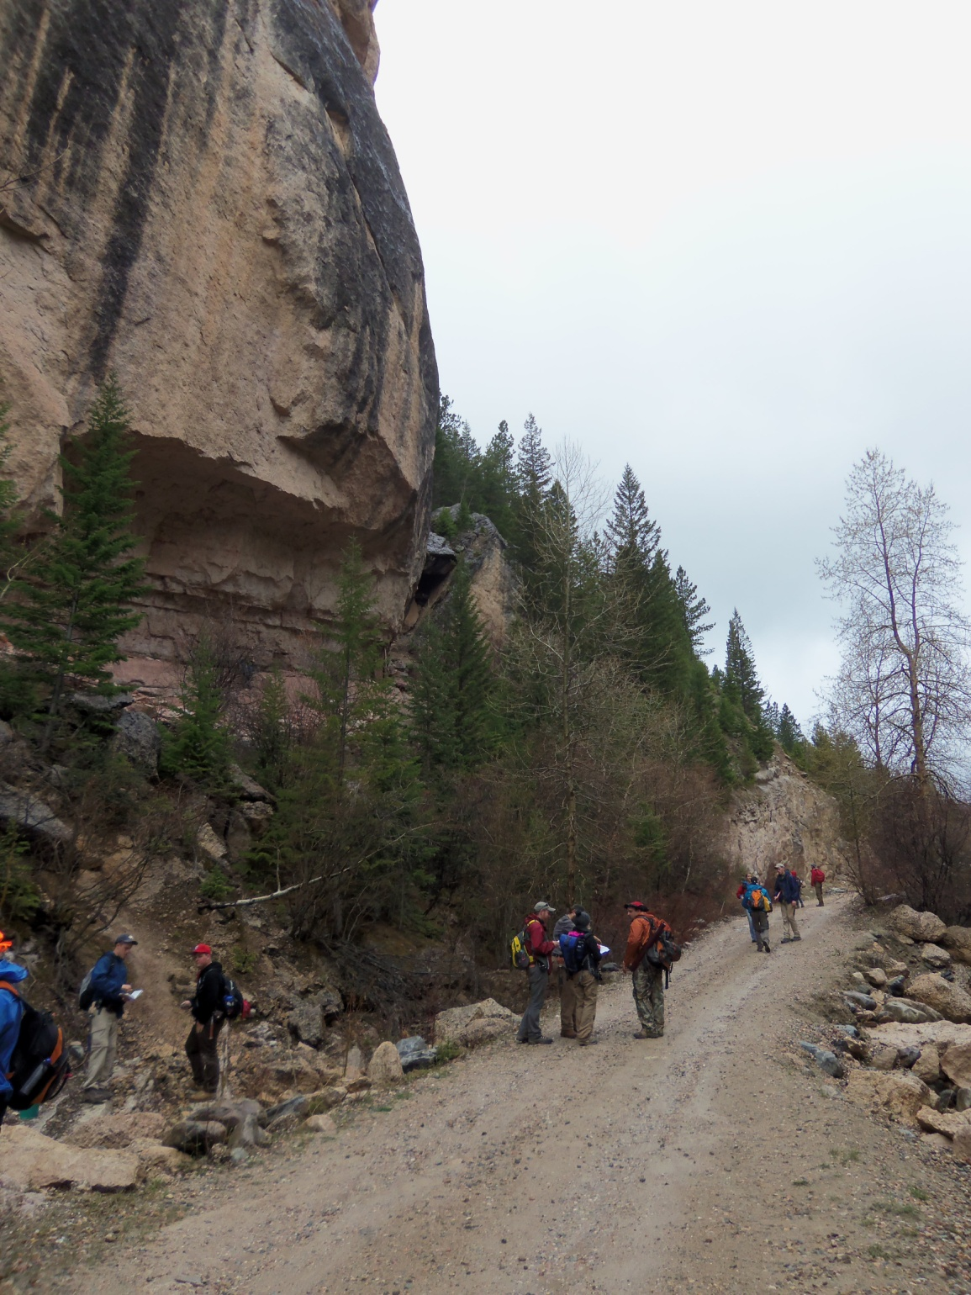
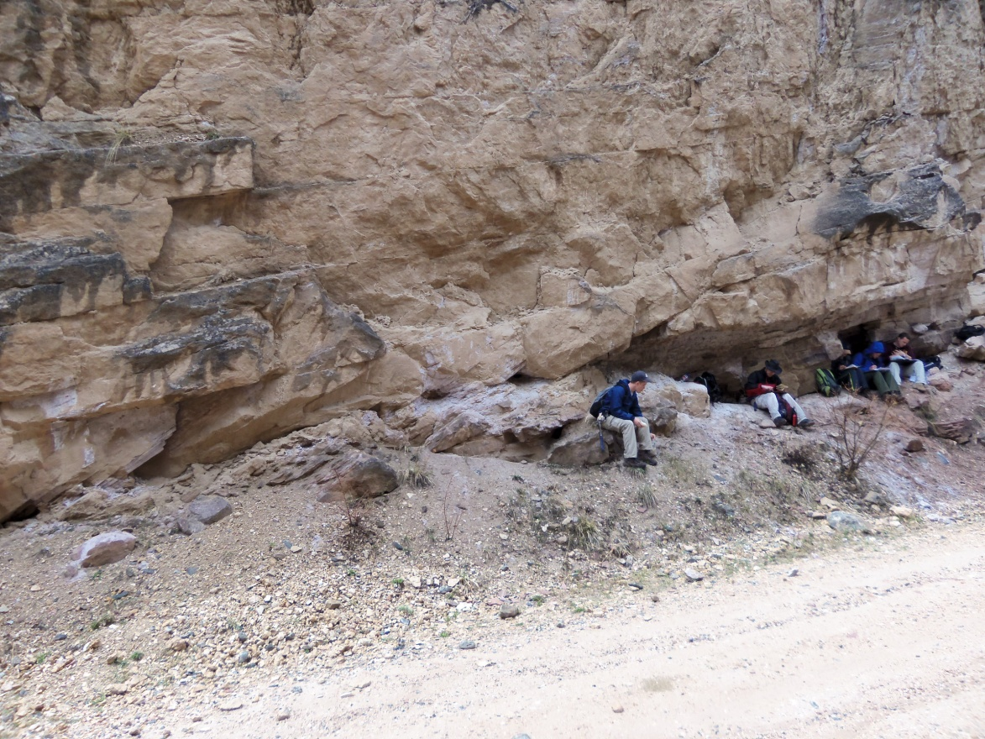
Sandstone ravinement and nearshore shoreface and inner shelf sandstones make up lower 5-10 m of the Bighorn above its contact with the Gallatin
(photos from section in Crazy Woman Canyon 2012).

Slide 32
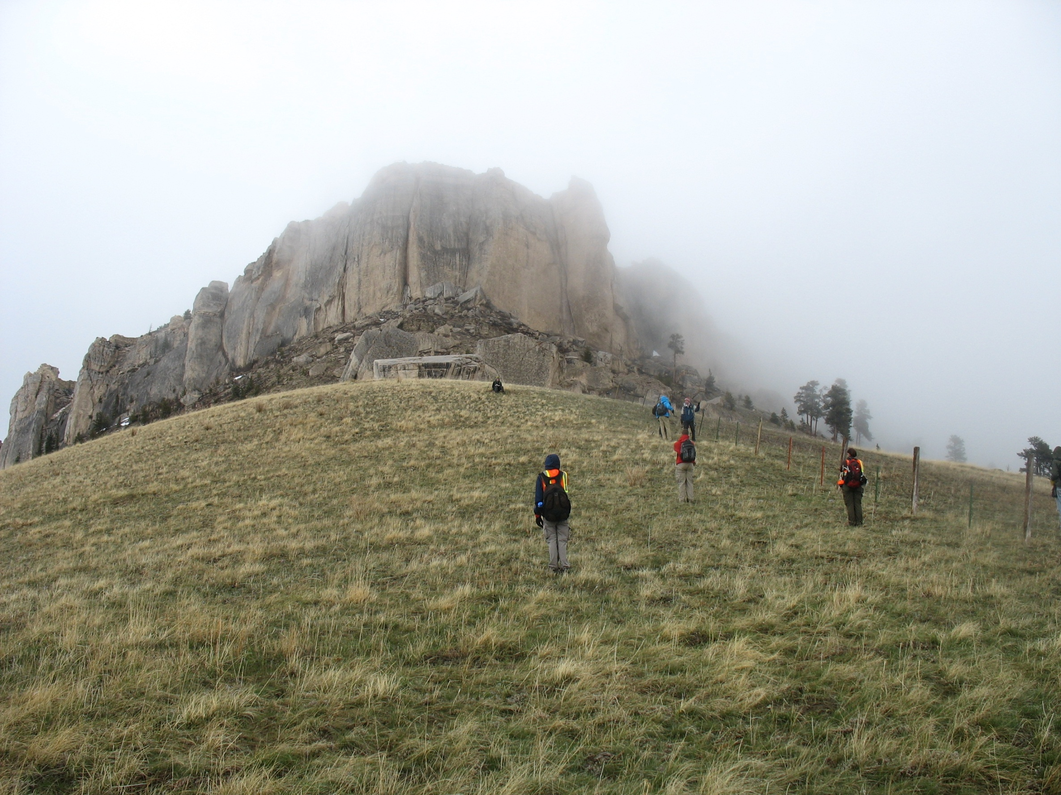
Bighorn
Gallatin
Slope forming Cambrian Gros Ventre and Gallatin formations, overlain by Middle and Late Ordovician Bighorn Dolomite
Gros Ventre

Slide 33
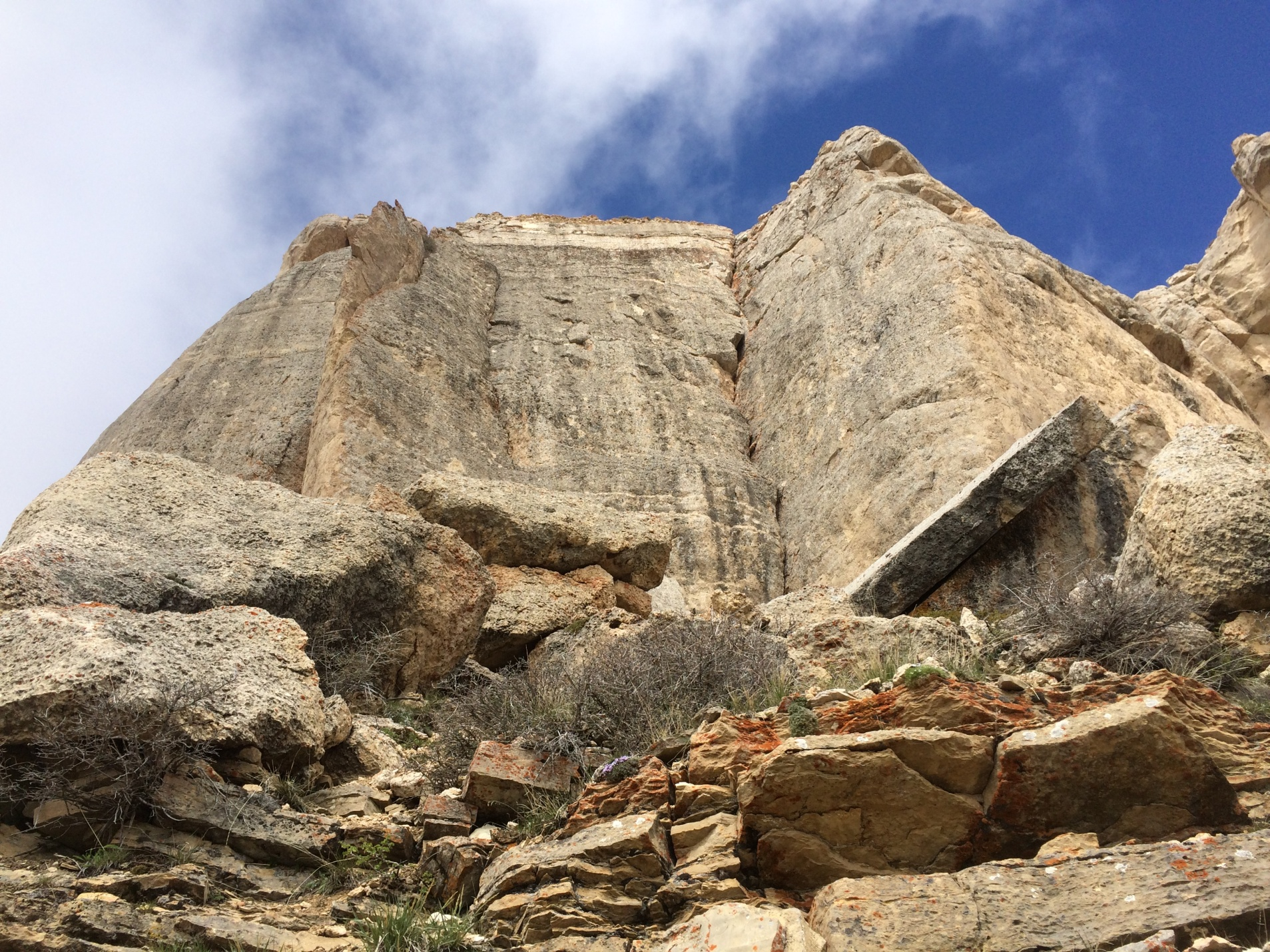
Cambrian Gallatin Formation, overalin by Ordovician Bighorn Dolomite
Bighorn
Gallatin

